Slide 1

SALW control
KOSOVO
Progress and challenges in armS control
9th Regional meeting SALW Commissions
28-29 May 2018 Tirana , Albania

Slide 2


Legal Framework
Law on Weapon
Law on Legalization
SOP on Deactivation
ROADMAP ….
Goal I ROADMAP for a sustainable solution to the illegal possession, misuse and trafficking of Small Arms and Light Weapons in the Western Balkans

Slide 3

Evidence based policies
SALW Strategy
SALW meetings
Intelligence Led Strategy
Strategic threat assessm.
SALW Survey
Goal II ROADMAP for a sustainable solution to the illegal possession, misuse and trafficking of Small Arms and Light Weapons in the Western Balkans

Slide 4
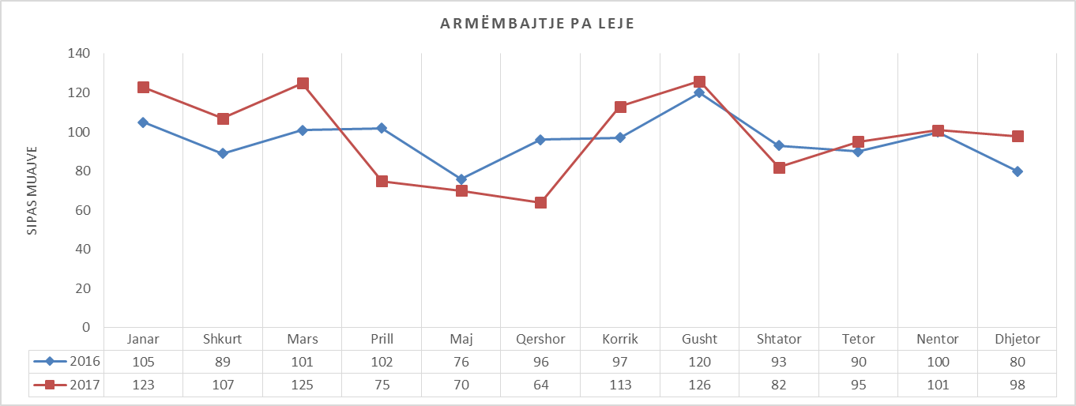
Evidence based policies
Firearm Focal Point - Gun crime annual report
krimet qe ndërlidhen me armë
armët dhe municionin e konfiskuar
trafikimin e armëve
gjurmimin ndërkombëtar të armëve
armët legale
shkatërrimin e armëve
te dhënat mbi armët e ekzaminuar nga Divizioni i Balistikes – AKF
te dhënat nga Këshilli Prokurorial për veprat penale te armeve
te dhënat nga Këshilli Gjyqësor për veprat penale te armeve
etj.
Goal II ROADMAP for a sustainable solution to the illegal possession, misuse and trafficking of Small Arms and Light Weapons in the Western Balkans

Slide 5
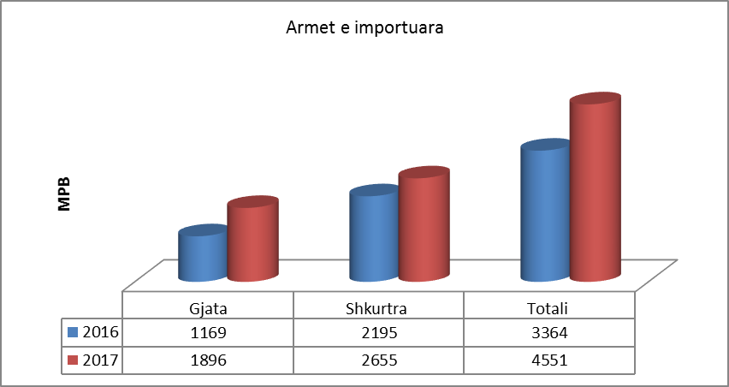
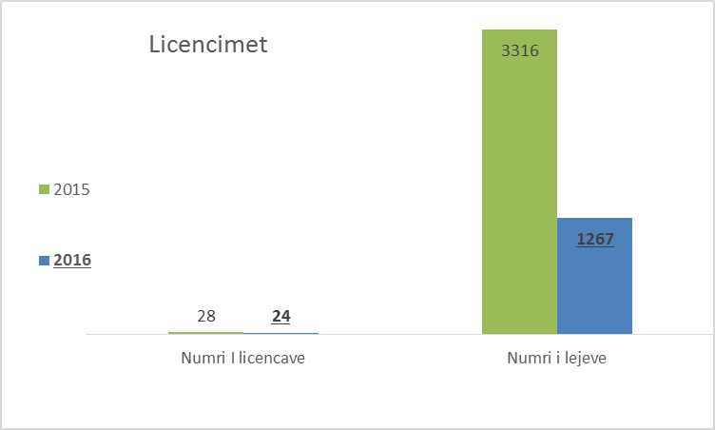
PREVENTION AND COUNTERING
  Import control
  Marking
Goal III ROADMAP for a sustainable solution to the illegal possession, misuse and trafficking of Small Arms and Light Weapons in the Western Balkans

Slide 6
PREVENTION AND COUNTERING
  Border Control – Interagency cooperation
  Police Operational activities
  Celebratory shooting – arrest 48hrs
Goal III ROADMAP for a sustainable solution to the illegal possession, misuse and trafficking of Small Arms and Light Weapons in the Western Balkans

Slide 7
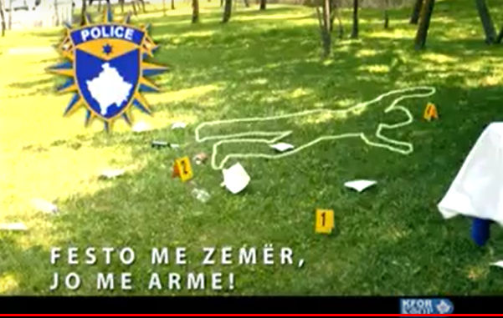
Awareness
  Celebrate with heart not with the gun
  Legalization campaign - Preparation
Goal IV ROADMAP for a sustainable solution to the illegal possession, misuse and trafficking of Small Arms and Light Weapons in the Western Balkans

Slide 8
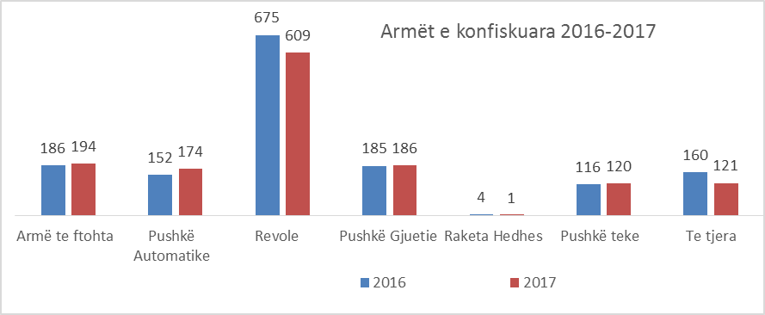
Reducing Illicit possession
Confiscation
1405 weapon seized
Legalization planned
Deactivation
Goal V ROADMAP for a sustainable solution to the illegal possession, misuse and trafficking of Small Arms and Light Weapons in the Western Balkans

Slide 9

SALW Destruction
2017 105 weapons were destroyed
2018 1003 weapons selected to be destroyed
Goal VI ROADMAP for a sustainable solution to the illegal possession, misuse and trafficking of Small Arms and Light Weapons in the Western Balkans

Slide 10
Stock Pile Management
Stockpile management standards in place for natural persons and legal entities in line with ISACS
Training in Physical security and stockpile management (PSSM).
Goal VI ROADMAP for a sustainable solution to the illegal possession, misuse and trafficking of Small Arms and Light Weapons in the Western Balkans

Slide 11

THANK YOU

