Slide 1

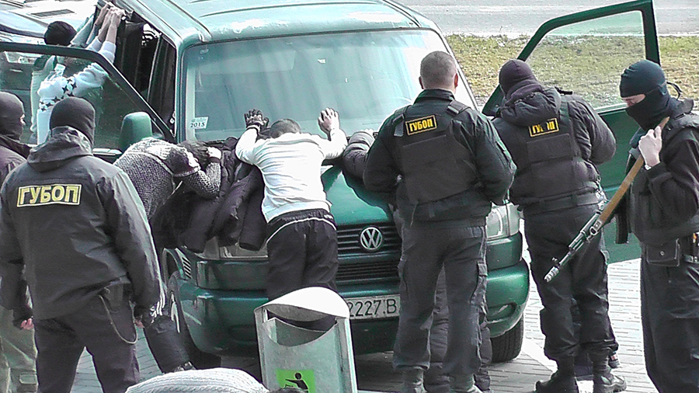
The Ministry of Internal Affairs of the Republic of Belarus
Destruction
of confiscated weapons
and ammunition
by the police of Belarus

Slide 2
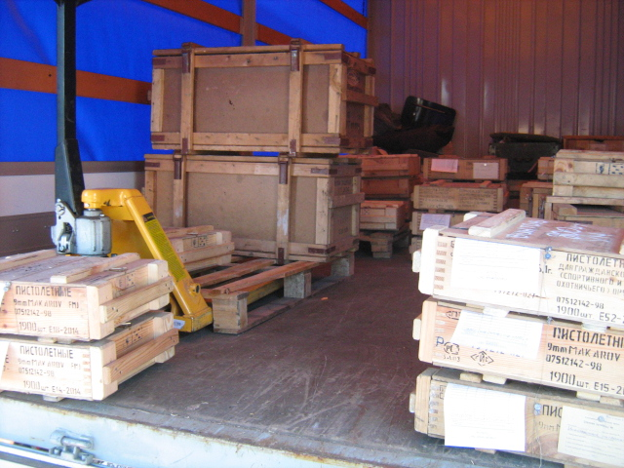
Destruction of ammunition
Delivery of ammunition to the landfill

Slide 3
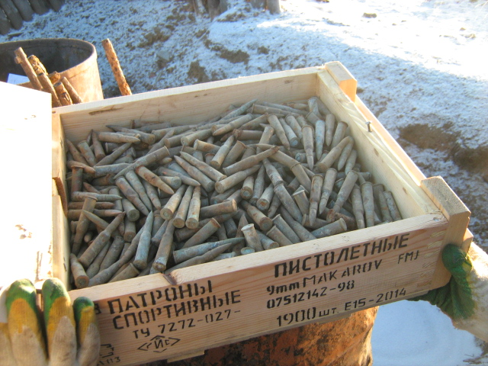
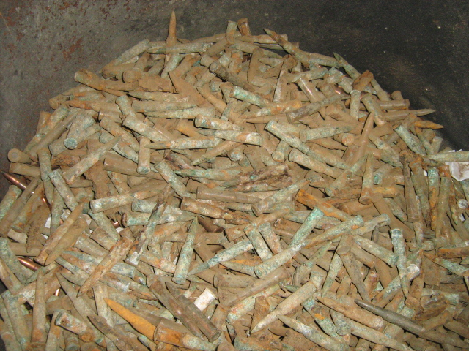
Destruction of ammunition
Loading ammunition into barrels for burning

Slide 4
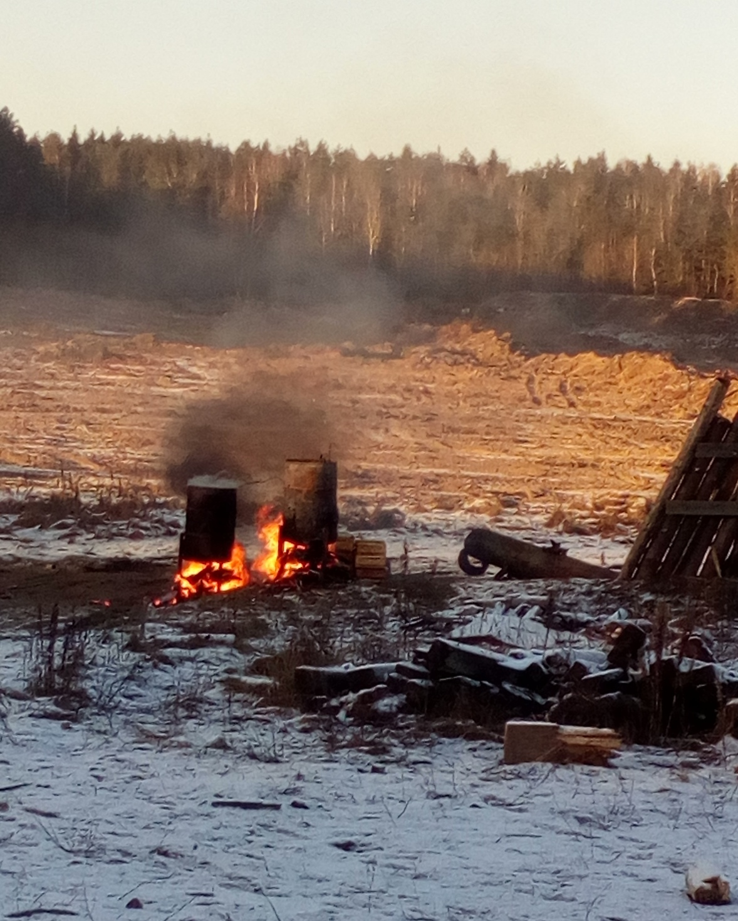
Destruction of ammunition
Burning of ammunition in barrels at the landfill

Slide 5
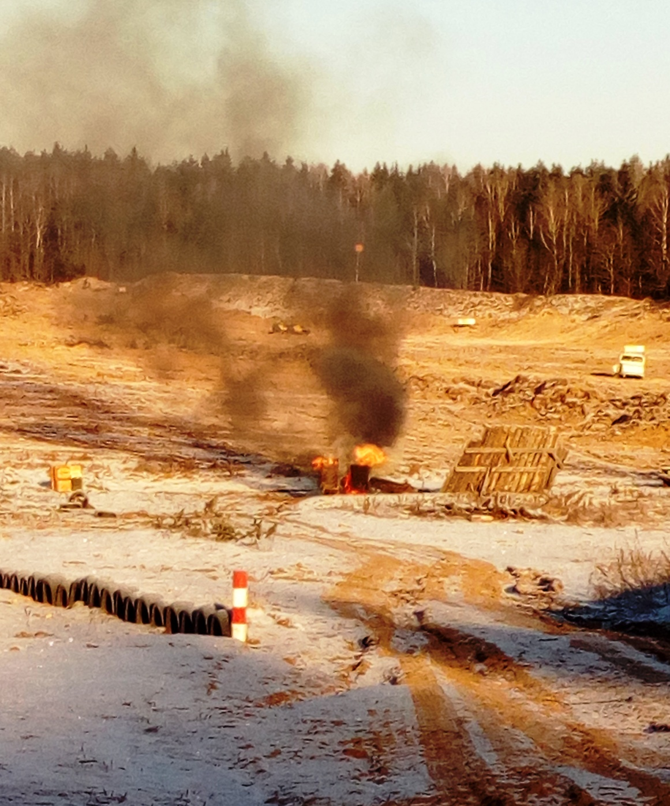
Destruction of ammunition
Burning of ammunition in barrels at the landfill

Slide 6
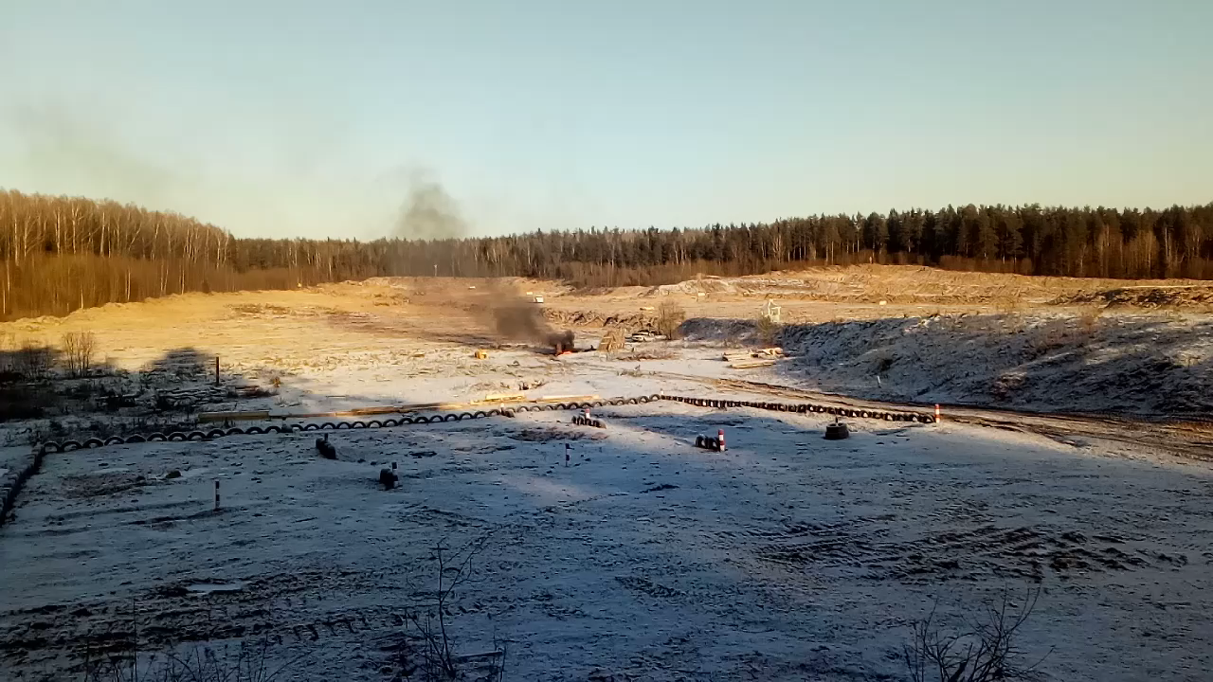
Destruction of ammunition

Slide 7
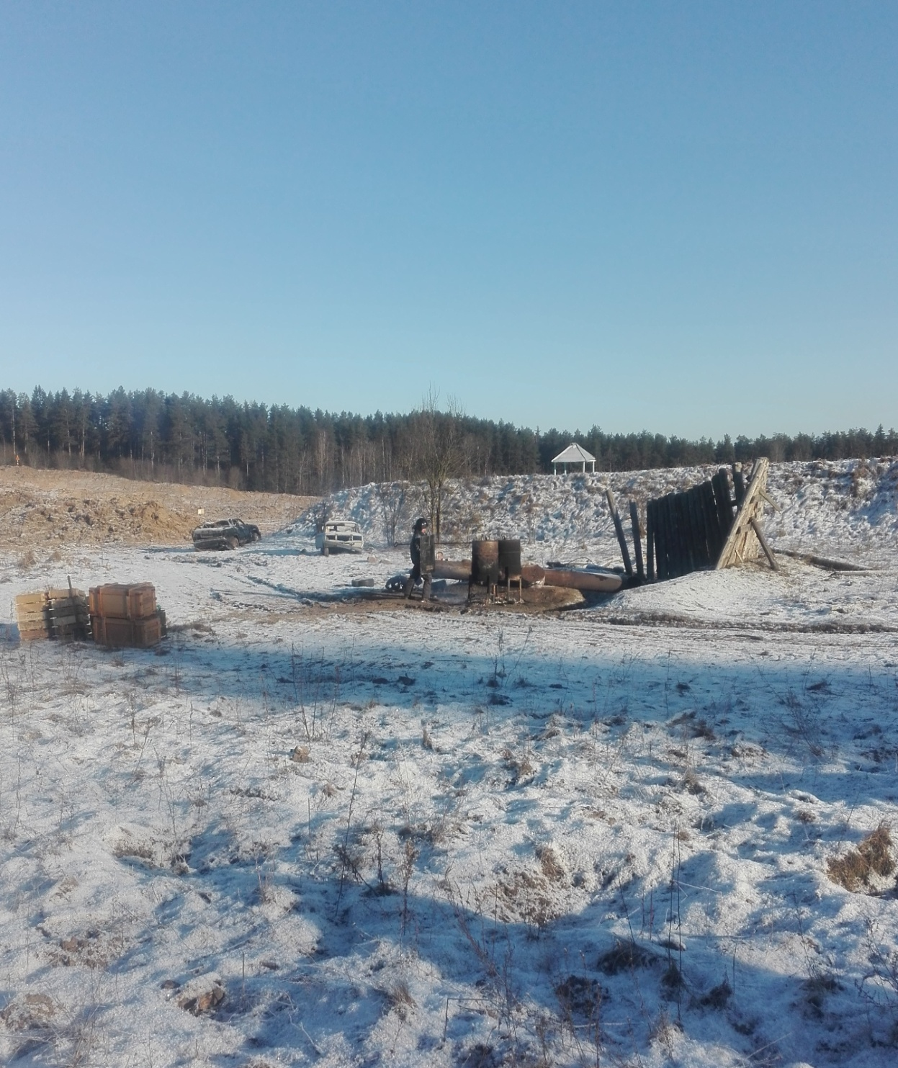
Destruction of ammunition
Burning of ammunition in barrels at the landfill

Slide 8
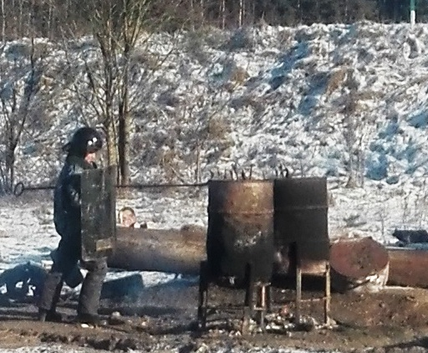
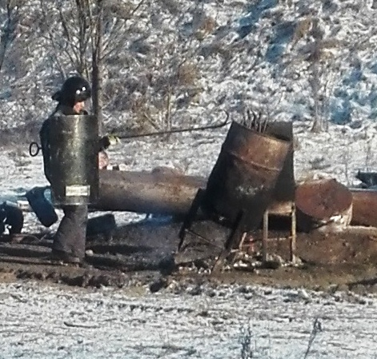
Destruction of ammunition
Burning of ammunition in barrels at the landfill

Slide 9
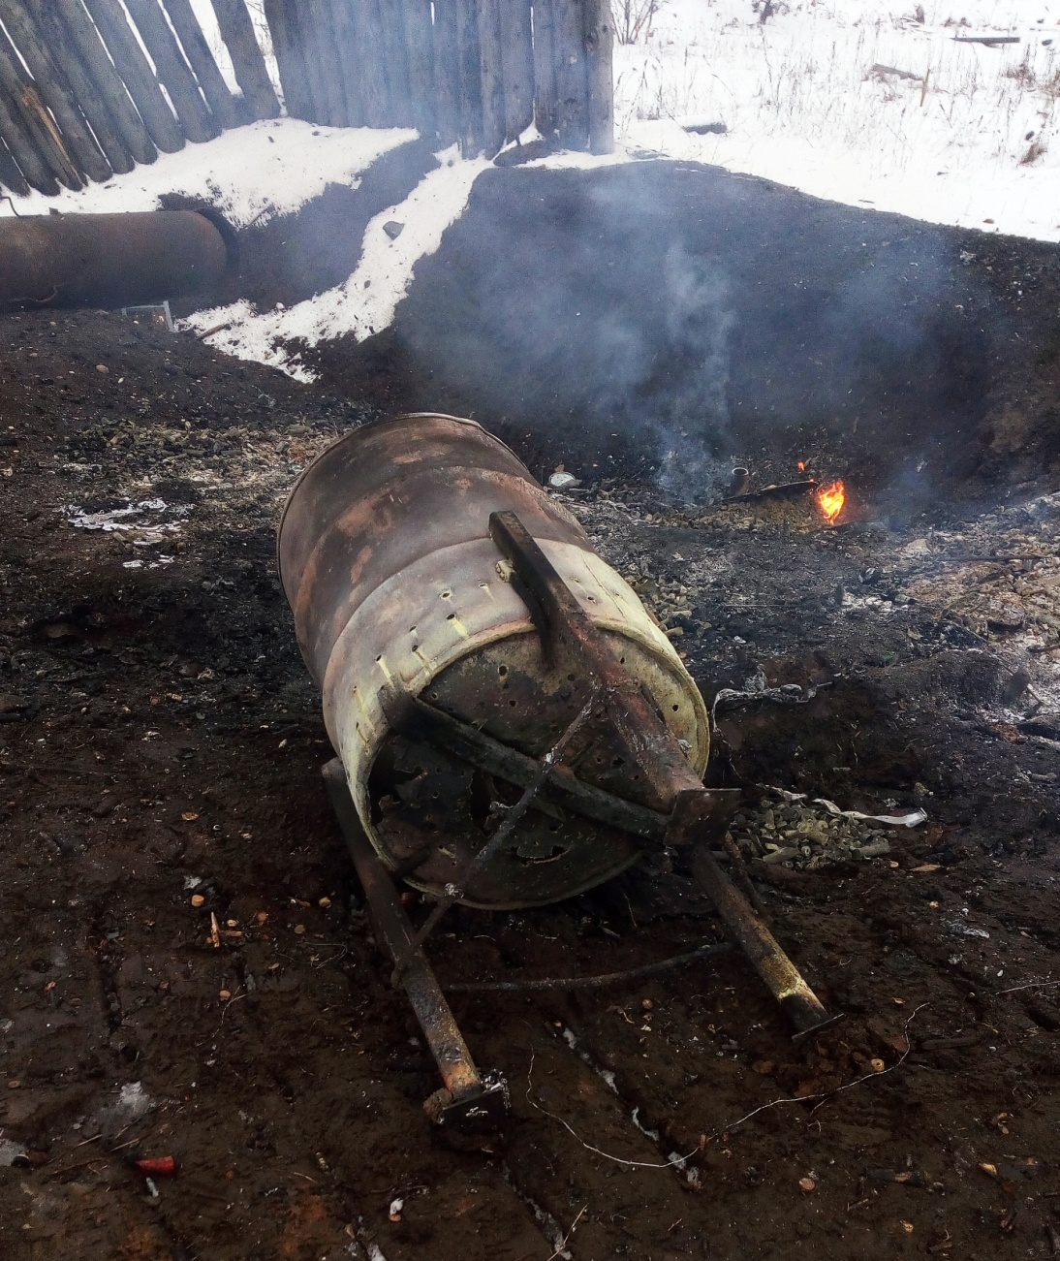
Destruction of ammunition
Burning of ammunition in barrels at the landfill

Slide 10
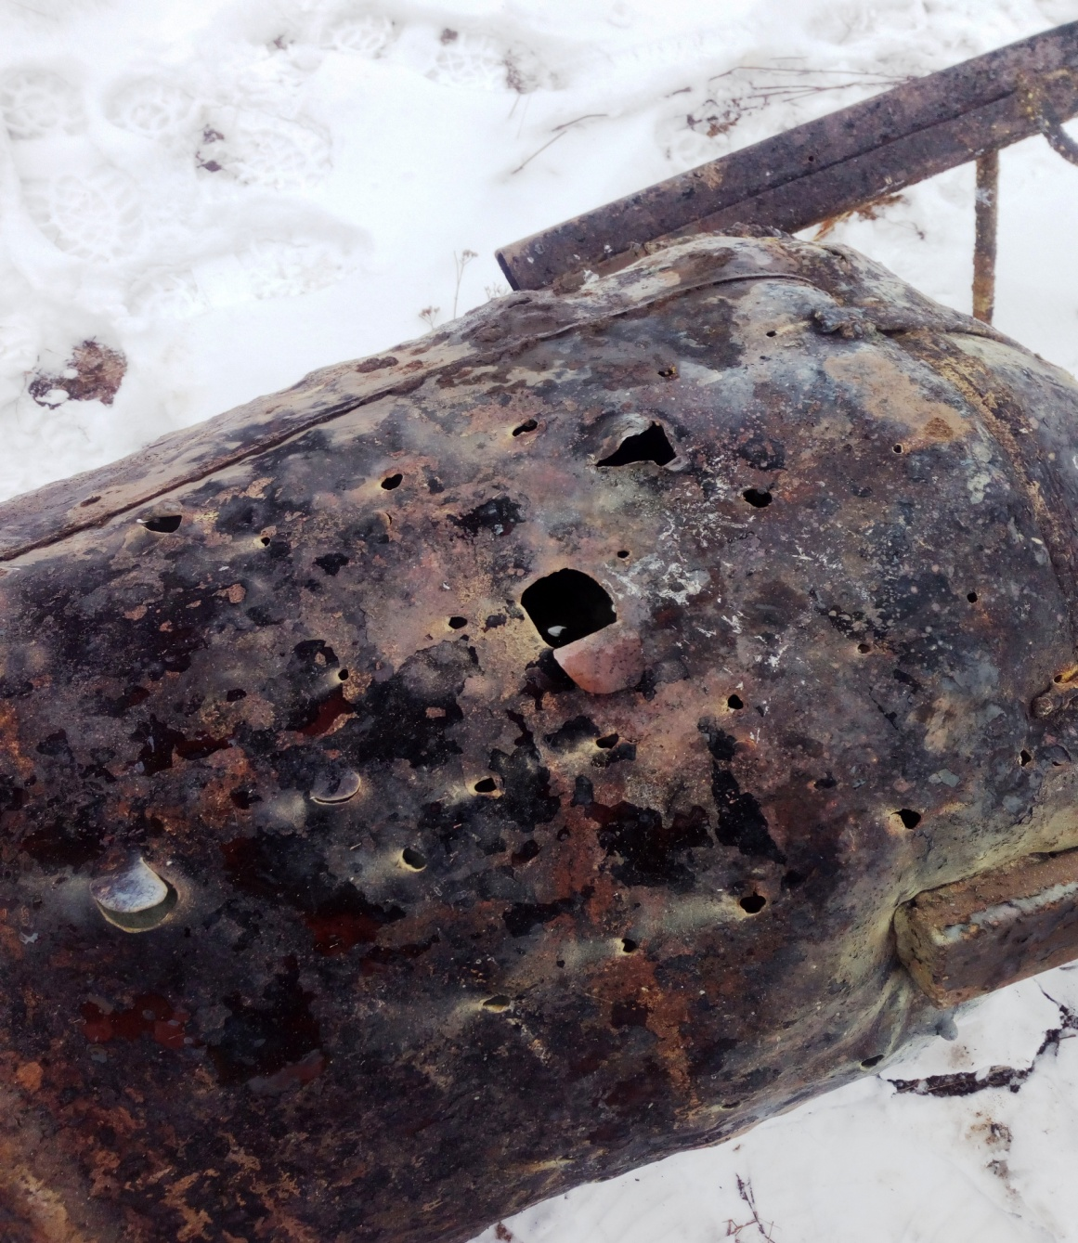
Destruction of ammunition
Bullet holes in the barrel after burning

Slide 11
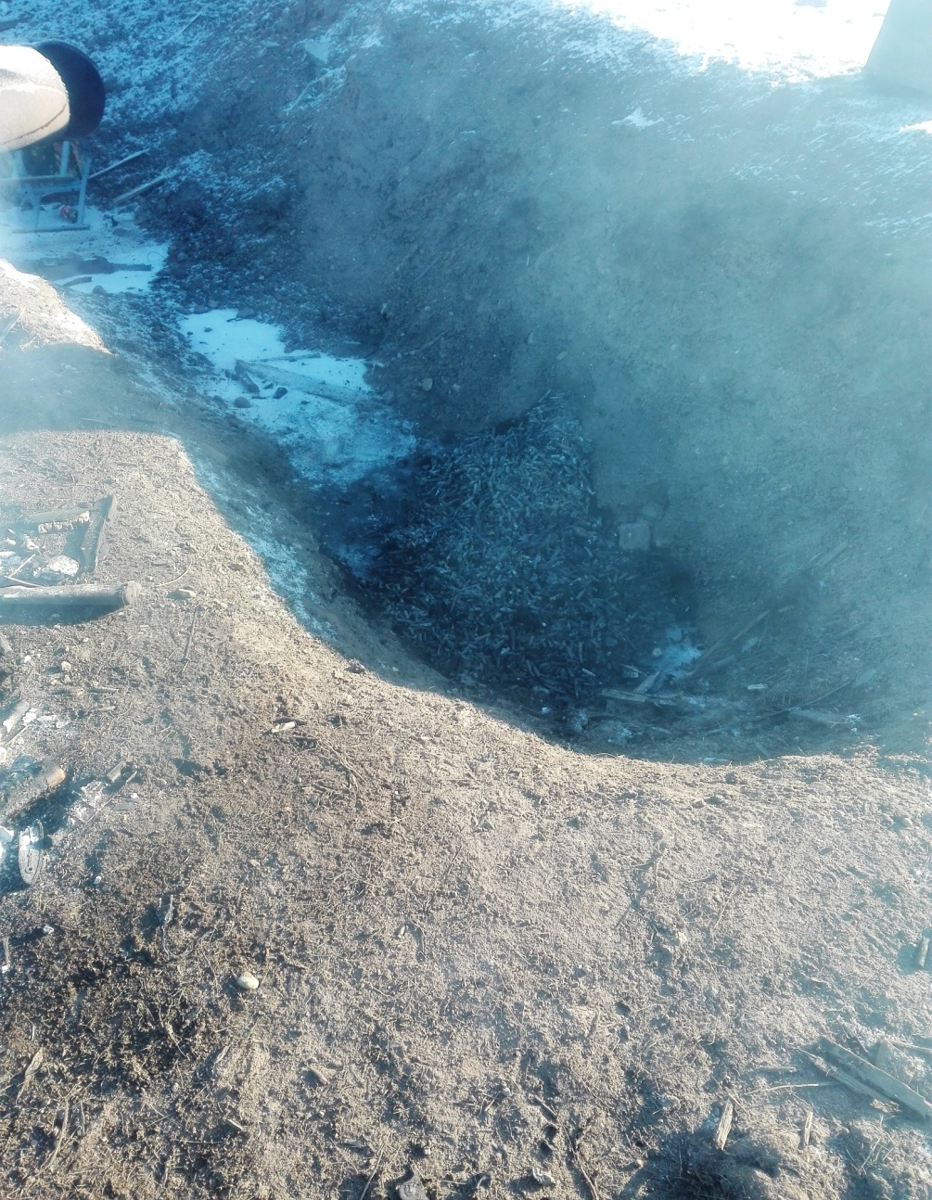
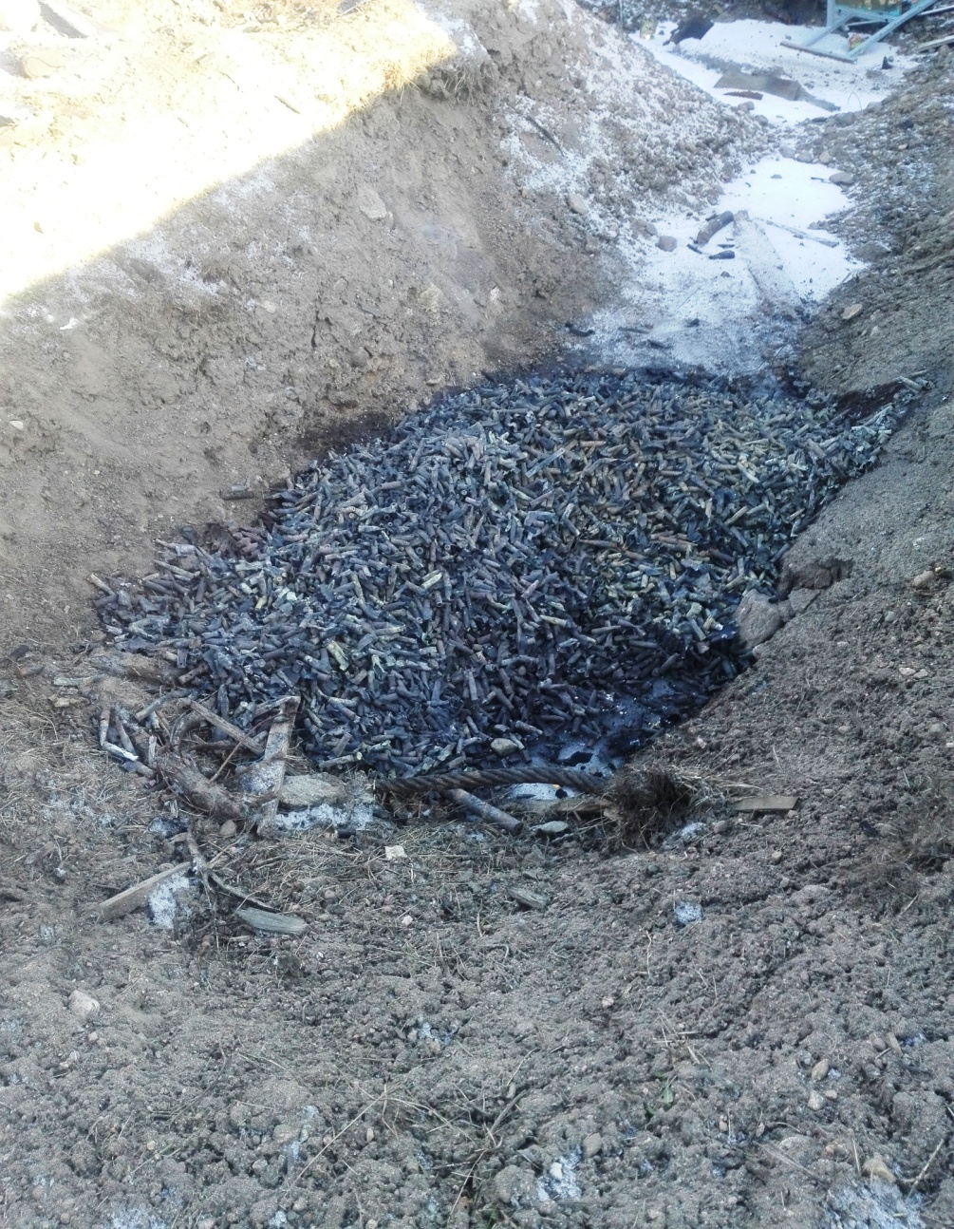
Destruction of ammunition
Burial of destroyed ammunition

Slide 12
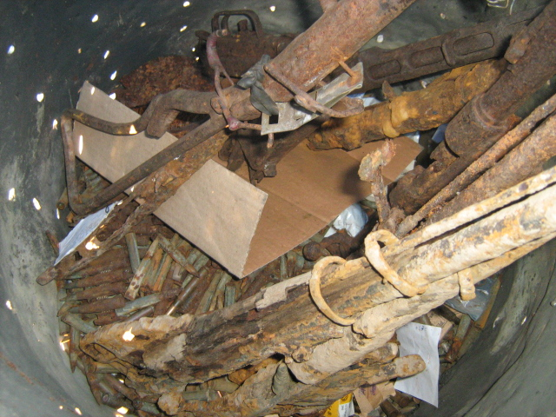
Destruction of weapons and ammunition
Burning weapons in barrels at the landfill

Slide 13
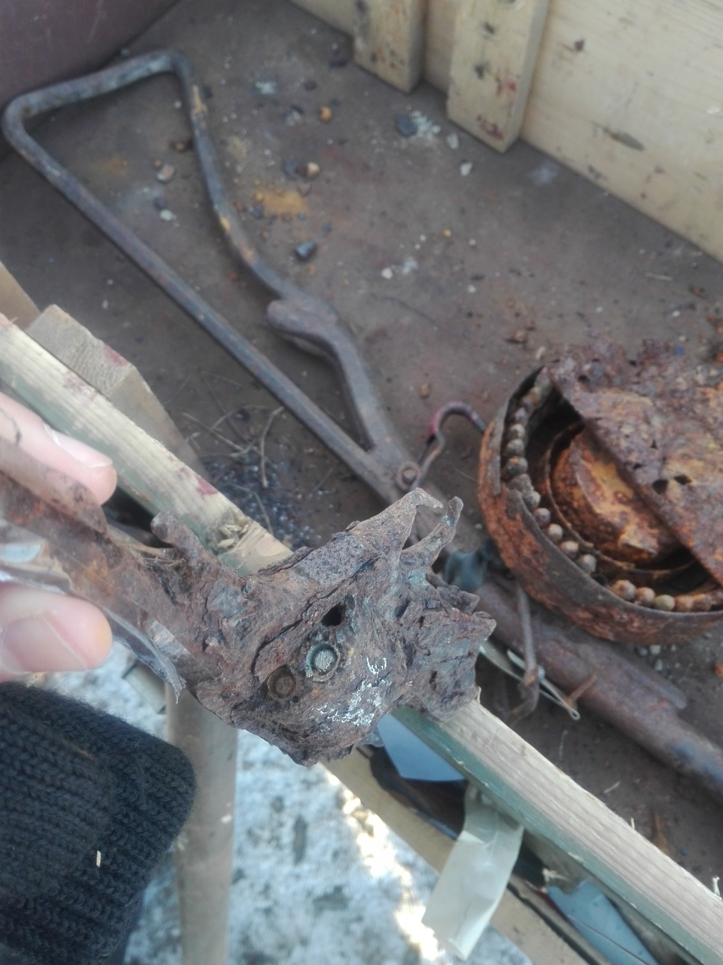
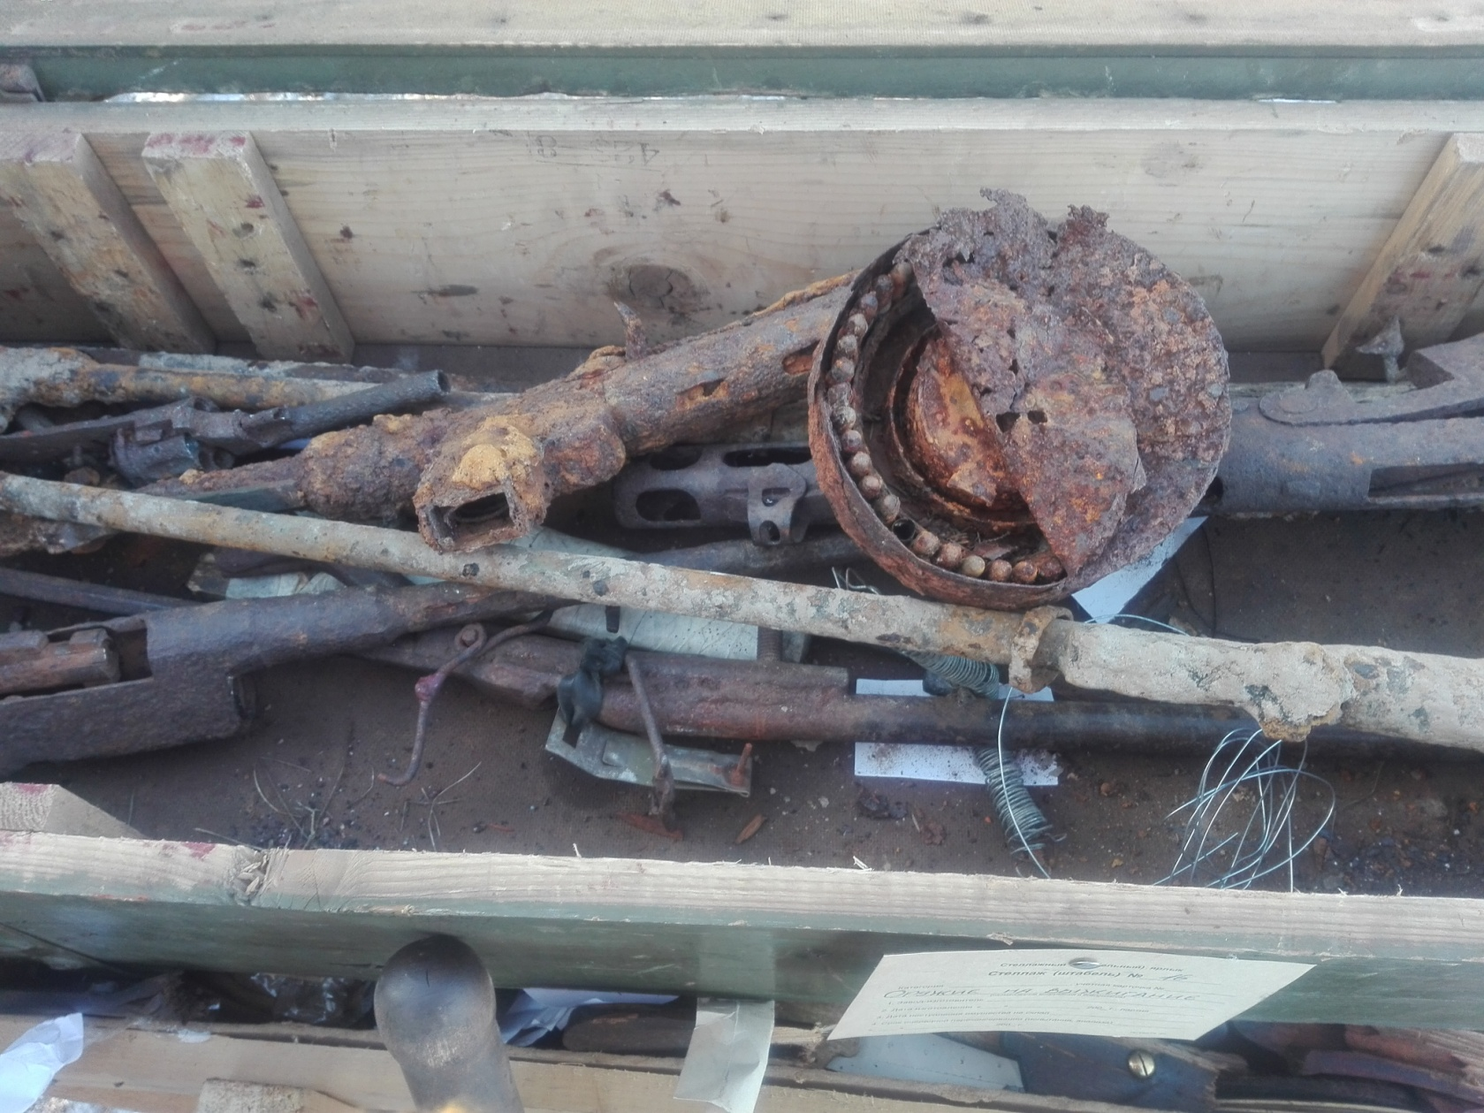
Destruction of weapons and ammunition
Weapons with jammed cartridges

Slide 14
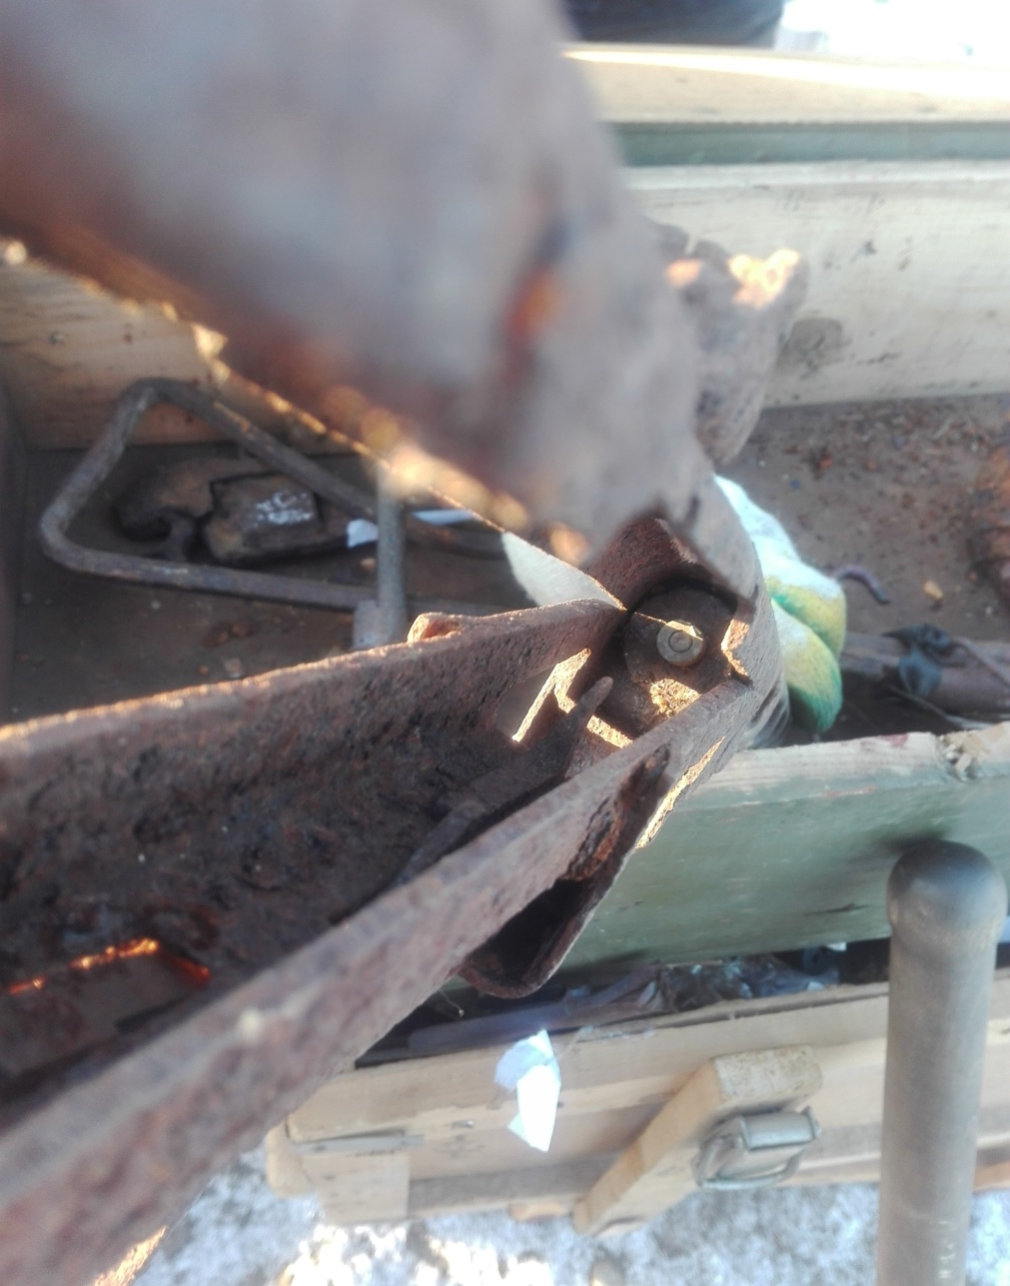
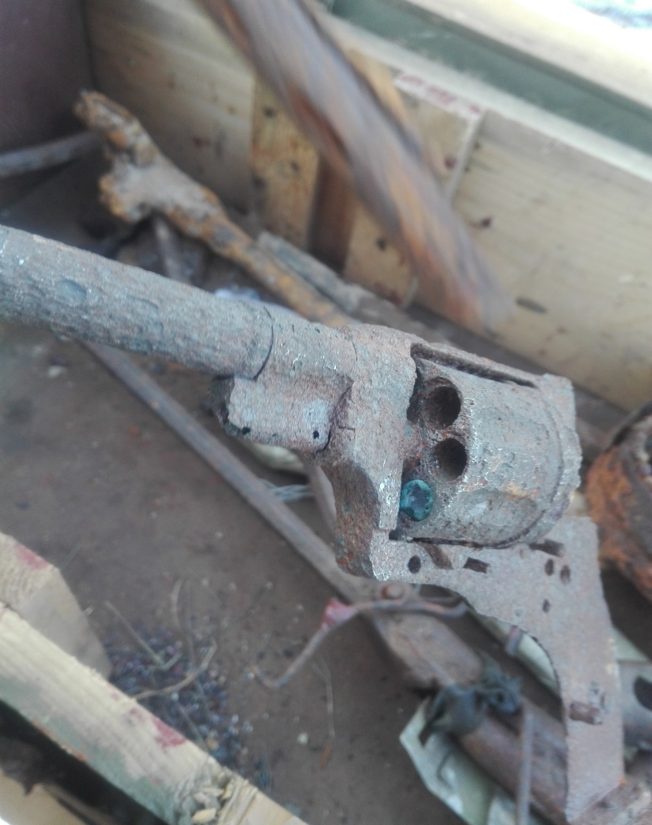
Destruction of weapons and ammunition
Weapons with jammed cartridges

Slide 15
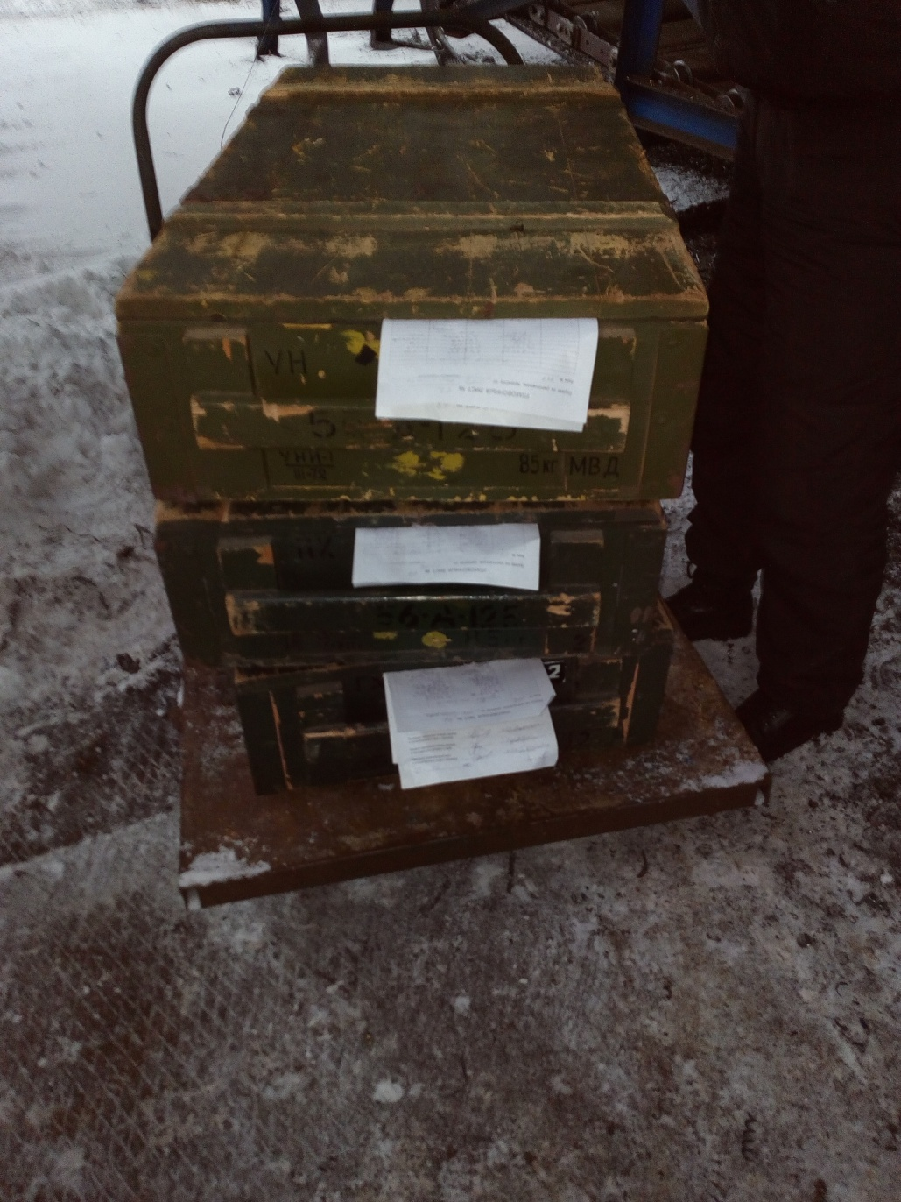
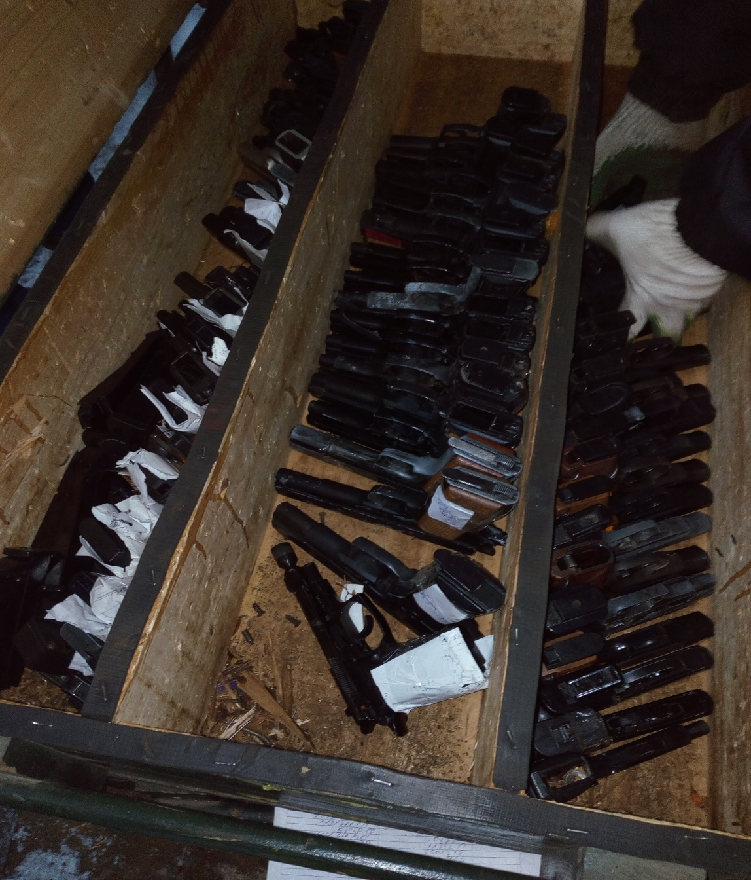
Destruction of gas weapons in a crusher
1

Slide 16
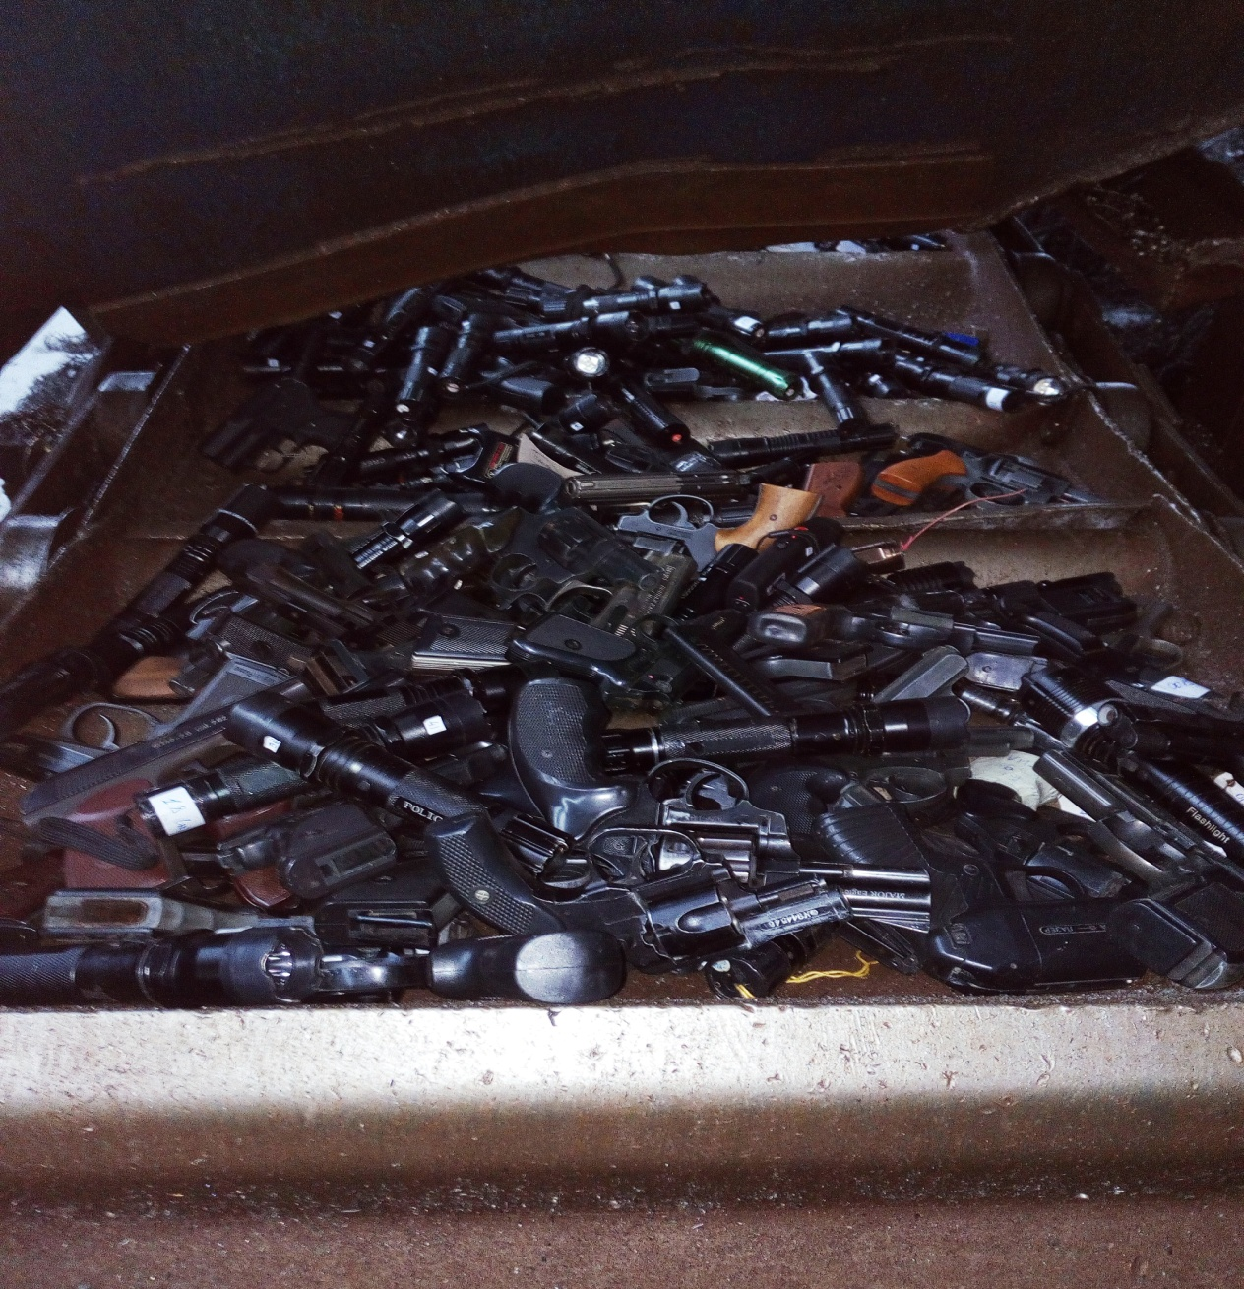
Destruction of gas weapons in a crusher
Weapons on crushers tape

Slide 17
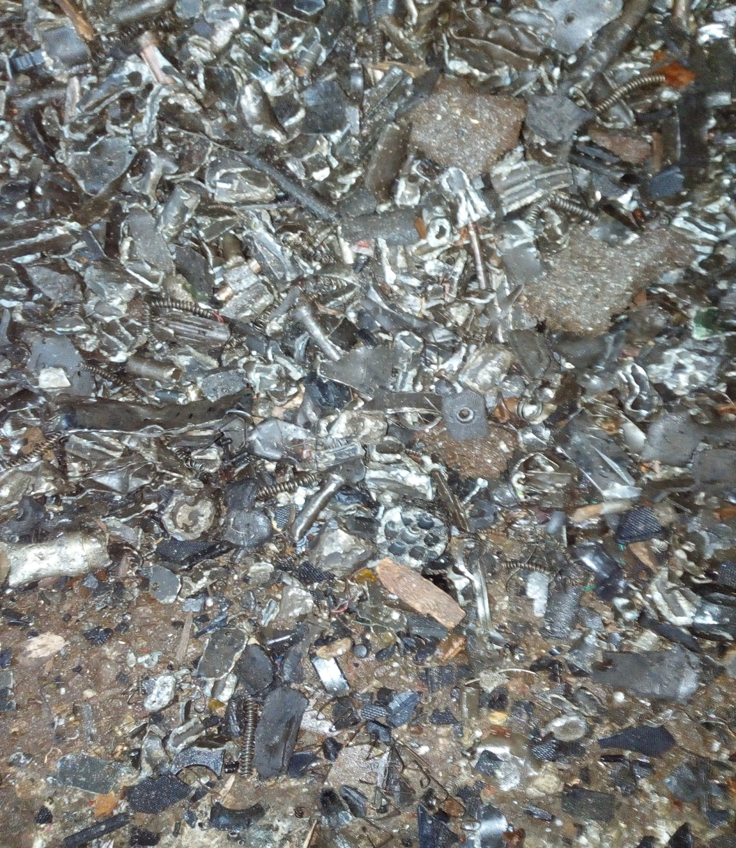
Destruction of gas weapons in a crusher
Weapons after crushing

