Slide 1


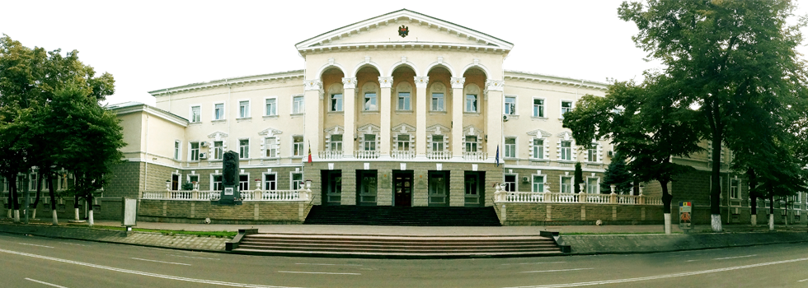
Republic of Moldova
MINISTRY OF INTERNAL AFFAIRS
Small Arms and Light Weapons

Slide 2
Republic of Moldova
MINISTRY OF INTERNAL AFFAIRS
Small Arms and Light Weapons
AMENDAMENTE LEGISLATIVE
Modification and completion of the Law no. 130 of 08.06.2012 on the regime of arms and ammunition for civil use;
Government Decision no. 210 of March 7, 2018 "On the establishment of the National Commission for the Monitoring of the Small Arms and Light Weapons' Movement";
Government Decision no. May 16, 2018 "For the approval of the Concept of the Automated Information System" State Register of Weapons".

Slide 3
Republic of Moldova
MINISTRY OF INTERNAL AFFAIRS
Small Arms and Light Weapons
Amending, modifying and supplementing the Law 130
of 08.06.2012 on the regime of arms and ammunition for civilian use
By Law no. 251 of 01.12.2017
for amending and supplementing some legislative acts, which entered into force on 5 January 2018, amendments and additions to Law 130/2012 were made, thus tightening up the arms regime and removing some gaps in the relevant legislation.

Slide 4
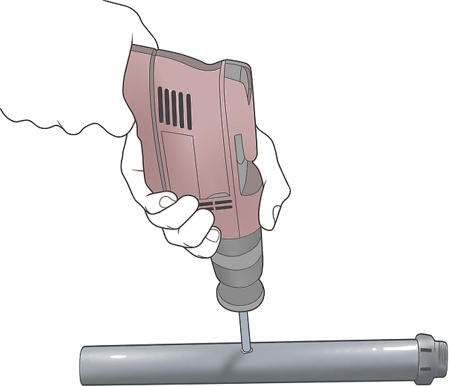


Republic of Moldova
MINISTRY OF INTERNAL AFFAIRS
Small Arms and Light Weapons
Making of the Law no 130/2012
consistent with the Criminal Code
Adjustment of the material norm for the application of art. 290 Criminal Code of the Republic of Moldova, which provides for criminal liability for the illicit modification of the construction of weapons for criminal purposes::
changing or transforming the essential parts or components of the weapon (pipe, locking device, fire-giving mechanism);
mounting of noise reduction devices;
replacing the pipe or changing the pipe channel.
replacing or modifying the pen.
cutting pipes of long weapons.

Slide 5
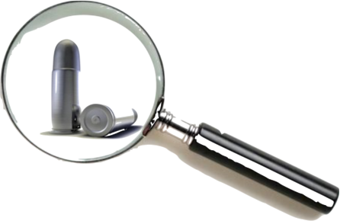
Republic of Moldova
MINISTRY OF INTERNAL AFFAIRS
Small Arms and Light Weapons
Assuring the process of identifying weapons
Taking into account that the channel of the pipes is worn as a result of multiple shots or corrosion, so that the traces left on the bullets drawn from the weapon change, natural and legal persons holding rifled lethal weapons are obliged once 10 years, to present each weapon with three cartridges for experimental firing.
Performing the experimental firing is certified by a report - for legal persons and by certificate - for individuals.

Slide 6
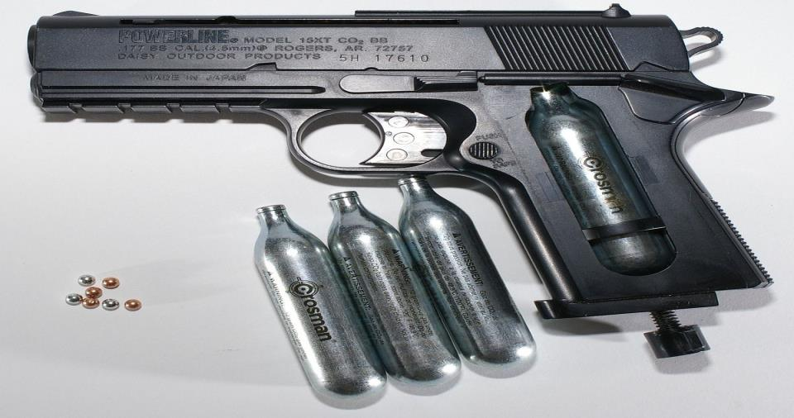
Republic of Moldova
MINISTRY OF INTERNAL AFFAIRS
Small Arms and Light Weapons
Tightening the non-lethal weapon regime
Pneumatic weapons are required to be registered and authorized by the police if they have a pipe pressure greater than 0.5 Joules.
It is established that weapons which are subject to declaration (pneumatic and gas weapons) must be kept at the home of the owner of the weapon in a metal safe, or under the same conditions foreseen for the storage of firearms.

Slide 7
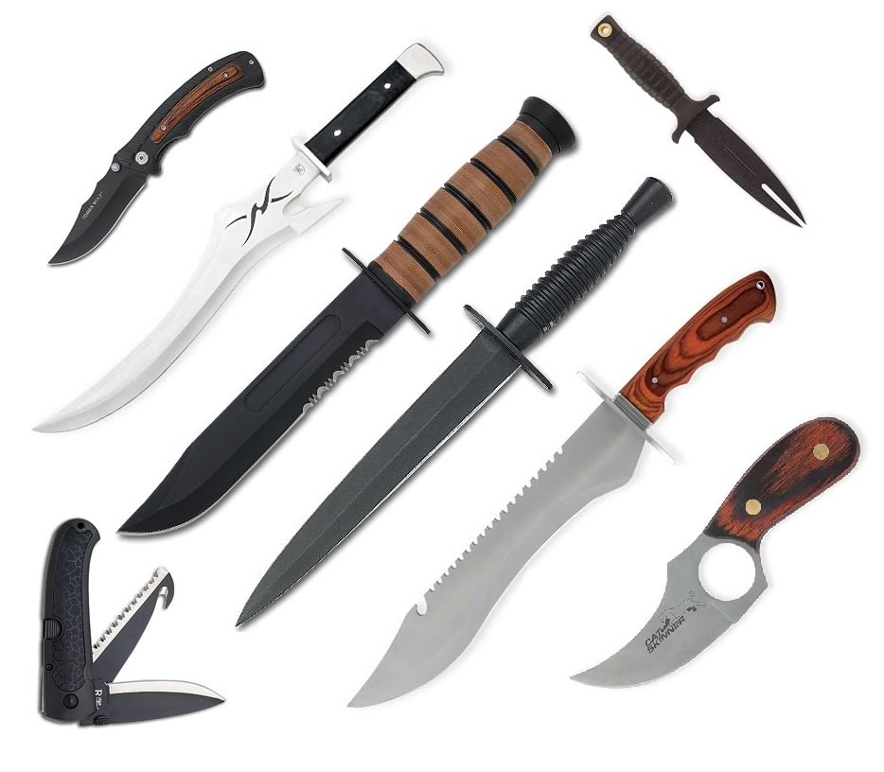
Republic of Moldova
MINISTRY OF INTERNAL AFFAIRS
Small Arms and Light Weapons
Tightening the Cold Arms Regime
The port of cold weapons is forbidden (except for hunting knives, the port of which is allowed only for hunting).
The following parameters were established for knives to be counted as cold arms:
the thickness of the blade exceeds 2.6 mm
OR
the blade length exceeds 95 mm

Slide 8
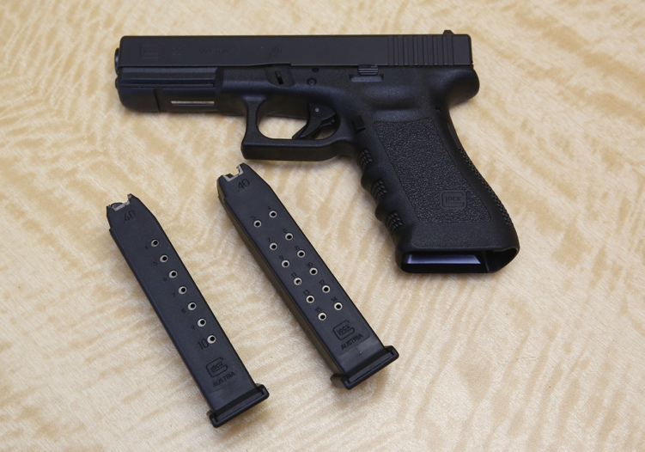
Republic of Moldova
MINISTRY OF INTERNAL AFFAIRS
Small Arms and Light Weapons
Regulating the amount of ammunition that can be worn
It is difficult to comply with the rule for carrying a quantity of ammunitions of no more than 18 cartridges because the chargers have different capacities and it is much simpler and clearer for the holder to know that it is allowed to carry 2 chargers for gun cartridges or 1 device with quick-release cartridges for revolver.

Slide 9
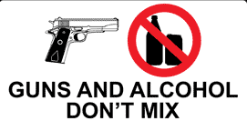
Republic of Moldova
MINISTRY OF INTERNAL AFFAIRS
Small Arms and Light Weapons
Tightening of conditions on wearing arms
The holder who has refused, resisted or escaped from alcohol testing, medical examination to determine the state of drunkenness and its nature, or the collection of biological samples, will be sanctioned.
In this case, the holder risks being punished by prohibiting the possession of weapons for a period of 5 years.

Slide 10
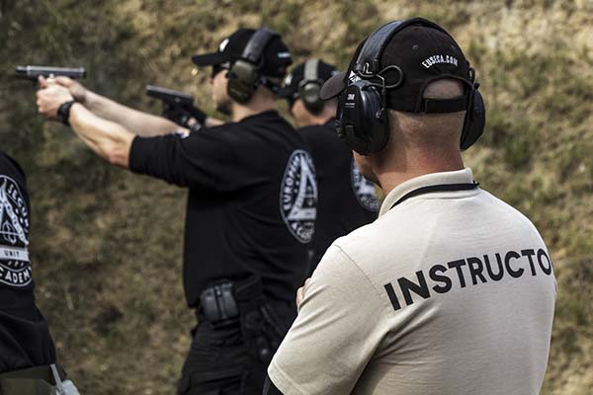
Republic of Moldova
MINISTRY OF INTERNAL AFFAIRS
Small Arms and Light Weapons
Improving knowledge and raising the level of weapon use culture
They are required to repeatedly undergo a theoretical and practical course of firearms training:
Owners of arms of whom ownership of weapons has been restricted for 5 years.

Slide 11
Republic of Moldova
MINISTRY OF INTERNAL AFFAIRS
Small Arms and Light Weapons
Conditions that required the creation of the National Commission for the Monitoring of Small Arms and Light Weapons
The creation of the Commission was imposed by the obligations incumbent on the Republic of Moldova to fulfill its commitments to the European Community and the international organizations competent in the field of small arms and light weapons control (SALW).

Slide 12
Republic of Moldova
MINISTRY OF INTERNAL AFFAIRS
Small Arms and Light Weapons
The current situation on the creation of the National Commission on SALW
On March 7, 2018, the Government Decision no. 210 “On the establishment of the National Commission for the Monitoring of Small Arms and Light Weapons' Movement” was approved.

Slide 13
Republic of Moldova
MINISTRY OF INTERNAL AFFAIRS
Small Arms and Light Weapons
Government Decision no. 210 of March 7, 2018 regulates:
Establishment of the National Commission for Monitoring the Small Arms and Light Weapons;
Establishing the composition of the National Commission for the Monitoring of Small Arms and Light Weapons;
Approval of the regulation on the work of the National Commission for the Monitoring of Small Arms and Light Weapons.

Slide 14
Republic of Moldova
MINISTRY OF INTERNAL AFFAIRS
Small Arms and Light Weapons
COMPOSITION
of the National Commission for Trafficking in SALW
President of the Commision, Secretary of State
of the Ministry of Internal Affairs
Secretary of the Commision
Head of
DGSP of IGP of the MIA
Head of the
General Police Inspectorate of the MIA
Secretary of State of the Ministery of Economy and Infrastructure
Secretary of State of the Ministry of Finance
Secretary of State of the Ministry of Justice
Vice-President of the Commision, Secretary of State of the Ministry of Defense
Vice-President of the Commision, Secretary of State of the Ministry of Foreign Affairs
Deputy Head of the Custom Services
Deputy Head of the Service for Information and Security

Slide 15
Republic of Moldova
MINISTRY OF INTERNAL AFFAIRS
Small Arms and Light Weapons
Mission of the Commission
The Commission's mission is to coordinate the implementation of the provisions of the international treaties on SALW to which the Republic of Moldova is a party, to prepare national reports in the field of reference and to ensure the achievement of the tasks and objectives within the limits of competence established by the Commission Regulation.

Slide 16
Republic of Moldova
MINISTRY OF INTERNAL AFFAIRS
Small Arms and Light Weapons
THE ORGANIZATION AND FUNCTIONING OF THE COMMISSION
The meetings of the Commission shall be convened by its chairman or at the request of one of the Vice-Presidents or members of the Commission, addressed to the President of the Commission.
The secretarial work of the Commission is provided by the General Public Security Directorate of the General Police Inspectorate.
The members of the Commission are appointed by the head of the authority to which they belong, in accordance with the legal provisions.
The General Police Inspectorate is the institution responsible for organizing the work of the Commission.
The Commission is headed by the chairman and, in his absence, by one of the Vice-Presidents of the Commission.

Slide 17
Republic of Moldova
MINISTRY OF INTERNAL AFFAIRS
Small Arms and Light Weapons
ACTIVITY OF THE COMMISSION
In June 2018, the Commission's first working meeting will be organized and held, in which the following topics will be addressed:
Setting the objectives and actions for drawing up the Commissions works plan
Setting up a group of experts in the field to achieve the Commission's tasks and objectives;
Setting priorities for the development of the National Strategy on the Control of Small Arms and Light Weapons;
Setting priorities for the development of the National Action Plan on Small Arms and Light Weapons;

Slide 18
Republic of Moldova
MINISTRY OF INTERNAL AFFAIRS
Small Arms and Light Weapons
Evidence of weapons on the territory of the Republic of Moldova
On May 16, 2018 the Government Decision "For the approval of the Concept of the Automated Information System" The State Register of Weapons“ was approved, according to which:
1) drafting of specifications;
2) development of the electronic system (software);
3) The training of the police employees who will use the Automated Information System "The State Register of Weapons"

Slide 19
Republic of Moldova
MINISTRY OF INTERNAL AFFAIRS
Small Arms and Light Weapons
Upgrading the infrastructure of the arms depot
of the Police
At the moment, the Police's Arms Depot stores weapons from police equipment, delinquent weapons and confiscated weapons. It is becoming more and more difficult to keep them because the warehouse is located in the city center and is in a deplorable condition.
At present, with the support of SEESAC, the procedure of identifying a company for the modernization of storage facilities for temporary storage and storage of weapons from police custody

Slide 20
Republic of Moldova
MINISTRY OF INTERNAL AFFAIRS
Small Arms and Light Weapons
Reported offenses related to the wearing, preservation, procurement, illegal manufacture of firearms and ammunition during the period 2017 - 2018

Slide 21
Republic of Moldova
MINISTRY OF INTERNAL AFFAIRS
Small Arms and Light Weapons
Weapons captured or voluntarily surrendered from illegal possession during the period 2017 - 2018

Slide 22
Republic of Moldova
MINISTRY OF INTERNAL AFFAIRS
Small Arms and Light Weapons
Objectives and Priorities for 2018
Amending and supplementing the Criminal Code and the Code of Contravention;
Amending and completing the Government Decision no. 293 of 23 April 2014 "On the approval of the Regulation on the regime of arms and ammunition for civilian use" and of the Government Decision no. 1447 of December 30, 2016 "Regarding the State Commission for the Valuation, Bonification and Redemption of Weapons";
Elaboration and implementation of the new Arms Register System, as well as the elaboration of the Regulation on keeping the State Register of Weapons, which will be approved by Government Decision;
Developing the National Strategy on Small Arms and Light Weapons Control and the National Action Plan on Small Arms and Light Weapons;
Organizing and Deploying the National Campaign to Raise Civil Society on the Dangers of Illegally Owned Weapons "Now is the time to hand over the weapons!“.

Slide 23
Republic of Moldova
MINISTRY OF INTERNAL AFFAIRS
Small Arms and Light Weapons
NEEDS
Identification of financial sources for elaboration of the specification and electronic system (software) of the Automated Information System "State Register of Weapons", provision of system maintenance, as well as training of police personnel on its use;
Identifying financial sources for organizing and running the National Campaign to Raise Awareness on the Dangers of Illegally Owned Weapons "Now is the time, we hand over the weapons!"
Identifying financial sources for organizing an arms smudging exercise during the year 2018;

Slide 24

Republic of Moldova
MINISTRY OF INTERNAL AFFAIRS
Small Arms and Light Weapons
Thank you for your attention

