Slide 1


8th SALW COMMISSIONS MEETIG
Activities and priorities of the National Army of Republic of Moldova on the SALW & CA

Slide 2


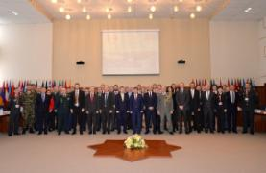
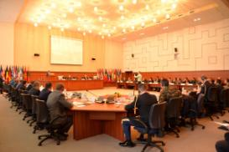
I High-level national SALW/CA Conference on 16 February 2017
2017
2020
Explosive Risk Mitigation
Professional training
Physical Safety and Security
Safety on Ammunition storage areas
Mobile laboratories
Chemical Laboratory
International cooperation
Construction New CA Site

Slide 3
ESTABLISHMENT OF TASK FORCE
Group 1
100% INVENTORY AND VISUAL INSPECTION
Group 2
AMMUNITION STORAGE MANAGEMENT
Notes:
Explosive risk mitigation
Professional capacity development
Professional training
Transportation cost
International cooperation
Information campaign
Chemical assessment capacity

Slide 4
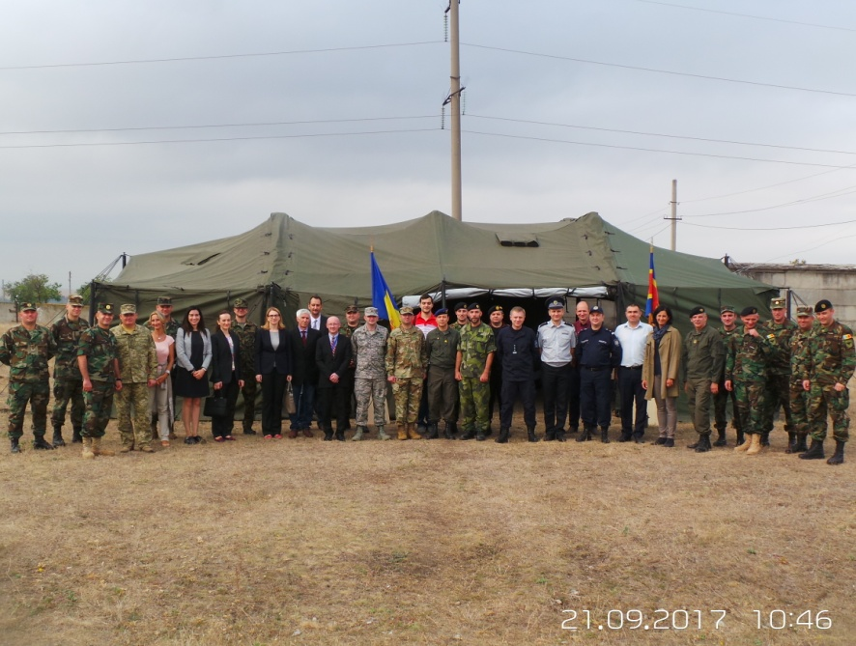
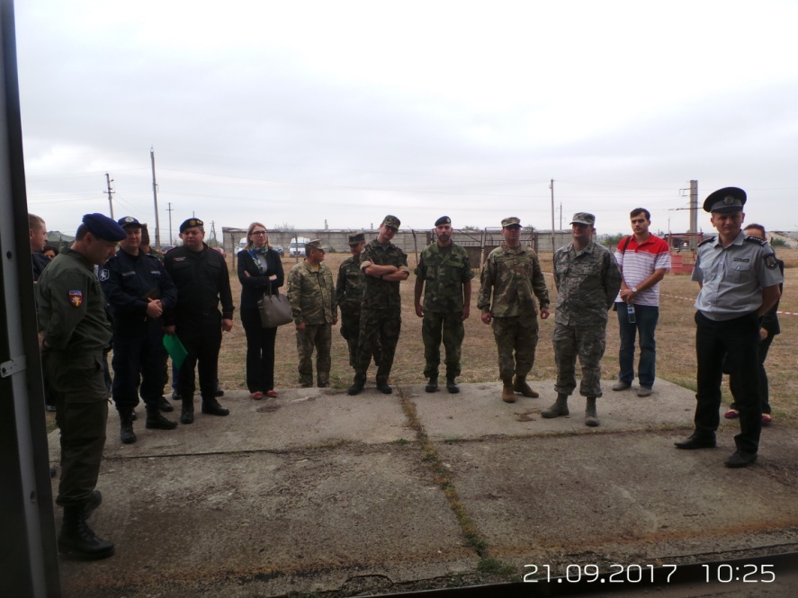
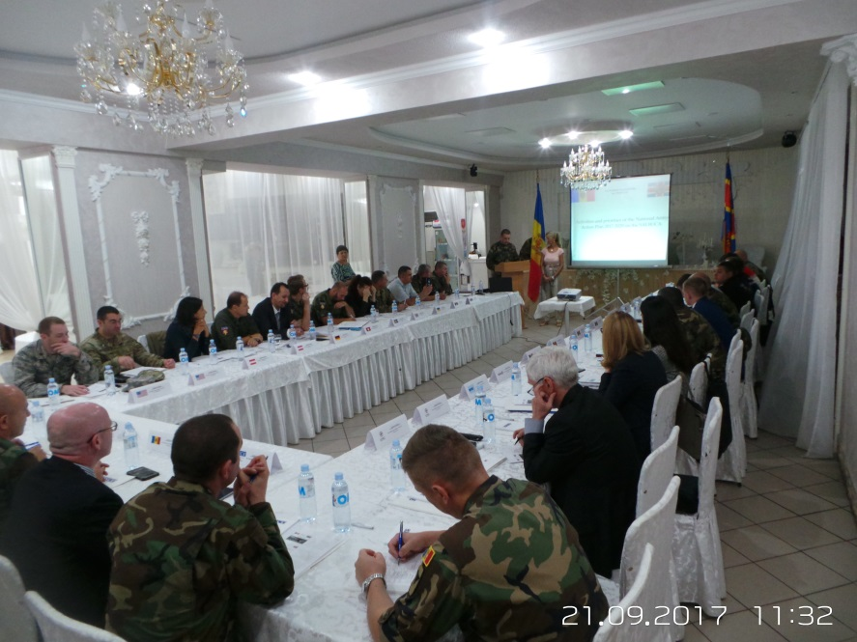
The Technical expert meeting on SALW /CA
on 21 September 2017
National Army Action plan 2017-2020 on SALW/CA
Assessing the achieved progress
Existing problems/challenges
Future coordination of activities in the SALW/CA field

Slide 5
 | Florești | Cahul | Bulboaca | Chișinău | Bălți | Dănceni
GRUOP 1
100 % Visual inspection & inventory
GROUP 2
Physical Security System (fence)
Fire-fighting systems
Resistance test and marking of storage sites
Equipped warehouses
Refurbishment of access roads
Wall of protection
Upgrade of SALW/CA storage sites
Reducing the amount of explosives
Level 1 chemical laboratory
Dismantling of ammunition
Utilization of ammunition
Information campaign

Slide 6
Thank you for your attention!
Questions?

