Slide 1



Effective Compliance Programme
Alain E. Lapon
Skopje, 21 November 2017

Slide 2
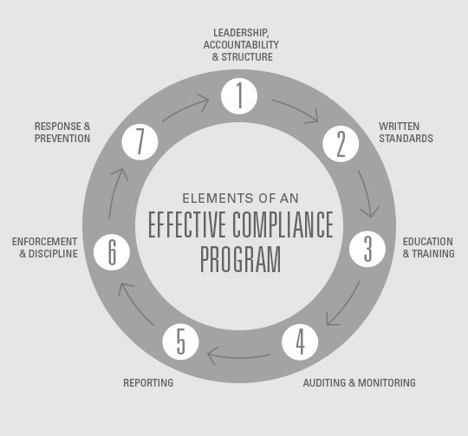

Slide 3
Internal Export Control System

Slide 4
Cooperation and Collaboration
Institutions
Commercial sector

Slide 5
Reasons
Combat together Illicit Arms Trafficking
1
Stay on the right side of the law
2
Protect the name of the Company and the exporting country
3
Avoid liability risks
4
Freedom of foreign trade
5

Slide 6
Duties and responsibilities
Duties of companies and institutions
1
Application process
2
Benefits from simplified procedures
3
Improve operational effectiveness – avoid unnecessary work
4

Slide 7
ICP Criteria
Human and technical resources
Organizational structure/ chain of responsibility
Audits/Supervision
Workflow management/operating procedures and general awareness
Physical and technical security
Records and record keeping

Slide 8
Risk assessment and WARNINGS
Business Activity
Customer
Commodity
Order Processing
End Use
Shipping

