Slide 1

changes to EU Firearms Directive and their implementation with focus on deactivation of firearms
Alain E. Lapon
Chief Technical Advisor
Skopje 20 – 21 November 2017

Slide 2
NEW EU LEGAL FRAMEWORK
Deactivation Implementing regulation 2015/2403
Applicable 08 April 2016
Amended Firearms Directive 2017/853
17 May 2017
Compliance :
14 September 2018
Article 10 b

Slide 3
PROPOSED METHODOLOGY
Amending Firearms Directive 2016/…
Deactivation Implementing Regulation 2015/2403
Consolidated version
Table of Concordance
Table of concordance
Existing Legal Framework
Amending Legal Framework

Slide 4
Amended Firearms Directive
2017/853
Alain E. Lapon
Chief Technical Advisor
Skopje 20 – 21 November 2017

Slide 5
New Definitions
CONVERSION:
Can be used both ways?
MODIFICATION:
?
The activities of a dealer include not only the manufacturing but also the modification or conversion of firearms, essential components and ammunition, such as the shortening of a complete firearm, leading to a change in their category or subcategory. Purely private, non-commercial activities, such as hand-loading and reloading of ammunition from ammunition components for own use or modifications of firearms or essential components owned by the person concerned, such as changes to the stock or sight or maintenance to address wear and tear of essential components, should not be considered to be activities that only a dealer would be permitted to undertake.

Slide 6
NEW DEFINITIONS CTD
“Parts” deleted –
Essential components “receiver”: Lower and upper receiver
Serial number on the Receiver but…..

Slide 7
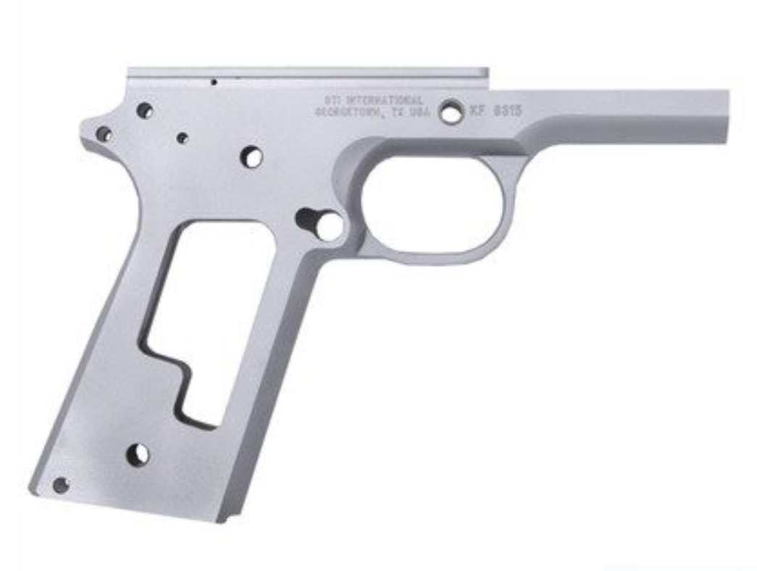
Lower versus Upper receiver
In firearms terminology, the firearm receiver or firearm frame is the part of a firearm which provides housing for internal components such as the hammer, bolt or breechblock, action and firing mechanism, and is usually threaded at its forward portion to "receive" the barrel and has screw holes on the bottom and/or rear to receive the stock and grip.

Slide 8
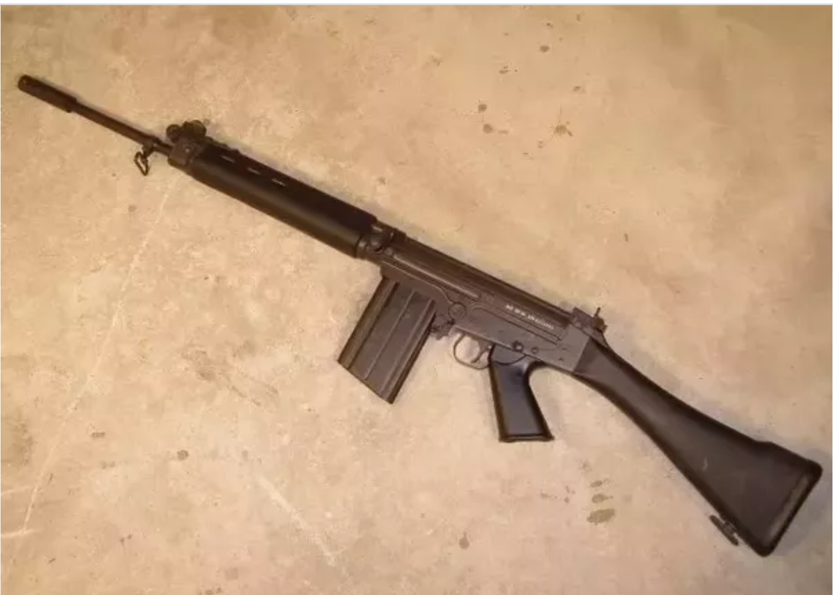
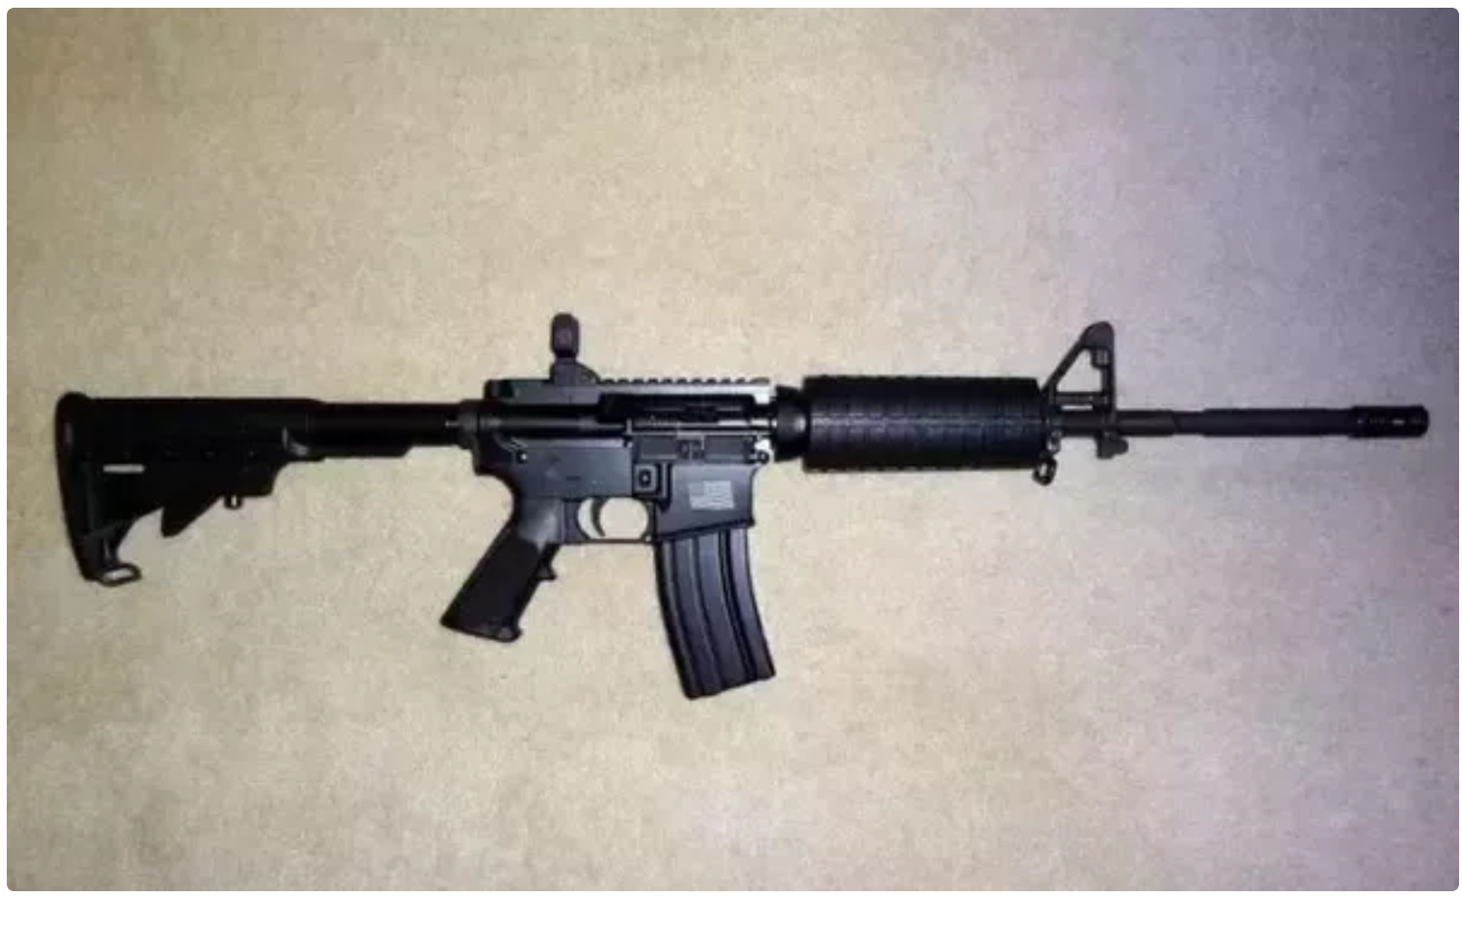
SERIal numbering and receiver
SN
SN

Slide 9
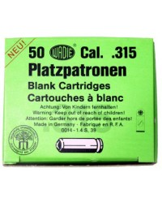
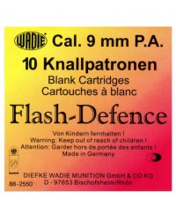
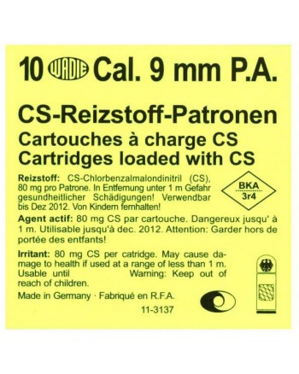
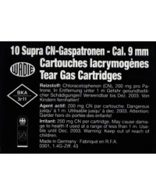
NEW DEFINITIONS CTD
Alarm and signal weapons: need for regulating ammunition!

Slide 10
NEW DEFINITIONS CTD
Salute and acoustic weapons: B, C and D
A
B
C

Slide 11
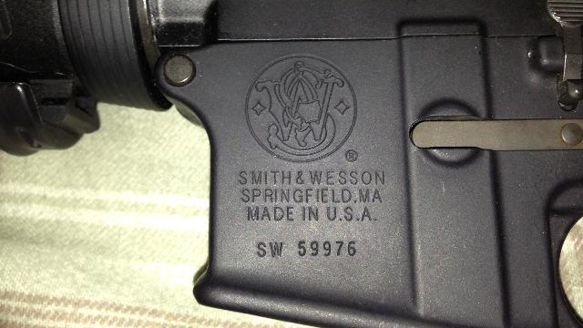
UNIQUE MARKING
Manufacturer
1
Brand
2
Country or place of manufacture
3
Serial number
4
Year of manufacture
5
Model if feasible
6
OMITTED: Caliber ?
7

Slide 12
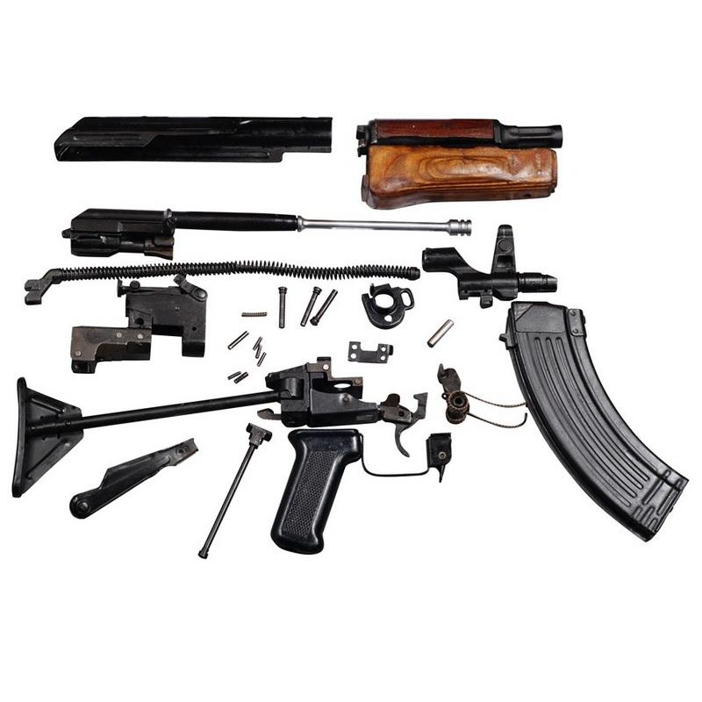
Marking essential components
Where they differ from the number of the receiver or frame
Minimum Serial number can be alpha numberic or digital code

Slide 13

Registration software
Serial numbers of essential components
1
Conversions or modifications
2

Slide 14
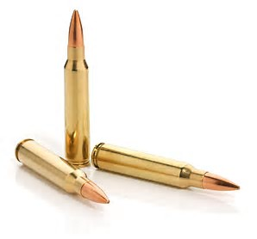
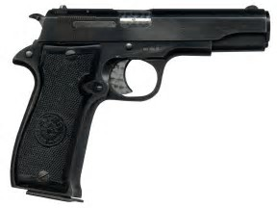
TRACING

Slide 15

Monitoring and evaluation authorisations
Monitoring duration of authorizations
1
Relevant medical and psychological situation and criminal incidents
2

Slide 16
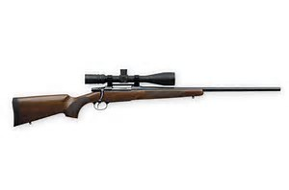
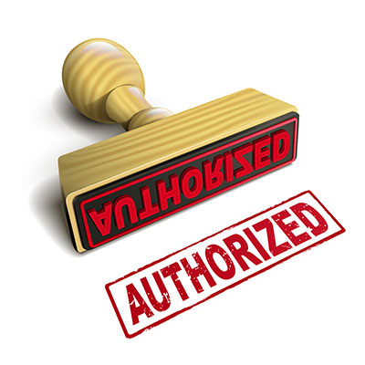
LOADING DEVICES
More than 10 rounds
Repeating and semi automatic center fire firearms
More than 20 rounds

Slide 17
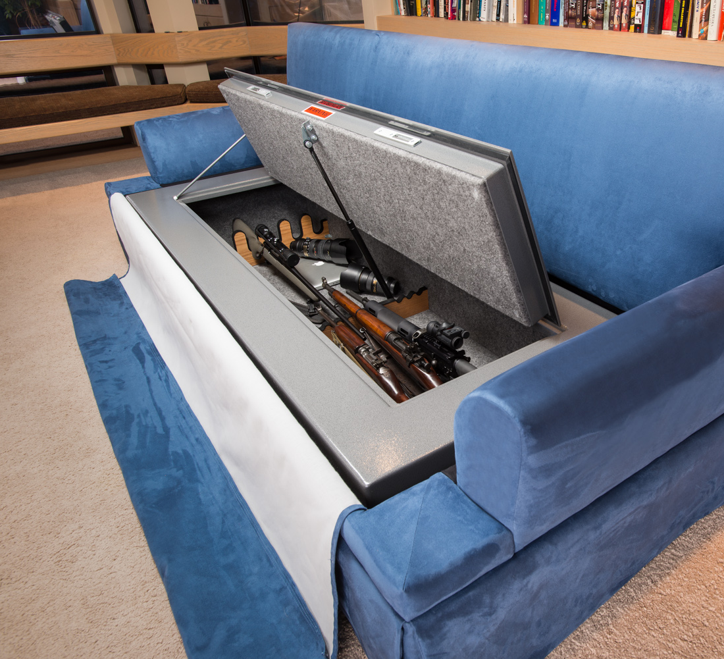
WEAPON STORAGE
Level of scrutiny for proper storage arrangements depends on number and category

Slide 18

Distance Contract
‘distance contract’ means any contract concluded between the trader and the consumer under an organised distance sales or service-provision scheme without the simultaneous physical presence of the trader and the consumer, with the exclusive use of one or more means of distance communication up to and including the time at which the contract is concluded;

Slide 19

Article 10 : category A prohibited
BUT
EXEMPTIONS FOR:
Security of critical infrastructure
Commercial shipping
High value convoys
Sensitive premises
National defense
Educational, cultural, research and historical purposes

Slide 20
COMMISSION implementing acts
Technical specifications for Marking
1
Technical Specifications for alarm and signal weapons
2
14 September 2018

Slide 21
DEACTIVATION IMPLEMENTING REGULATION 2015/2403
Alain E. Lapon
Chief Technical Advisor
Skopje 20 – 21 November 2017

Slide 22
DEACTIVATION
IMPLEMENTING REGULATION 2015/2403
IMPLEMENTING REGULATION
Deactivation can be applied to A,B, C and D category
Implementation by licensed entity : Public or private
Designation of verification authority
  (Symbol of verifying authority)
Issuance and form of deactivation certificate
Record keeping – 20 years
Marking of deactivated firearms
Transfer in EU
Done in BRUSSELS: 15 December 2015
Applicable: 08 April 2016

Slide 23
DEACTIVATION
IMPLEMENTING REGULATION 2015/2403
IMPLEMENTING REGULATION
ANNEX I: Technical Specifications for Deactivation of firearms
Table I: Types of firearms
Table II: Operations performed on each essential components
Table III: Operations (Tab II) to be performed per type of firearms ( Tab I)
Done in BRUSSELS: 15 December 2015
Applicable: 08 April 2016
ANNEX II: Marking of Deactivated Firearms
ANNEX III: Model certificate for deactivated firearms

Slide 24
ANNEX I
 | Type | Remark
1 | Pistols | single shot, semi-automatic
2 | Revolvers | including cylinder loading revolvers)
3 | Single- shot long firearm | not break action
4 | Break action firearms | e.g. smoothbore, rifled, combination, falling/rolling block action, short and long firearms
5 | Repeating long firearms | smoothbore, rifled
6 | Semi- automatic long firearms | smoothbore, rifled
7 | (Full) automatic firearms | e.g. selected assault rifles, (sub) machine guns, (full) automatic pistols
8 | Muzzle loading firearms
TABLE I
TYPES OF FIREARMS

Slide 25
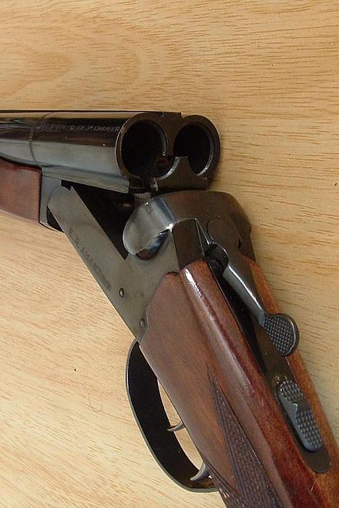
BREAK ACTION

Slide 26
ANNEX I
 | Essential component
1 | Barrel
2 | Breech block, bolt head
3 | Cylinder
4 | Slide
5 | Frame (pistols)
6 | Automatic system
7 | Action
8 | Magazine ( where applicable)
9 | Muzzle loading
10 | Sound Moderator
TABLE II
TYPES OF OPERATIONS

Slide 27
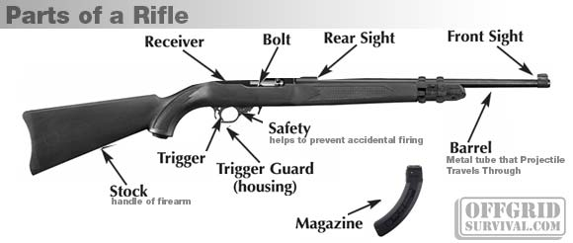
PARTS RIFLE

Slide 28
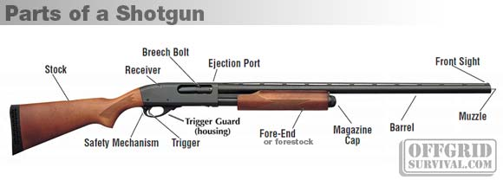
PARTS OF A SHOTGUN

Slide 29
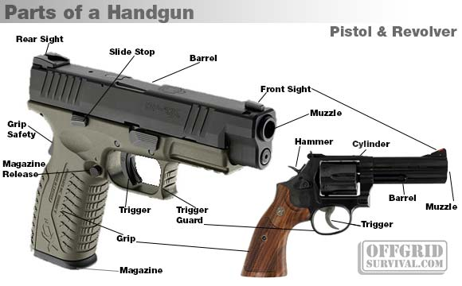
PARTS OF A HANDGUN

Slide 30
ANNEX II
EU 1) aa 2) bb 3) cc 4)
EX: EU FR bb 17
Deactivation mark
Country of deactivation — official international code
Symbol of the entity that certified the deactivation of the firearm
Deactivation year
The full mark will be affixed only on the frame of the firearm, while the deactivation mark (1) and the country of deactivation (2) will be affixed on all other essential components
MARKING OF DEACTIVATED FIREARMS

Slide 31
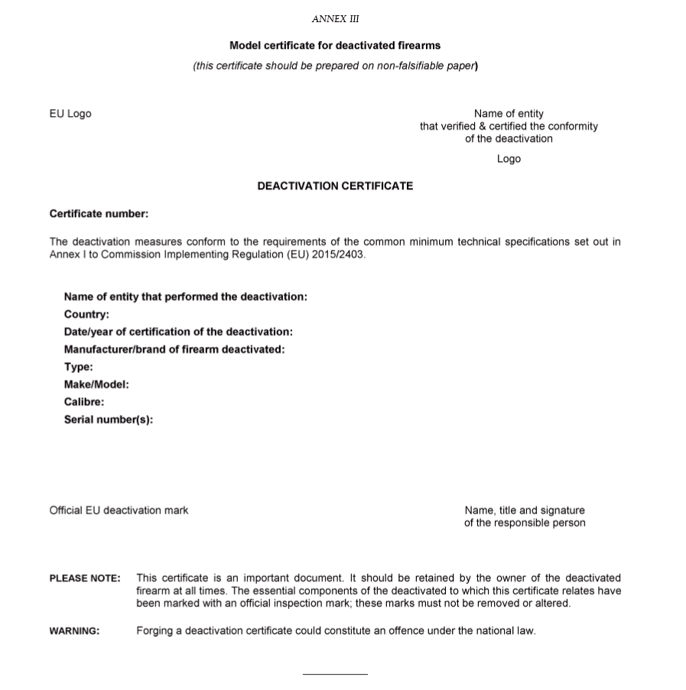
ANNEX IIi
MODEL CERTIFICATE

Slide 32
What about already deactivated weapons?
The implementing acts referred to in paragraph 2 shall not apply to firearms deactivated prior to the date of application of those implementing acts unless those firearms are transferred to another Member State or placed on the market subsequent to that date.
4. Member States may notify to the Commission within 2 months after 13 June 2017 their national deactivation standards and techniques applied before 8 April 2016, justifying the reasons for which the level of security ensured by those national deactivation standards and techniques is equivalent to that ensured by the technical specifications for deactivation of firearms set out in Annex I to Commission Implementing Regulation (EU) 2015/2403 (*4) as applicable on 8 April 2016.
5. When Member States notify the Commission in accordance with paragraph 4 of this Article, the Commission shall, at the latest 12 months after notification, adopt implementing acts deciding whether the national deactivation standards and techniques thus notified ensured that firearms were deactivated with a level of security equivalent to that ensured by the technical specifications for deactivation of firearms set out in Annex I to Implementing Regulation (EU) 2015/2403 as applicable on 8 April 2016. Those implementing acts shall be adopted in accordance with the examination procedure referred to in Article 13b(2).
6. Until the date of application of the implementing acts referred to in paragraph 5, any firearm deactivated in accordance with the national deactivation standards and techniques applied before 8 April 2016 shall, when transferred to another Member State or placed on the market, comply with the technical specifications for deactivation of firearms set out in Annex I to Implementing Regulation (EU) 2015/2403.
7. Firearms deactivated before 8 April 2016 in accordance with the national deactivation standards and techniques that have been found to ensure a level of security equivalent to that ensured by the technical specifications for deactivation of firearms set out in Annex I to Implementing Regulation (EU) 2015/2403 as applicable on 8 April 2016 shall be considered to be deactivated firearms, including when they are transferred to another Member State or placed on the market after the date of application of the implementing acts referred to in paragraph 5.

Slide 33


