Slide 1

The Ministry of Internal Affairs of the Republic of Belarus
Counteraction
illicit trafficking
of Small Arms in Belarus

Slide 2
Normative and legal regulation of the turnover of firearms in Belarus
The main legal acts regulating the trafficking of firearms and ammunition in Belarus:
1) The Law "On Arms";
2) Decree of the President of Belarus №473 «On regulating the turnover of combat, service, civilian weapons and ammunition to it on the territory of Belarus ";
3) The UN Protocol "Against the Illicit Manufacturing of and Trafficking in Firearms, Their Parts and Components and Ammunition, supplementing the UN Convention against Transnational Organized Crime" (Belarus acceded to the Protocol in 2004).

Slide 3
Normative and legal regulation of the turnover of firearms in Belarus
Individuals are not allowed
to own combat and service weapons, except for the award.
Individuals are allowed to own only civilian weapons
(sports, hunting, signal, gas).

Slide 4
Regulation of the turnover of firearms in Belarus
Control over the circulation of arms and ammunition is carried out by the police.
Permission to purchase, store and carry weapons and ammunition is issued by the police.
Licenses for the production, repair and sale of weapons by legal entities are issued by the police.

Slide 5
Criminal responsibility for the illicit trafficking of firearms in Belarus
Article 295 of the Criminal Code:
Illegal manufacture, acquisition, sale, storage, transportation, carrying of firearms, their parts or components, and ammunition - is punishable by imprisonment for up to seven years with confiscation of property.
A person who voluntarily surrendered firearms, their parts and components and ammunition - exempt from criminal liability, except in cases of sales.

Slide 6
Criminal responsibility for the illicit trafficking of firearms in Belarus
Article 294 of the Criminal Code:
Theft of firearms, their parts or components, and ammunition - is punishable by imprisonment for up to seven years with confiscation of property.
Article 298 of the Criminal Code:
Improper performance of duties by a person who was entrusted with the protection of firearms, ammunition, which entailed their theft or the onset of grave consequences, is punished with imprisonment for up to three years.

Slide 7
Regulation of the turnover of firearms in Belarus
All firearms in Belarus have a marking - allowing to determine the country where the weapon was manufactured, its manufacturer and the individual number of the weapon unit.
Information on service and civilian weapons and ammunition authorized for circulation in Belarus is entered into the State Cadastre of Service and Civil Weapons and Ammunition.

Slide 8
Criminal responsibility for the illicit trafficking of firearms in Belarus
Article 295-2 of the Criminal Code:
Forgery or willful destruction of the marking of firearms is punishable by imprisonment for up to two years.

Slide 9
Illicit trafficking of Small Arms in 2016
In 2016 on the territory of Belarus
law enforcement agencies from illegal trafficking seized 1 165 units of unregistered firearms, of which 119 units of rifled long-barreled Small Arms and 40 units of rifled short-barreled Small Arms, and more
63 000 ammunition of various calibers.

Slide 10
Illicit trafficking of Small Arms in 2016
In 2016, Belarusian citizens voluntarily surrendered to the police 1 005 units unregistered firearms, of which 72 units of rifled long-barreled Small Arms and
31 units of rifled short-barreled Small Arms, and more 81 000 ammunition of various calibers.

Slide 11
Illicit trafficking of Small Arms in 2016
In 2016, 661 criminal cases are opened in Belarus
for illegal actions against firearms and ammunition.
(Article 295 of the Criminal Code)

Slide 12
Action «Arsenal»
In order to take additional measures
on combating the illicit trafficking in firearms and ammunition In Belarus on the territory of the whole country the police annually conducts operatively-preventive action "Arsenal", directed on activization of voluntary delivery, and also withdrawal
the population of illegally stored firearms and ammunition.

Slide 13
Action «Arsenal»
In 2017 the action "Arsenal"
was held from 2 to 6 October.
As a result of this, 210 units of unregistered weapons, more than 9 000 munitions of various calibres and 26,6 kg of explosives were withdrawn from circulation.
Citizens voluntarily surrendered to the police
455 units of unregistered weapons and almost
15 000 ammunition.
32 illegal actions were registered with respect to weapons, ammunition, explosives.
(article 295 of the Criminal Code)

Slide 14
Illicit trafficking of Small Arms in 2017
During the ten months of 2017, Belarusian law enforcement agencies seized 1 150 unregistered firearms from illegal trafficking, 107 of which were rifled long-barreled Small Arms and 48 rifled
short-barreled Small Arms, and more
63 000 ammunition of various calibers.

Slide 15
Illicit trafficking of Small Arms in 2017
During the ten months of 2017, Belarusian citizens voluntarily surrendered to the police 1 298 unregistered firearms to the police,
96 of which are rifled long-barreled Small Arms and 25 rifled short-barreled Small Arms, and almost 59 000 ammunition of various calibers.

Slide 16
Illicit trafficking of Small Arms in 2017
During the ten months of 2017
537 criminal cases were instituted in Belarus against persons involved in unlawful actions with firearms and ammunition.
(article 295 of the Criminal Code)

Slide 17

The international cooperation
In April 2017 in Belarus with the participation of foreign police conducted a special international operation to prevent and
combat illicit trafficking in firearms "Trigger 2"

Slide 18
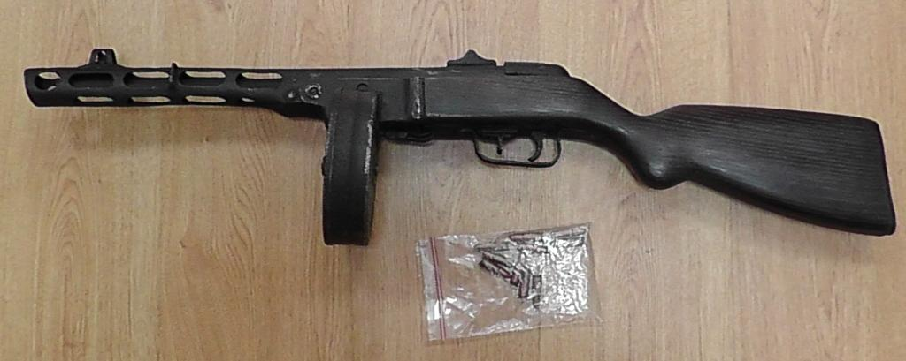
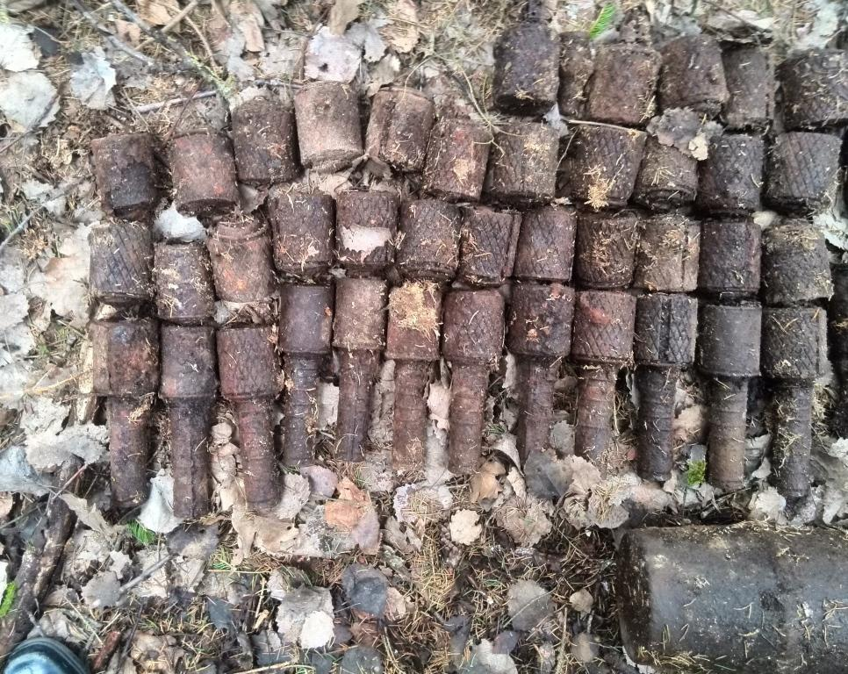
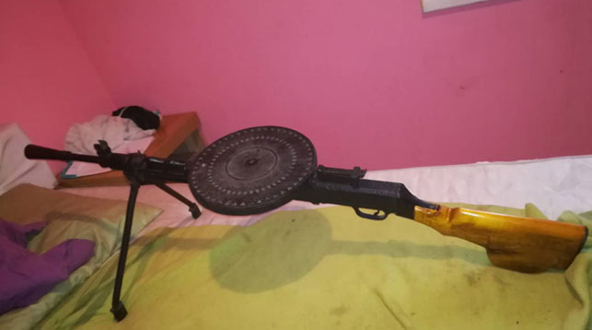
Counteraction to the activities of "Illegal Archaeologists"

Slide 19
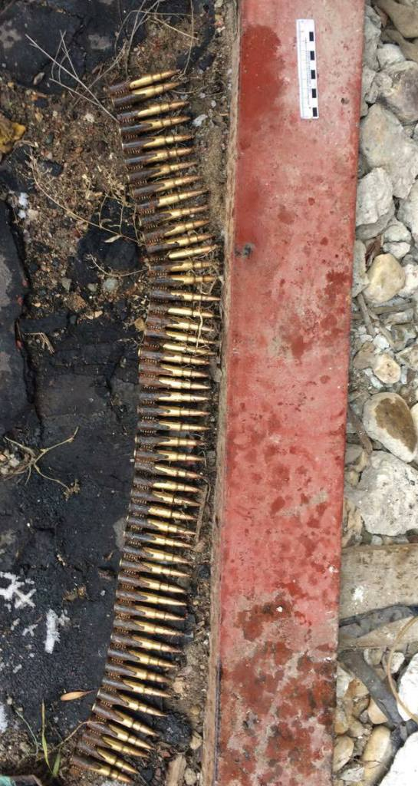
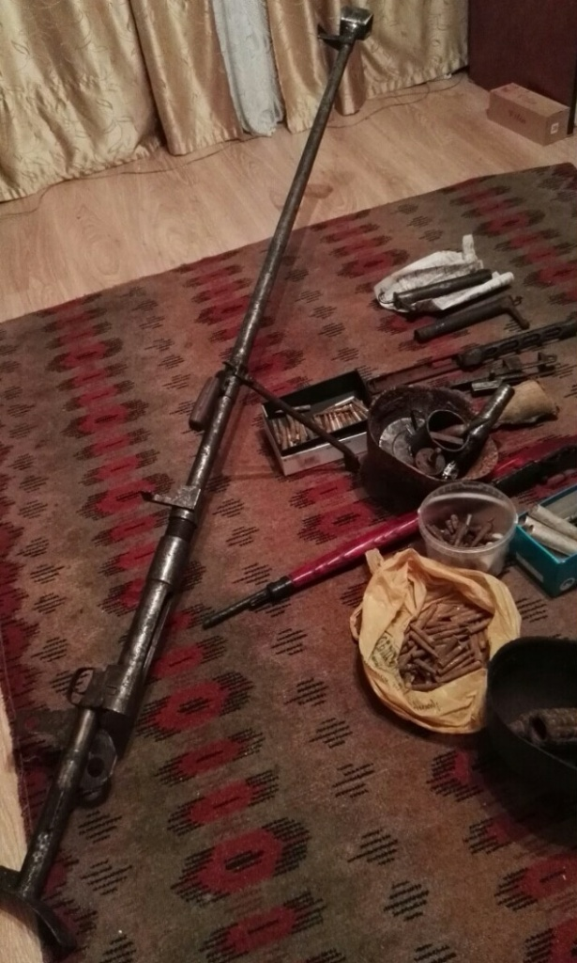
Counteraction to the activities of "Illegal Archaeologists"

Slide 20
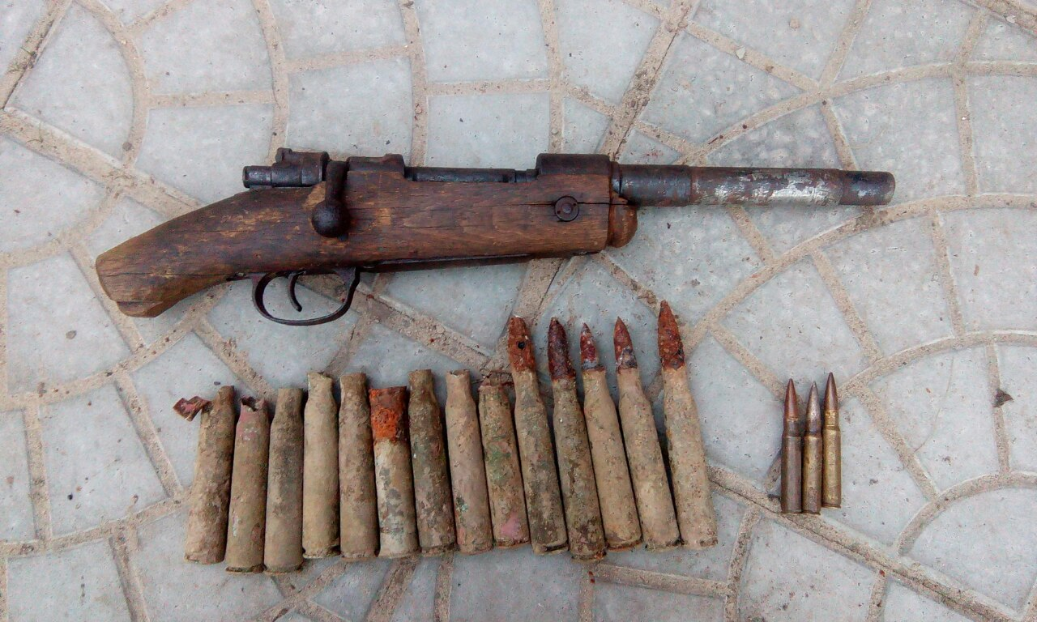
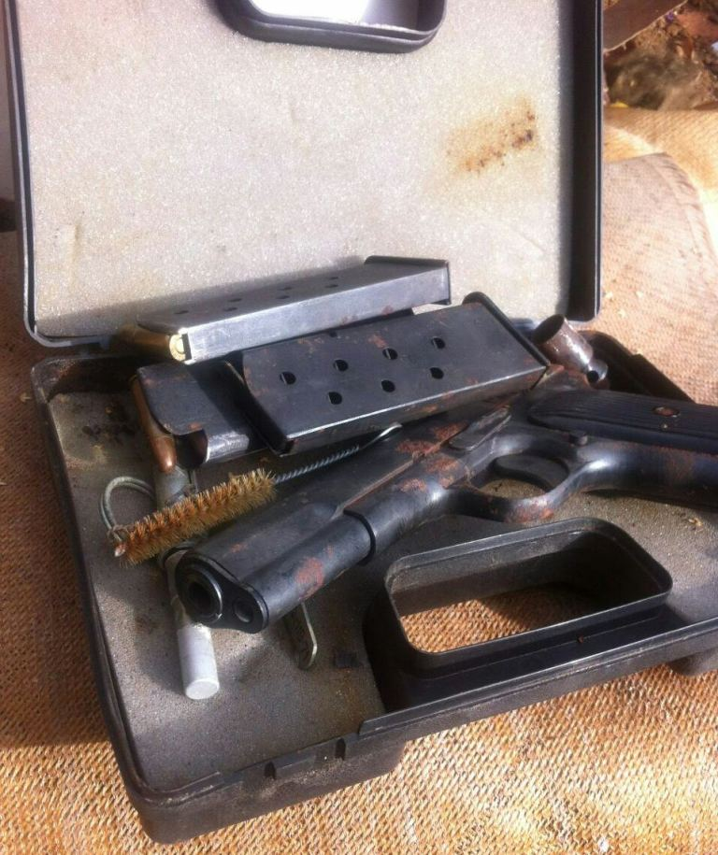
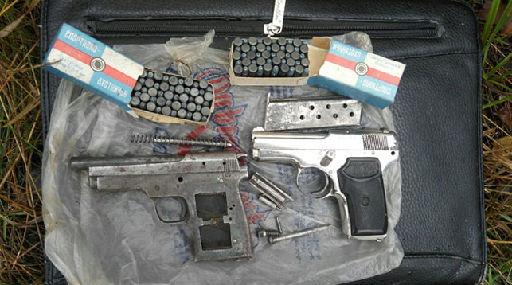
Counteraction to the activities of "Illegal Archaeologists"

Slide 21
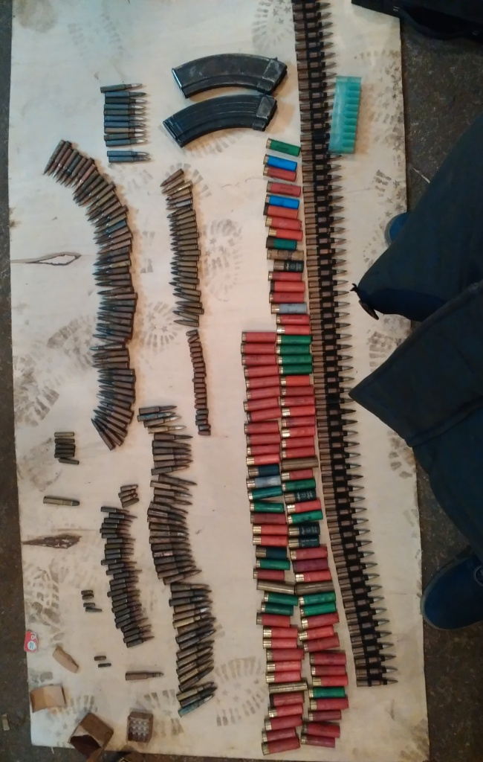
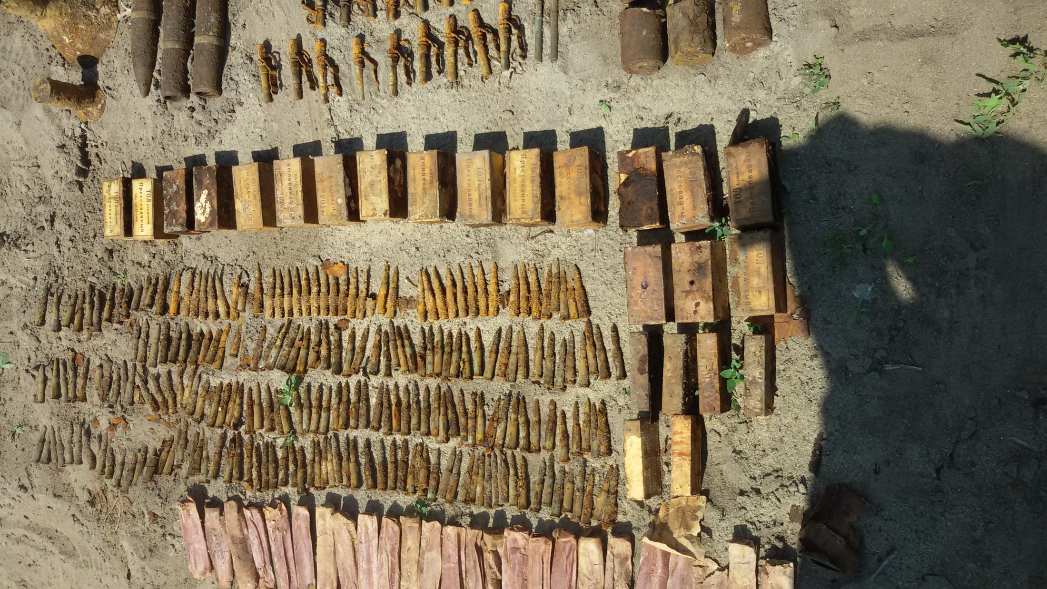
Counteraction to the activities of "Illegal Archaeologists"

Slide 22
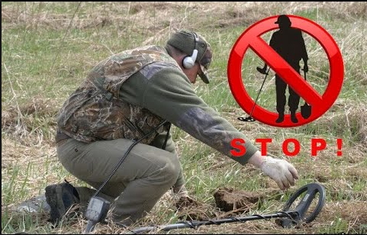
Legislative measures to counteract the activities of
"Illegal Archaeologists"
Administrative responsibility for the illegal search for archaeological artifacts is a fine equivalent
to 570 Euros with the confiscation
of artifacts and tools for committing an offense.
(Article 19.8 of the Code of Administrative Offenses)

Slide 23
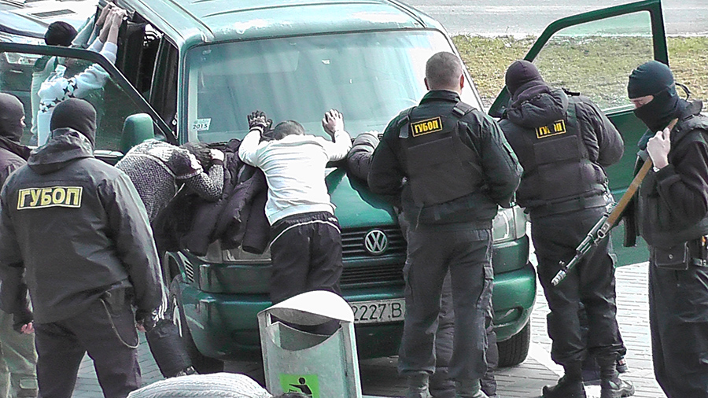
The special operation to arrest
"Illegal Archaeologists"

