Slide 1

The Ministry of Internal Affairs of the Republic of Belarus
Counteracting the illicit trafficking
of Small Arms in the Republic of Belarus

Slide 2
Criminal responsibility for the illicit trafficking of firearms in Belarus
Article 295 of the Criminal Code:
Illegal manufacture, acquisition, sale, storage, transportation, carrying of firearms, their parts or components, and ammunition - is punishable by imprisonment for up to seven years with confiscation of property.
A person who voluntarily surrendered firearms, their parts and components and ammunition - exempt from criminal liability, except in cases
of sales.

Slide 3
Illicit trafficking of Small Arms in 2016
In 2016 on the territory of Belarus law enforcement agencies from illegal trafficking seized 1 165 units of unregistered firearms, of which
119 units of rifled long-barreled Small Arms and 40 units of rifled
short-barreled Small Arms, as well as more than 63 000 ammunition
of various calibers.

Slide 4
Illicit trafficking of Small Arms in 2016
In 2016, Belarusian citizens voluntarily surrendered to the police
1 005 unregistered firearms, of which 72 units of rifled long-barreled Small Arms and 31 units of rifled
short-barreled Small Arms, as well as more than 81 000 ammunition
of various calibers.

Slide 5
Illicit trafficking of Small Arms in 2016
In 2016, 661 criminal cases are opened in Belarus
for illegal actions against firearms and ammunition.
(Article 295 of the Criminal Code)

Slide 6
The SCO «Arsenal»
In order to counter illegal trafficking in firearms and ammunition,
a special complex operation «Arsenal» is carried out every year in Belarus, aimed at activating voluntary surrender, as well as taking illegal firearms and ammunition from citizens.

Slide 7
Illicit trafficking of Small Arms in 2017
During the four months of 2017, Belarusian law enforcement agencies seized 563 unregistered firearms from illegal trafficking, 40 of which were rifled long-barreled Small Arms and 17 rifled
short-barreled Small Arms, as well as over 18 000 ammunition of various calibers.

Slide 8
Illicit trafficking of Small Arms in 2017
During the four months of 2017, Belarusian citizens voluntarily surrendered 656 unregistered firearms to the police, 39 of which are rifled long-barreled Small Arms and 11 rifled short-barreled Small Arms, as well as more than 35 000 ammunition
of various calibers.

Slide 9

The international cooperation
In April 2017 in Belarus with the participation of foreign police conducted a special international operation to prevent and
combat illicit trafficking in firearms "Trigger 2"

Slide 10
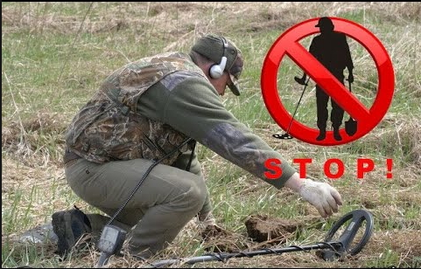
Legislative measures to counteract the activities
of "Illegal Archaeologists"
Administrative responsibility for the illegal search for archaeological artifacts is
a fine equivalent to 570 Euros with the confiscation of artifacts and tools for committing an offense.
(Article 19.8 of the Code of Administrative Offenses)

Slide 11
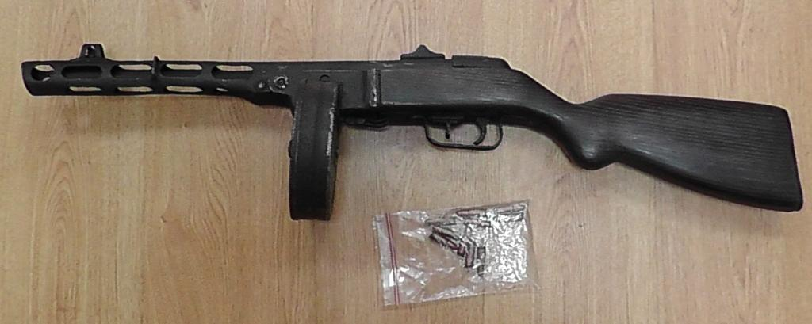
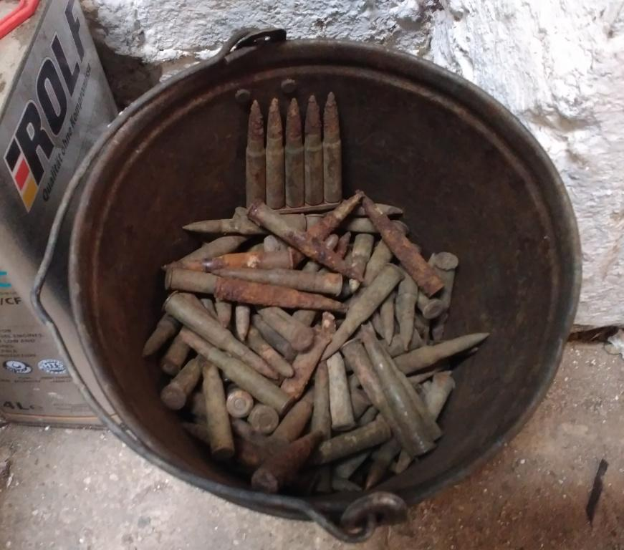
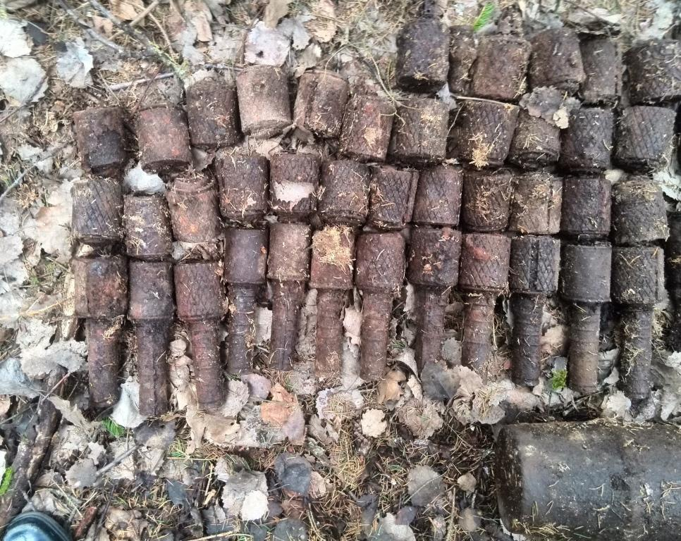
Counteraction to the activities of "Illegal Archaeologists"

Slide 12
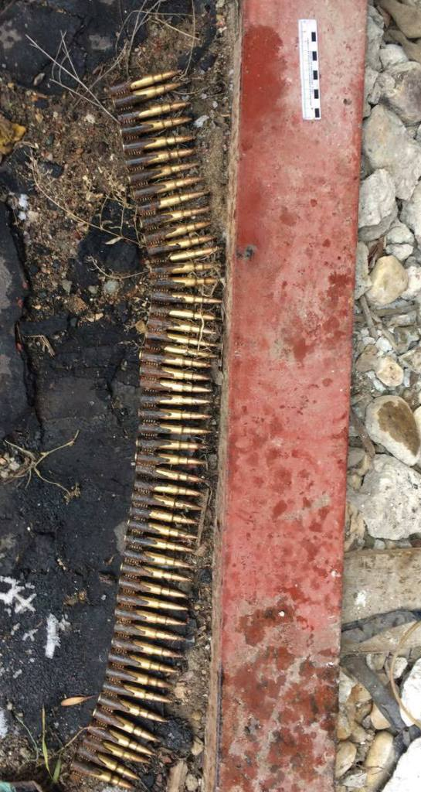
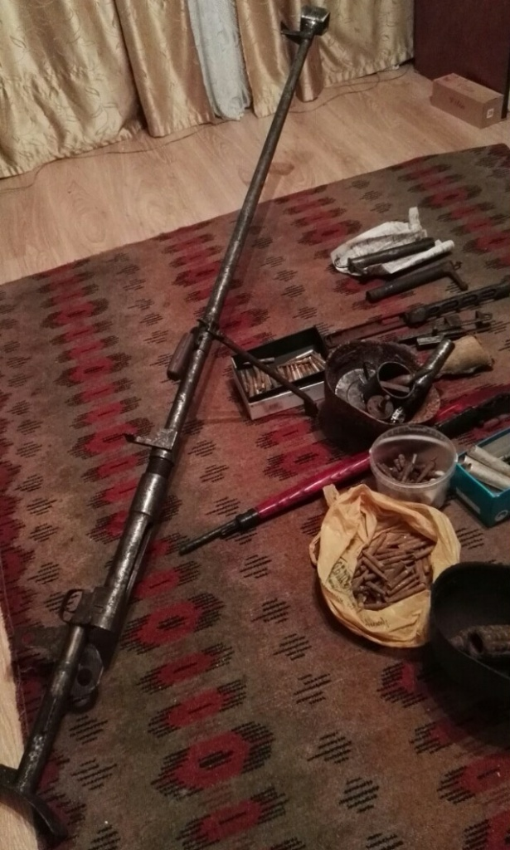
Counteraction to the activities of "Illegal Archaeologists"

Slide 13
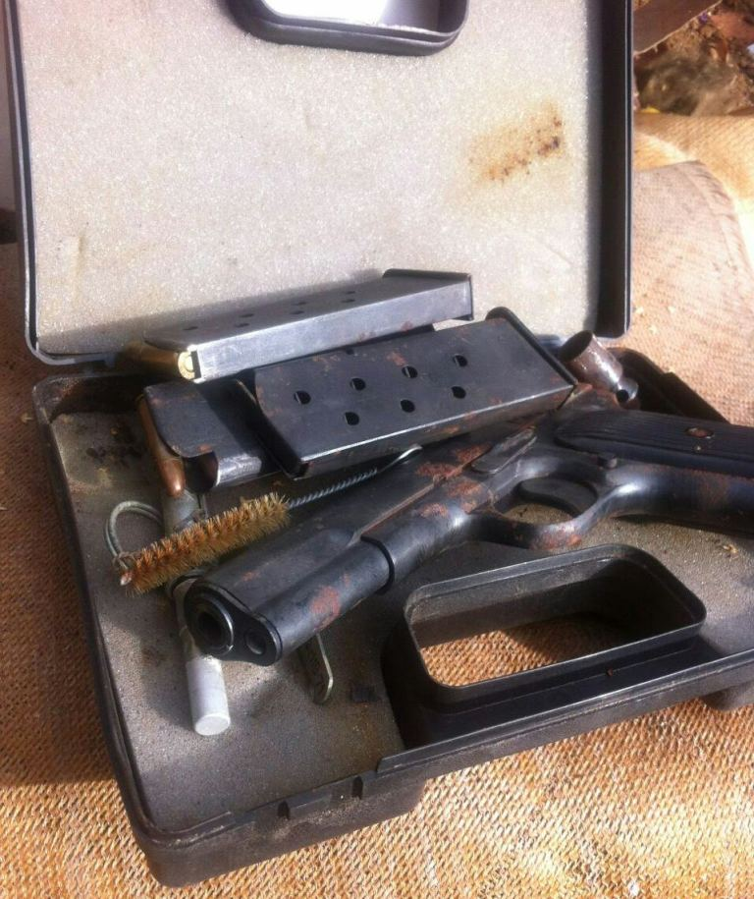
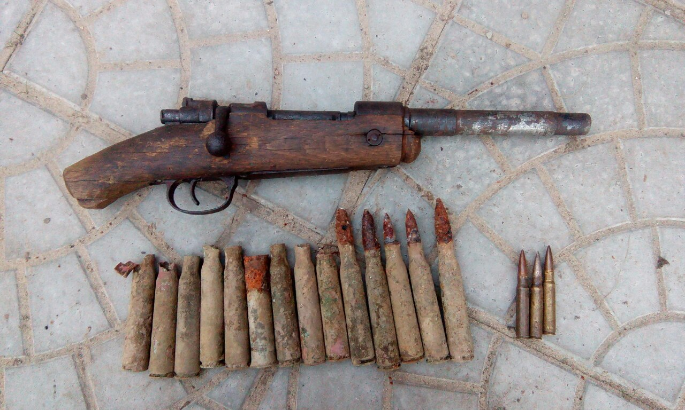
Counteraction to the activities of "Illegal Archaeologists"

Slide 14
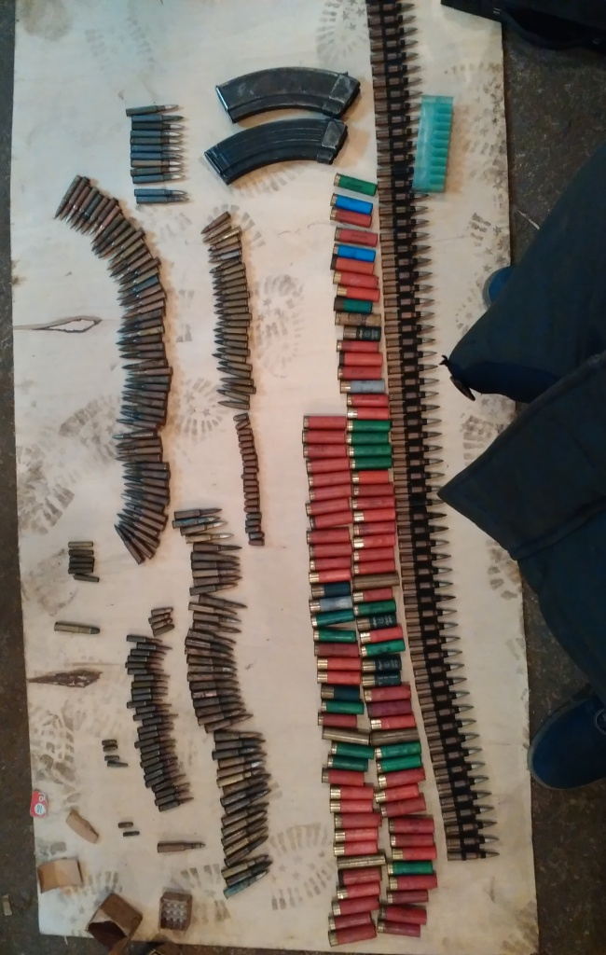
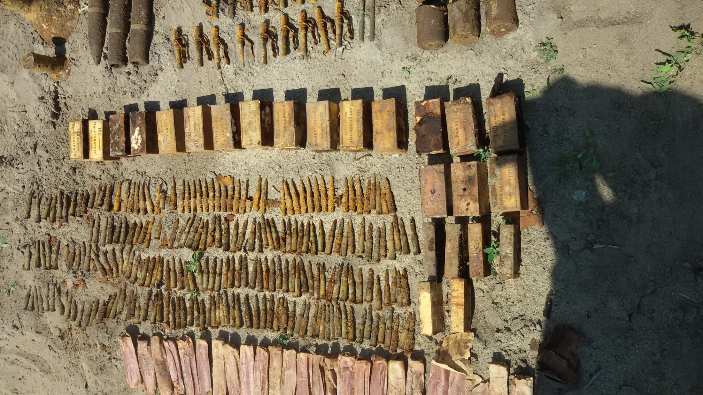
Counteraction to the activities of "Illegal Archaeologists"

Slide 15
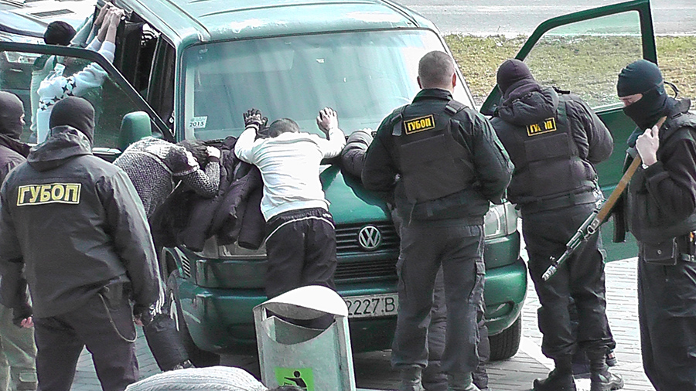
The special operation to arrest
"Illegal Archaeologists"

