Slide 1





KOSOVO
FIREARM FOCAL POINT
7th SALW meeting
15-16 may –Jahorina

Slide 2
KOSOVO FIREARM FOCAL POINT
In the line with
EU Security agenda
EU-SEE countries
Action Plan 2015 -2019
Supported by UNDP (FERM) in KOSOVO
A.L

Slide 3

FEASIBILITY STUDY
In order to establish FFP, and a Gun Crime Intelligence Desk (GCID) in Kosovo and to improve the way that ballistic intelligence is gathered, developed, disseminated and used both internally and with regional and international partners
Feasibility study was done ( by Arquebus –UK) and report with recommendations delivered to stakeholders.

Slide 4
Process of establishment of FFP
Consultation and meeting
Kosovo Police - Dep. Of Investigation / OPS / Intelligence
MIA Public Safety Department
KFA Ballistic Division
‘’Agreement’’ ….of stakeholders
The need for the establishment of FFP
The FFP creation is in line with ILP
Where should be placed FFP
The exchange of information

Slide 5
DECISION
The General Director of Police decided to establish the
Firearms Focal Point within ILECU
The firearms focal point will through its intelligence products also be able to assist other institutions, and partners locally and internationally.

Slide 6
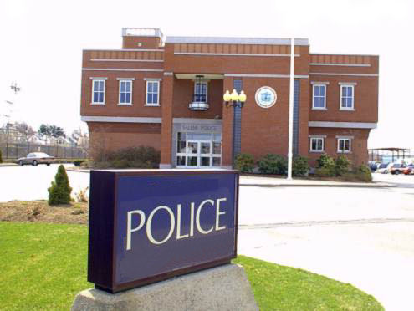



FFP
DIRECTORATE FOR INTERNATIONAL COOPERATION - ILECU
Investigator s
OPS
National Focal Point for Tracing
DIA
ILECU
FFP
MIA
LEGAL WEAPON
WB / EU Countries Bilateral
FORENSIC LAB
NCBM
SEEFEN
STATE PROSECUTORS
SEEFEG

Slide 7

AIM
Reaction
Intelligence collection analysis and sharing
Prevention

Slide 8
VISION
To provide an integrated tactical and strategic intelligence service that informs and supports Kosovo Police and its partners to better understand and effectively tackle firearms crime, minimizing the risk locally and internationally

Slide 9
KEY FUNCTIONS AND OUTPUTS
Collation and integration of a comprehensive, up-to-date intelligence dataset on firearms and ballistics intelligence
Strategic intelligence assessments describing the scale and nature of firearms-related criminality in Kosovo
Intelligence packages for investigations and operations targeting firearms criminals
Provision of an international firearms tracing service
A point of contact and center of expertise on firearms for national and international stakeholders and partners

Slide 10
KEY ACTIVITIES
Researching recovered ballistics items
Researching firearm-enabled crime
Researching firearms and their origins
Building knowledge and understanding of firearms crime
Firearms Intelligence co-ordination and exchange of information's

Slide 11
Implementation
ILP
Guidance to KP, other agencies and for the SALW strategies …
1. Collect data or have direct access to that data
2. Analyse data and produce intelligence products
3. Exchange information

Slide 12
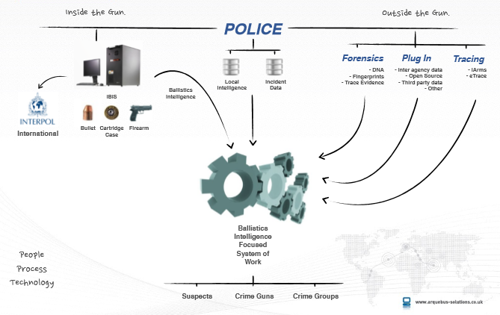
FFP WORK FLOW

Slide 13
FFP INFRASTRUCTURE
FFP
Kosovo Police Information System
Ballistic Intelligence
(Forensics)
Legal Possession/MIA
Import/Export/Transit
Dep. Investigations
Directorate Intelligence Analysis
Tracing
Evidence Rooms
NCBM
Customs
Prosecutors

Slide 14
FFP - PROCESS OF HANDLING OF INFORMATION
QUALITY CHECK
FEEDBACK
FFP
Intelligence Product
DIA
Quality check
Handling Information
INV/OPS
Investigations
Operations

Slide 15
FFP PRODUCTS
Subject profile
Threat/Risk Assessment
Quarterly Reporting
Intelligence Package
Problem Profile

Slide 16
KOSOVO FIREARM FOCAL POINT
ADVANTAGES
Kosovo Police had a Intelligence led policing model in place;
Vision of Kosovo Police is to become more proactive.
Kosovo has one of the most advanced Forensic laboratories in the region
Interoperability of databases – automatic exchange of data's
I base in use before by KP -DIA – and helped us.
Strong support from higher management , and by UNDP FERM
DISADVANTAGES
Data registered in three agencies – diff. managements
Procurement procedures in maintaining their databases
New staff in ILECU – not trained in this regards
No direct access to Interpol I-arms, and to Europol
BUT WE MANAGED

Slide 17
FURTHER NEEDS
Increasing the Capacity
Advanced and specialized training
Licensing the analyst officers
We hope/wait for SEESAC support

Slide 18
THANK YOU
?
FIREARM

