Slide 1
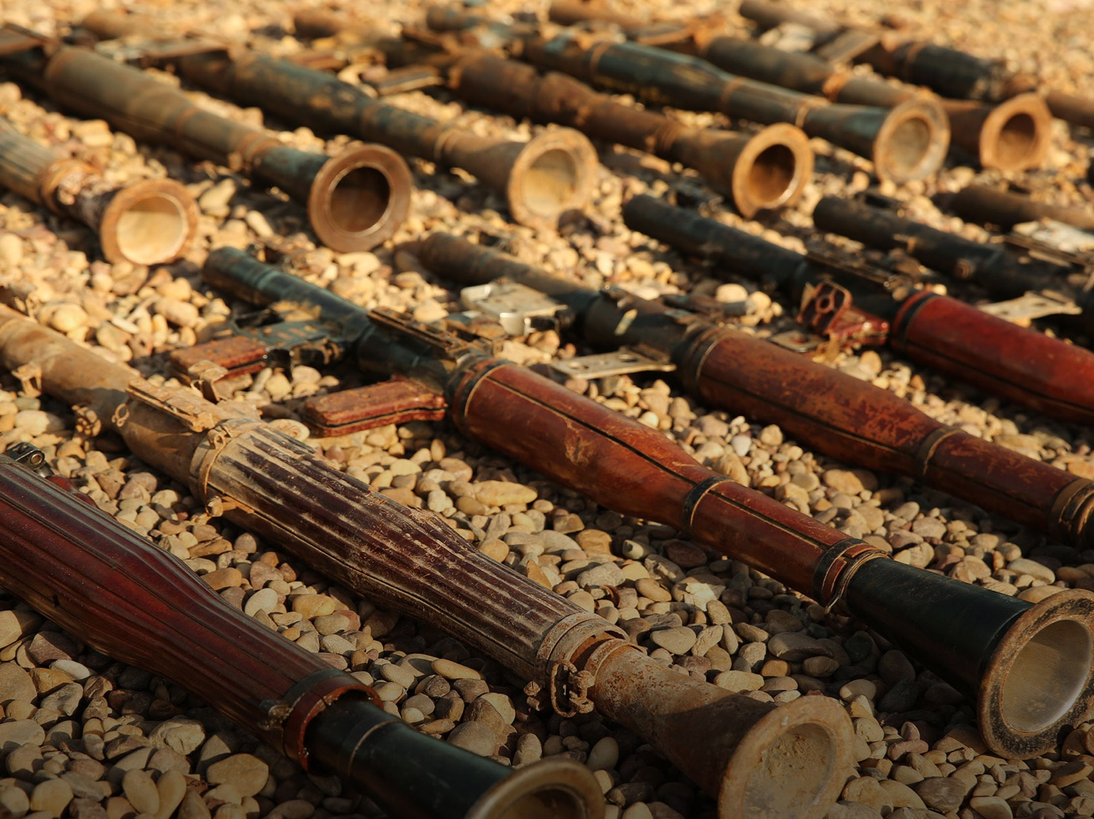



ARMS EXPORTS CONTROL
Addressing Diversion and Tracing Illicit Transfers of Weapons
Dr. Andrea Varisco - Head of Analytics, Conflict Armament Research
Conflict Armament Research (CAR)
presentation to the 11th Regional Meeting of SALW Commissions
Sarajevo,
30 May 2019

Slide 2
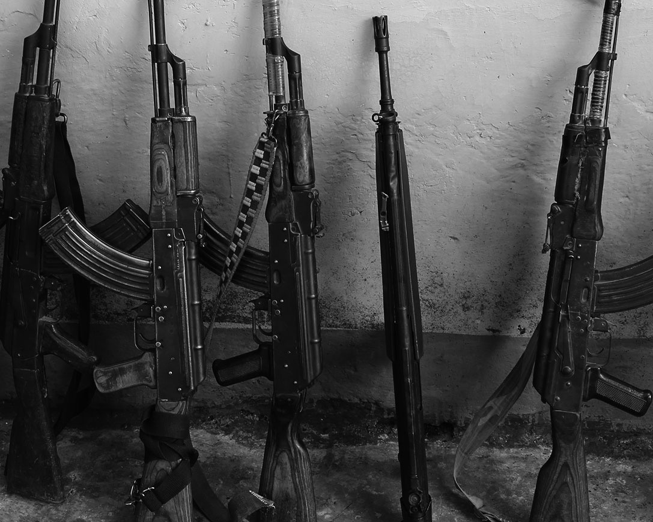
INTRODUCTION TO
CONFLICT ARMAMENT RESEARCH

Slide 3


Conflict Armament Research and iTRACE®
A NEW APPROACH TO CONFLICT WEAPONS
Est. 2011
EU and Germany funding
EU Council Decisions (2013, 2015, 2017)
Document illicit weapons, in situ, across 25+ countries
Supply routes mapped and diversion points identified

Slide 4
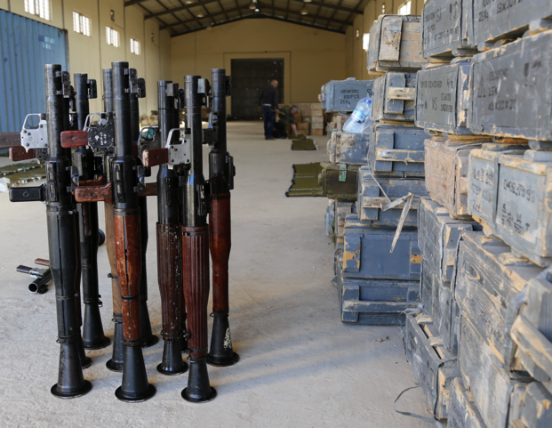
WHAT WE DO
Support defense and security forces.
Document weapons, ammunition, and IED-components.
Identify patterns of supply, and vectors/actors involved in diversion.

Slide 5
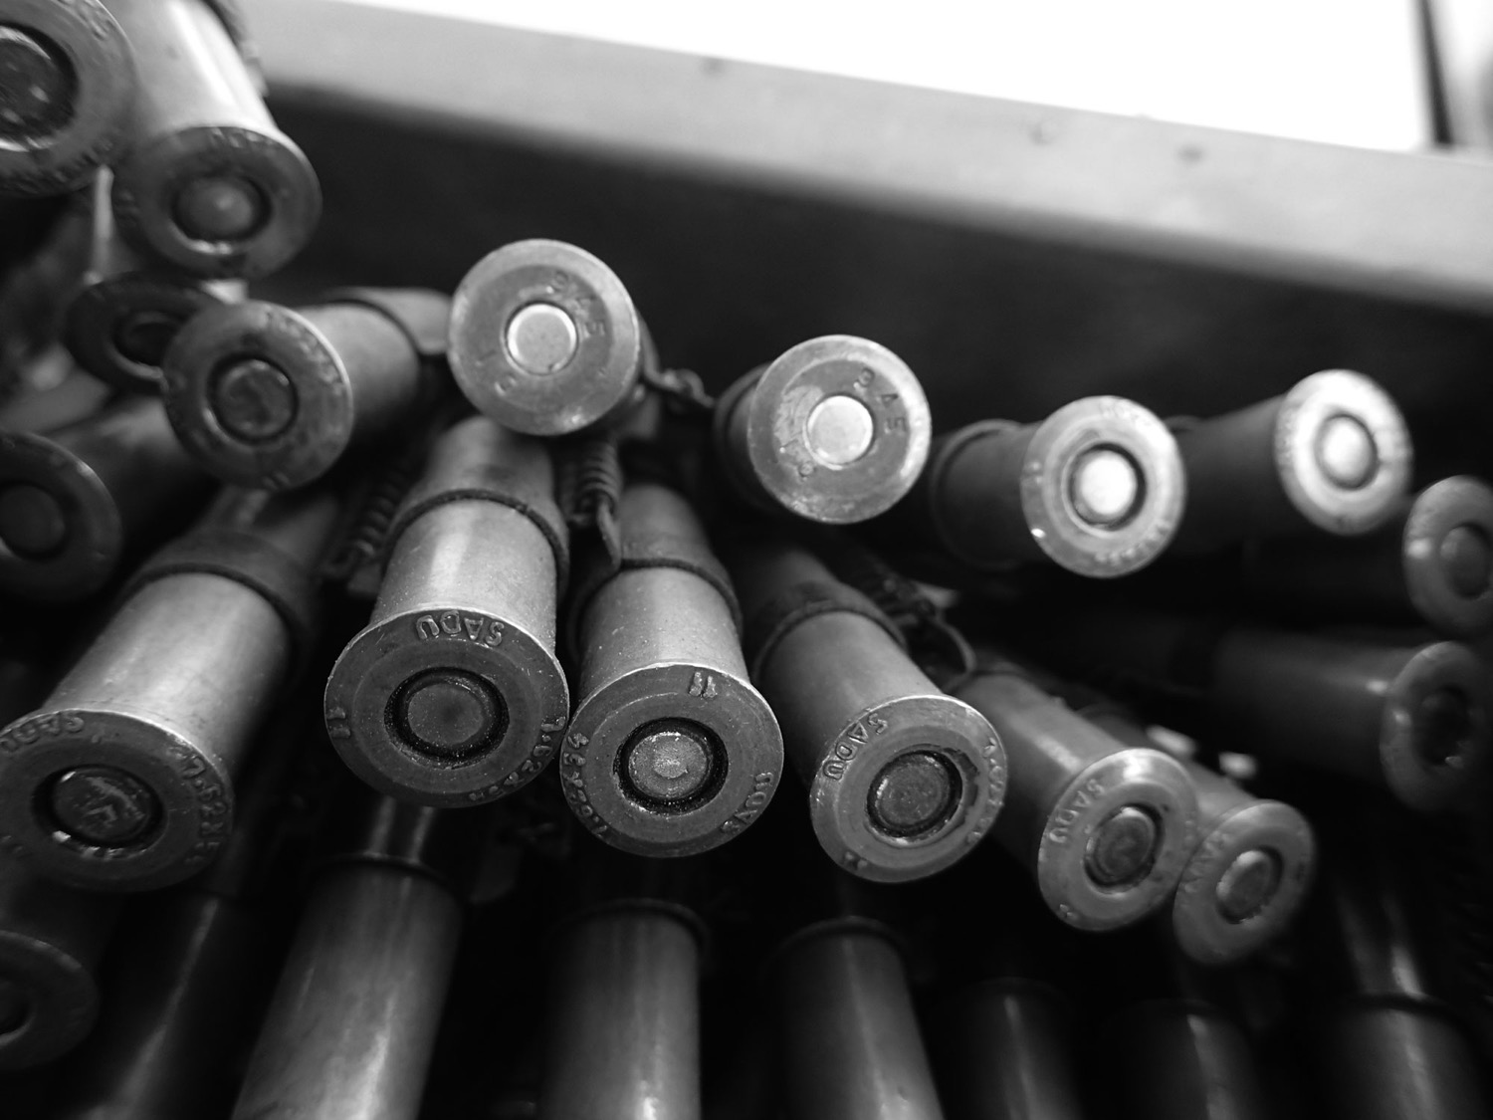
FIELD DOCUMENTATION AND TRACING

Slide 6
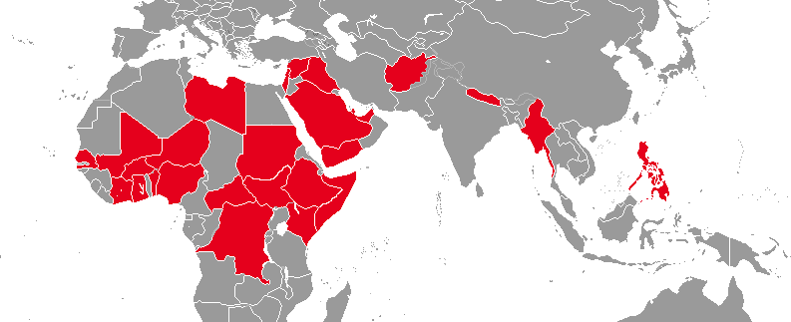
ASSET & CHALLENGE: ACCESS

Slide 7
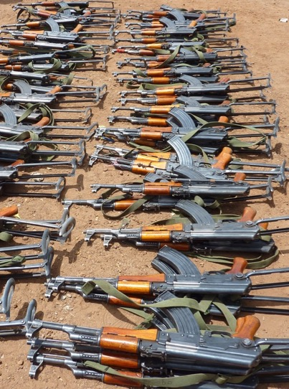
DOCUMENTATION STATISTICS
545,000
Weapons, ammunition and related materiel documented.
60
Countries of manufacture.
450
Manufacturers.
12,000
Cases of diversion documented.

Slide 8
RATIONALE OF TRACING
EU Council Decisions
Determine chain of custody
Understand diversion
Reduce risk of diversion
Identify trends (early warning system)
Accuracy of public information (primary sourcing)

Slide 9
CAR’S TRACING ACTIVITIES SINCE 2014
2,496
Trace requests sent since 2014
970
Responses (39% response rate)
200
Traces led to secondary traces (sent to next recipient in the supply chain)

Slide 10
TRACING CHALLENGES
Missing or destroyed records
State collapse
Reluctance to share sensitive information
Lack of capacity
Split ammunition lots

Slide 11
TRACING SUCCESSES
Parliamentary/attorney general inquiries
International criminal investigations
Changes to commercial sales policy
Changes to export licensing rules
Greater scrutiny of export license applications

Slide 12
ITRACE® AND ANALYSIS

Slide 13
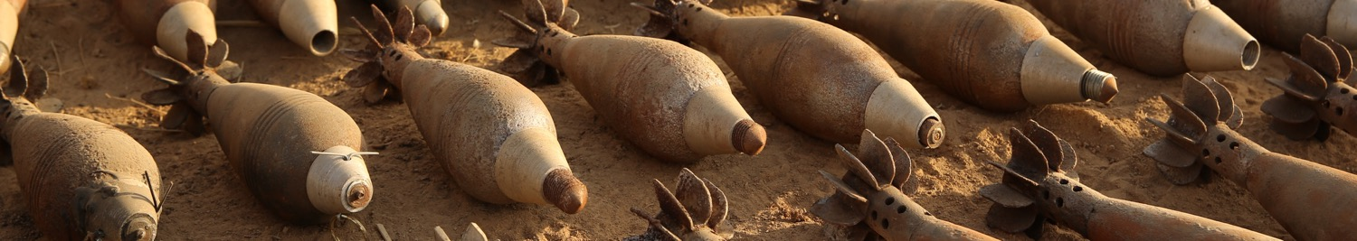
ITRACE®: EUROPEAN UNION MANDATE
“to maintain… an accessible and user-friendly global information-management system on diverted or trafficked SALW and other diverted or trafficked conventional weapons and ammunition in order to provide policymakers, conventional arms control experts and conventional arms export control officers with relevant information to develop effective, evidence-based strategies and projects against the illicit spread of SALW and of other conventional weapons and ammunition”
Council Decisions (CFSP) 2013/698, 2015/1908 & 2017/2283

Slide 14
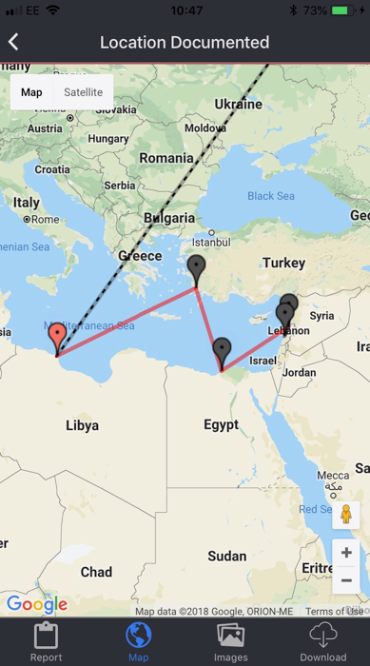
ITRACE®: MAP KEY
Point on route
Point of diversion
–––––– Confirmed direct transfer, legal
– – – – Potential indirect transfer, assumed legal
–––––– Confirmed diversion
– – – – Diverted under unknown circumstances
POINT OF DIVERSION
(WAYPOINT)
SEGMENT
WAYPOINT

Slide 15
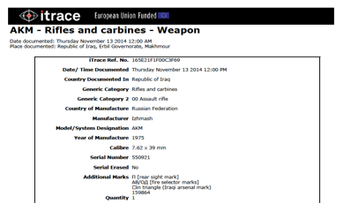
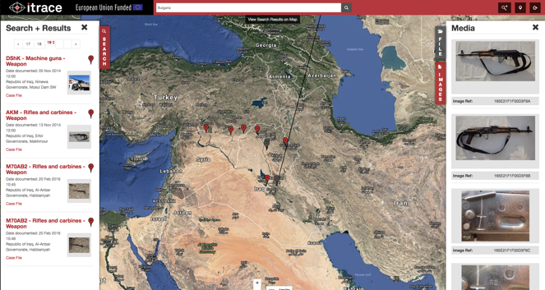
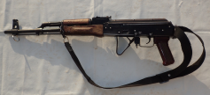
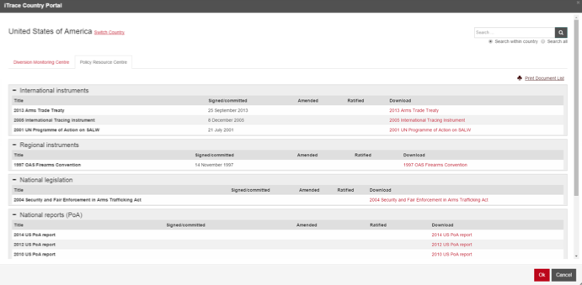
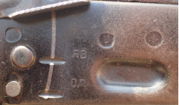
ITRACE®: WHAT IT DOES
Map weapon flows and points of diversion
Identify correlations and trends to assist counter-diversion and anti-trafficking policies
Generate reports on documented items

Slide 16
ANALYSIS
Correlations: same items in other locations or countries
Trends: flows of new materiel entering into a country, recent deliveries
Diversion: understand the different circumstances of diversion > evidence-based policy recommendations
Aggregation: measure the extent of the problem > diversion risk assessments (pre-export)

Slide 17
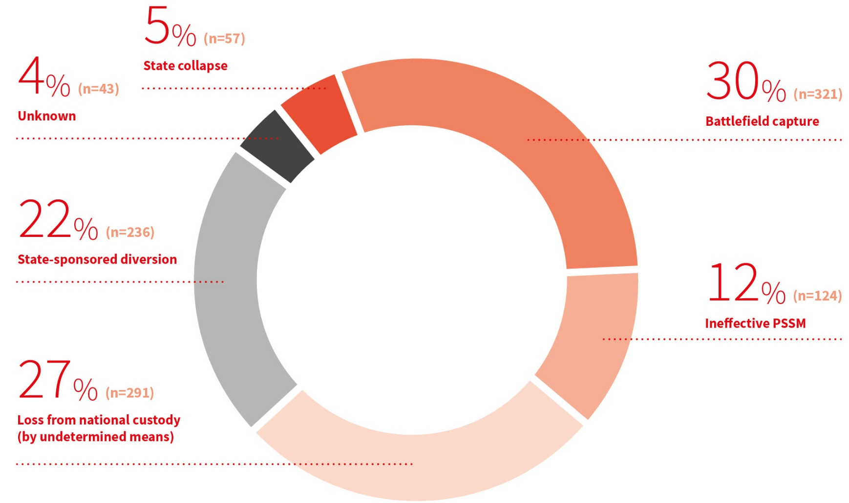
DIVERSION TYPOLOGY

Slide 18
THANK YOU
CAR WEBSITE
www.conflictarm.com
iTRACE WEBSITE
www.itrace.com
EMAIL
admin@conflictarm.com

