Slide 1

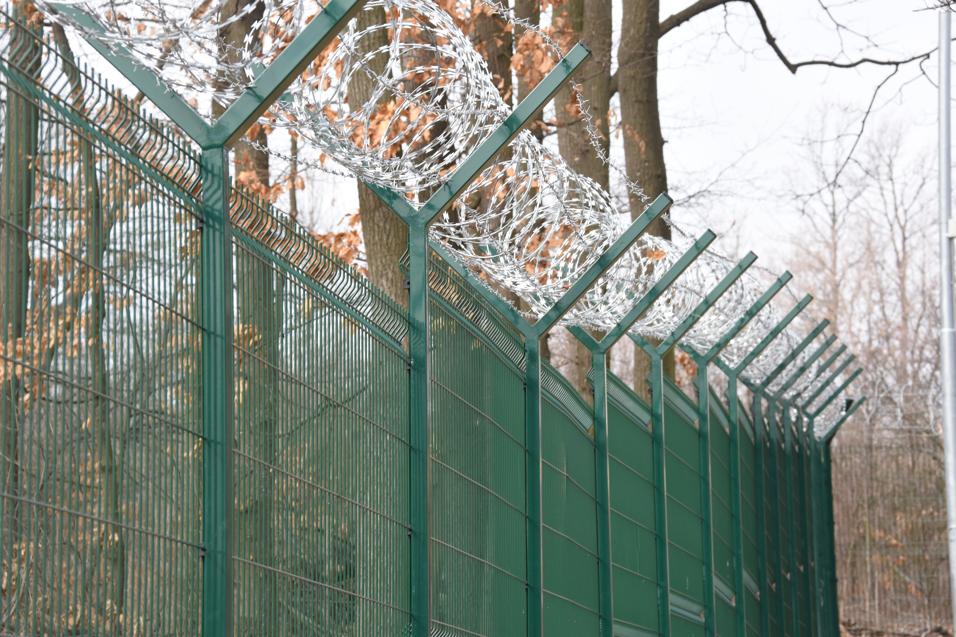
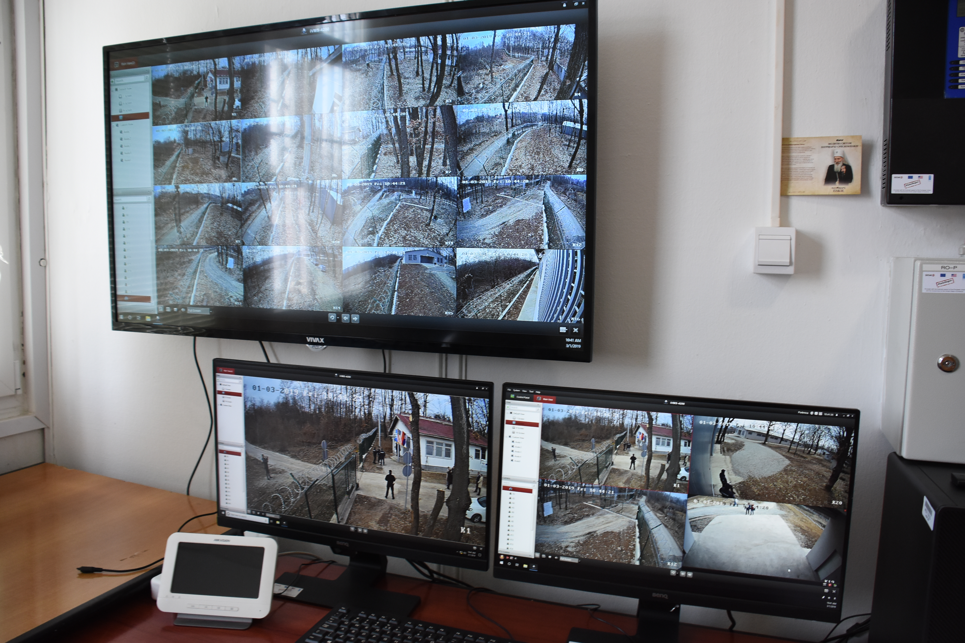
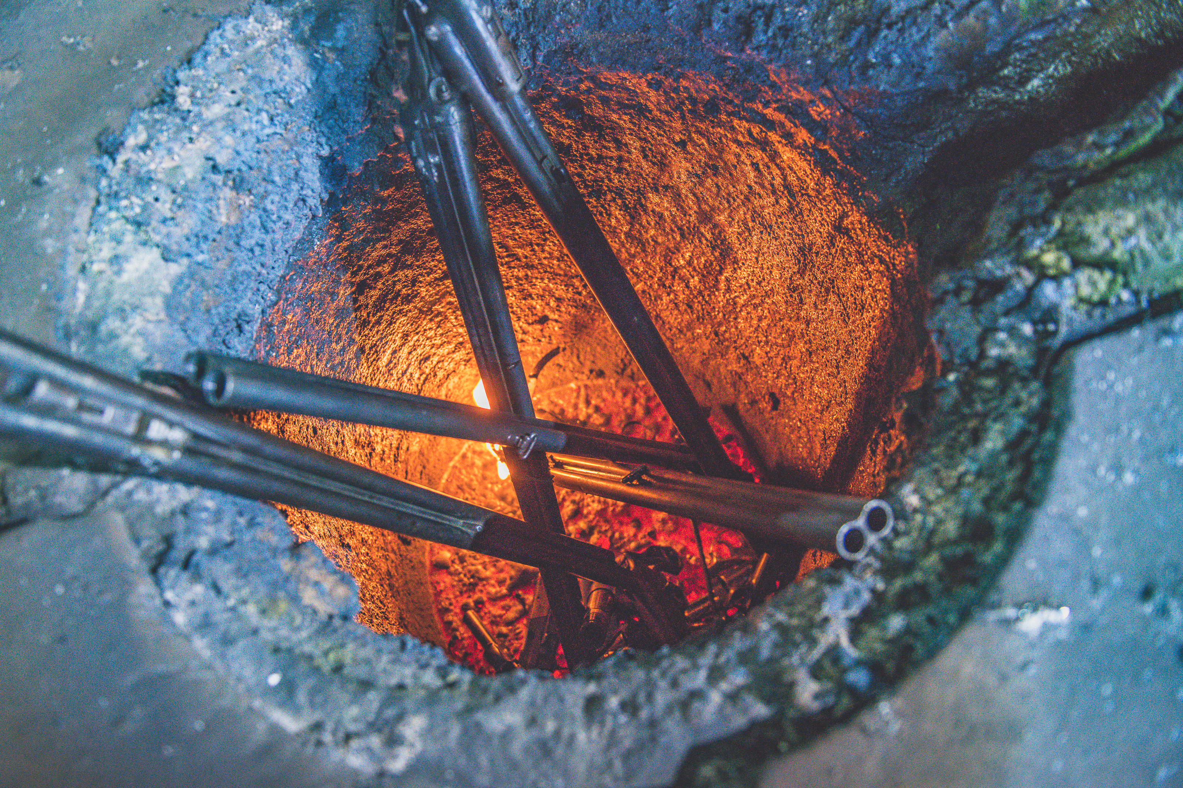
Overview of
SEESAC PSSM Activities
Tamara Svircev
SALW Control Project Officer

Slide 2
Council decision 2016/2356
Improved capacity for PSSM through infrastructure security upgrades, surplus reduction and training:
  Increasing security of stockpiles through cost-effective targeted infrastructure upgrades at police storage facilities in Albania, BiH, the Republic of Moldova, Montenegro, Serbia and Kosovo*. Focus on central police storages and evidence rooms in main police stations.
  Destroying up to 50 000 surplus and confiscated SALW in the region, and up to 500 000 pieces of SALW ammunition.
  Providing capacity development through the training of a regional pool of MoI trainers and support for national training sessions on PSSM based on the SEESAC curricula piloted under Council Decision 2013/730/CFSP.
  *“References to Kosovo shall be understood to be in the context of Security Council resolution 1244 (1999).”
Objective
To reduce the risk of proliferation through the enhancement of weapons and ammunition stockpile security and reducing surplus stocks of SALW and their ammunition in storage

Slide 3
KEY PERFORMANCE INDICATORS AND PROGRESS TO DATE
Security of central storage locations (7) enhanced in accordance with international standards and best practices;
Security of evidence rooms (15) increased;
A total of up to 50,000 pieces of conventional weapons destroyed;
A total of up to 500,000 pieces of ammunition and explosives at risk of proliferation demilitarized and destroyed.
Security of 5 central storage locations enhanced in accordance with international standards: Albania (1), BiH (2), Montenegro (1), and Serbia (1).
Security of 12 evidence rooms increased: Albania (2), BiH (5), Kosovo (1), Montenegro (2), and Serbia (2).
A total of 26,656 pieces of weapons and 7,308 parts and components destroyed;
A total of 445,888 pieces of ammunition at risk of proliferation demilitarized and destroyed.

Slide 4
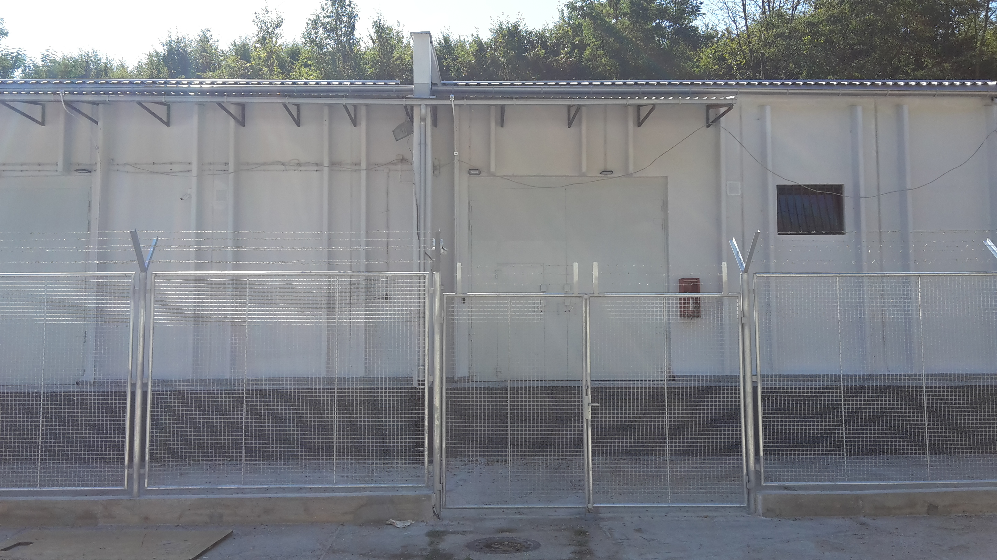
enhancement of weapons and ammunition stockpile security
    Albania
    US Department of State (DoS) supplementary funding for Albania;
    Works at the MoI Mullet SALW and ammunition storage initiated on 21 May;
            Additional funding proposal for Mullet prepared;
            Interventions at MoD (Mirake and Zall-Herr) locations planned for the end of the year pending signing of the Memorandum of Understanding between UNDP Albania and MoD.
KEY MILESTONES
              BiH
              Evidence rooms in BiH (Istočno Sarajevo and Zenica) completed in January;
              Official handover ceremony of all BiH locations took place on 5 and 7 February.

Slide 5
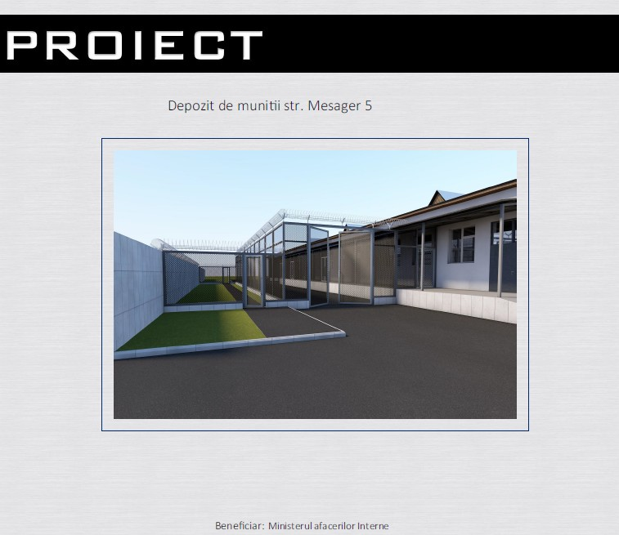
enhancement of weapons and ammunition stockpile security
  Kosovo
  Recruitment of designer for the Gadime storage and Gjakova evidence room upgrade is ongoing;
  The works start is planned for August.
KEY MILESTONES
              Moldova
              Procurement of works for Mesager SALW and ammunition storage and 2 evidence rooms (Cahul and Balti) upgrades is ongoing;
              The works start is planned for the end of June/early July.

Slide 6
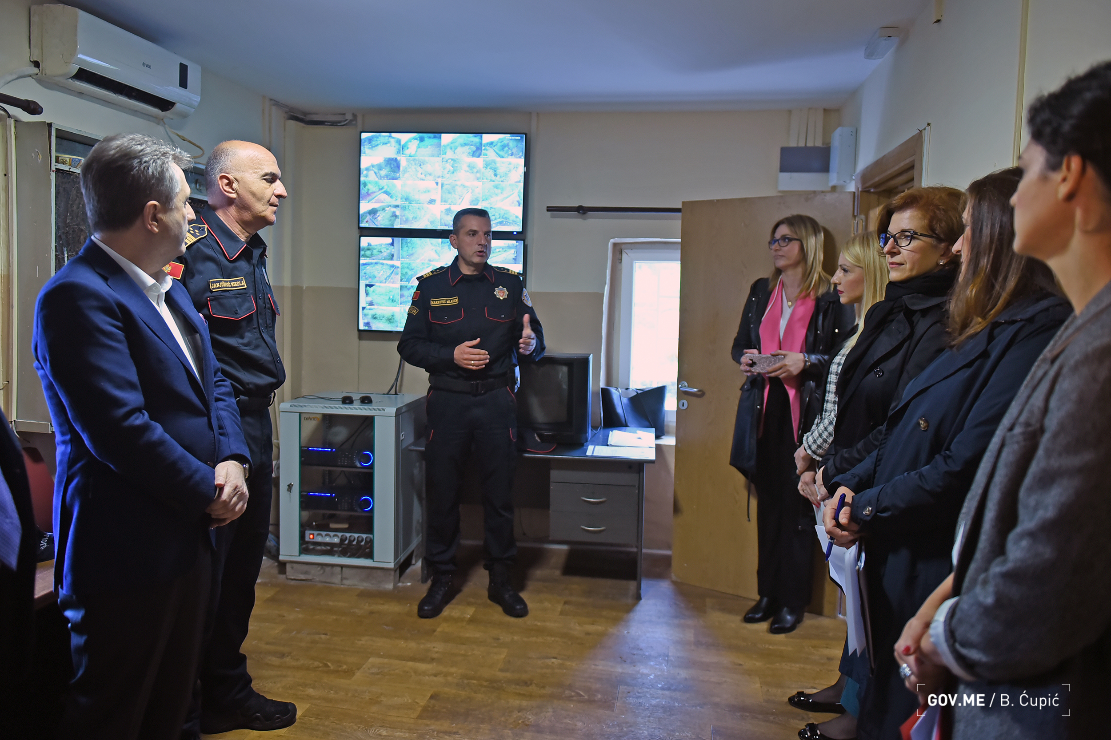
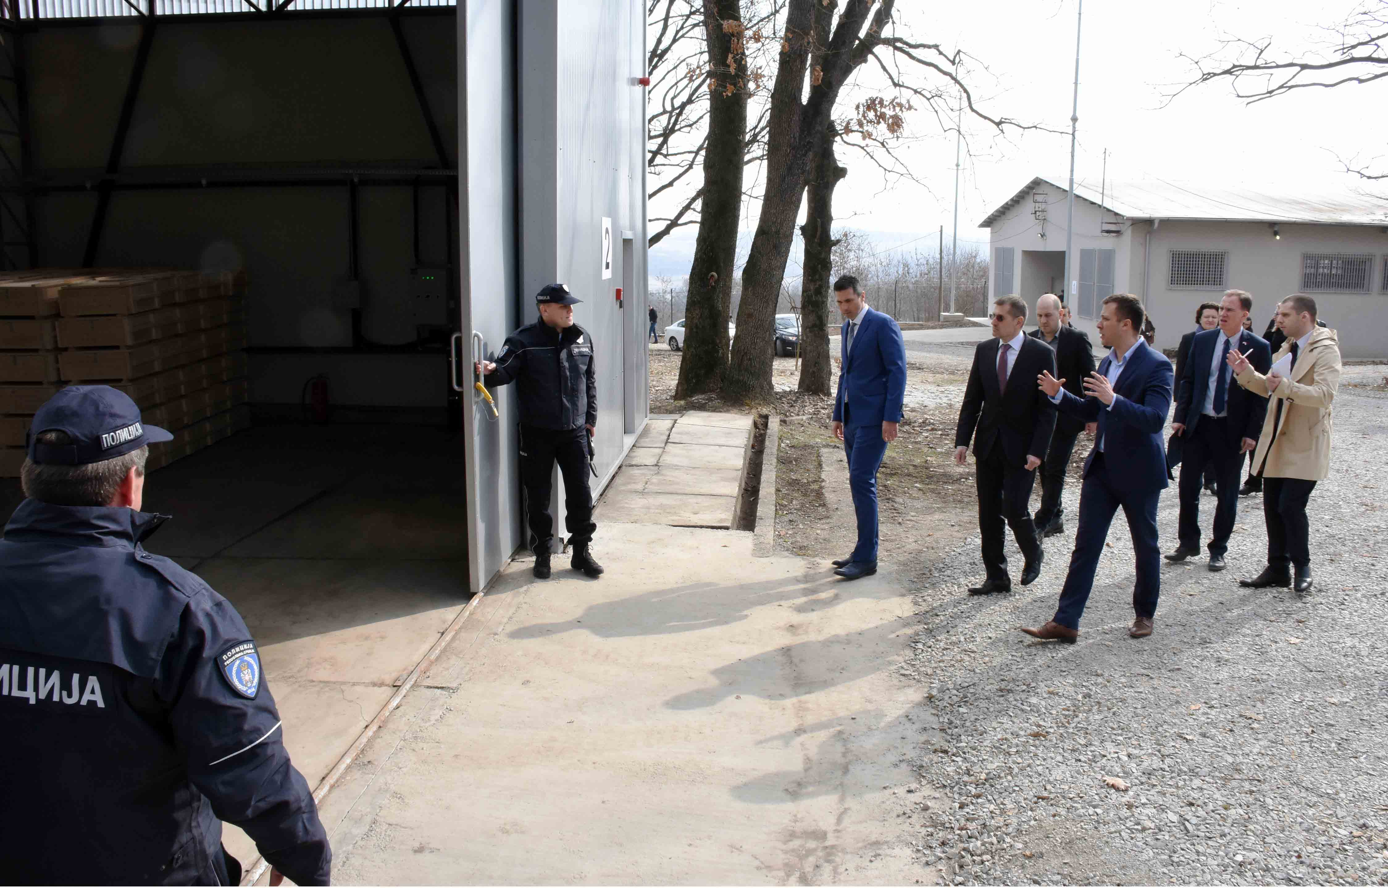
enhancement of weapons and ammunition stockpile security
  Montenegro
  Rogami SALW and Ammunition storage near Podgorica and 1 evidence room in the Forensic Center in Danilovgrad upgrades completed in mid-April 2019; handover ceremony held on 13 May.
KEY MILESTONES
        Serbia
        SALW storage Bošnjaci, Avala, and two evidence rooms, in Žarkovo and Čukarica, completed in December 2018; official handover took place on 1 March;
        Proposal for SALW and ammunition storage, Duvanište near Smederevo, security upgrade prepared.

Slide 7
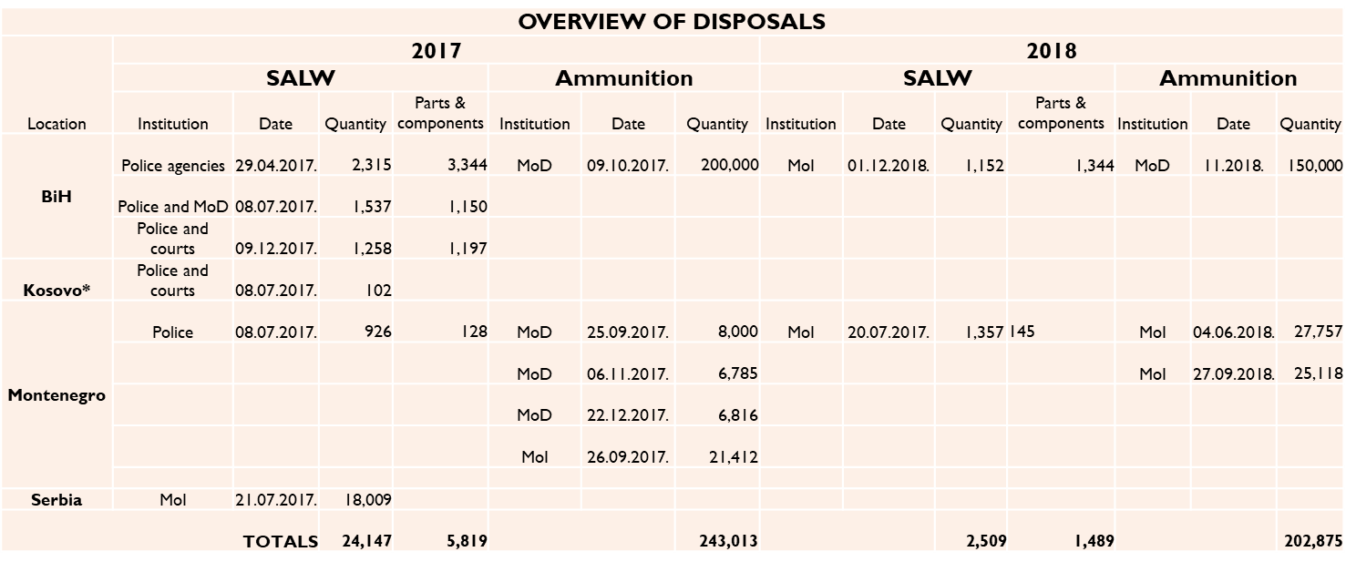
reducing surplus stocks of SALW and their ammunition
Location | DISPOSED TO DATE |  | 2019 PLAN
 | SALW | Ammunition | SALW | Ammunition
BiH | 6,262 | 350,000 | 2,000
Kosovo | 102
Moldova |  |  | 1,700
Montenegro | 2,283 | 95,888
Serbia | 18,009 |  | 19,643 | 54,111
TOTALS | 26,656 | 445,888 | 23,343 | 54,111
TARGETS:
≤ 50,000 SALW
≤ 500,000 ammunition pieces

Slide 8
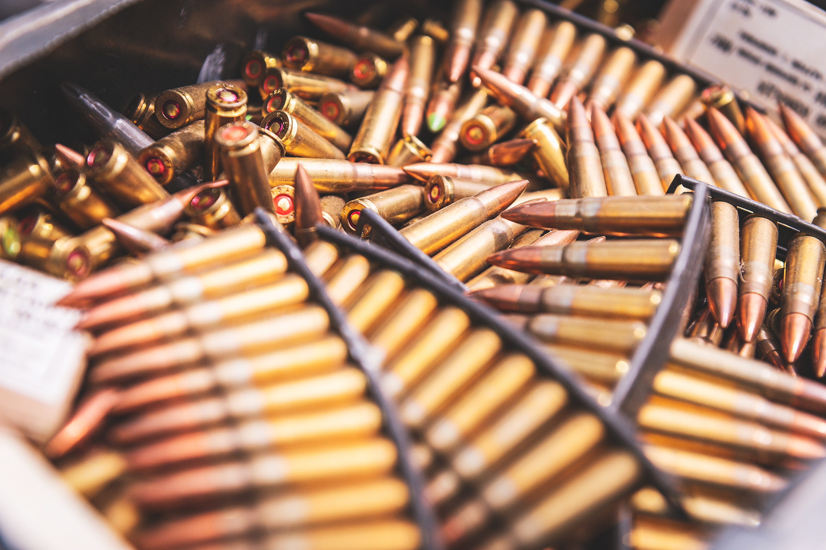
reducing surplus stocks of SALW and their ammunition in storage
              23,343 pieces of SALW are planned to be destroyed in autumn, in BiH (tentatively 2,000 pieces with MoS), Moldova (1,700 with MoIA/GPI) and Serbia (19,643 with MoI).
              54,111 pieces of ammunition (of caliber 7,7 and 12,7) are planned to be destroyed in Serbia before the end of 2019; Letter of Agreement between UNDP and MoI is being finalized.
PLANNED DISPOSALS

Slide 9
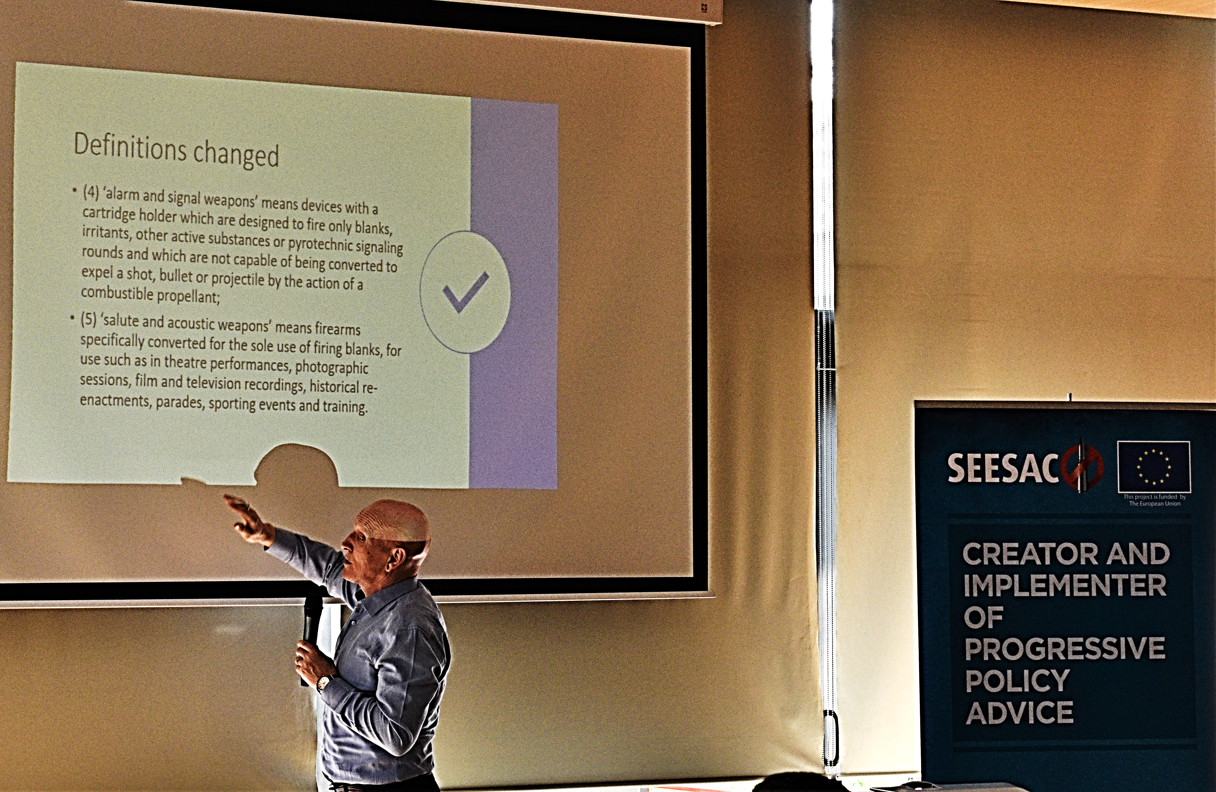
training of a regional pool of MoI trainers and support for national training sessions on PSSM
              Regional Meeting of Trainers for PSSM of SALW and their Ammunition held in Belgrade, on 9-10 April 2019. The meeting was a follow-up to the Regional ToT for PSSM in Durres, in November 2017. The Regional Meeting gathered police officers who participated in the previous regional training in a discussion-based exercise that assessed the results of and the follow-up actions to the previously implemented training.
              The national targeted PSSM course for the MoI Albania will take place in mid-October, through the present US funding. The curricula was prepared by SEESAC Technical Advisors that will also lecture the course. It will include a visit to the Mullet storage for the participants to observe the practical application of the international PSSM standards implemented.
              SEESAC is available to support the PSSM training at national level.
KEY MILESTONES

Slide 10

Thank you

