Slide 1

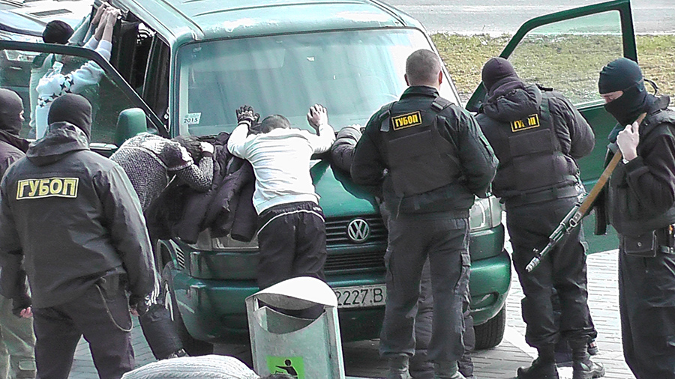
The Ministry of Internal Affairs of the Republic of Belarus
Results of the fight against illicit trafficking
in firearms in Belarus

Slide 2
Unregistered firearms seized
in 2016 - 2018
.

Slide 3
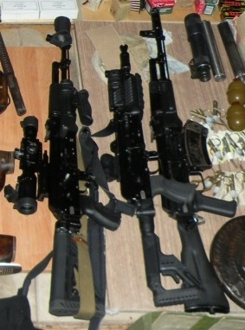
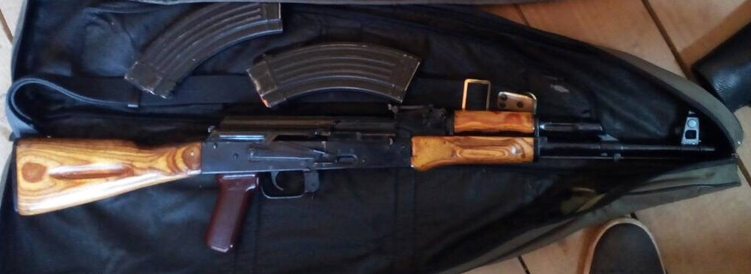
Restored Kalashnikov assault rifles
from deactivated weapons

