Slide 1

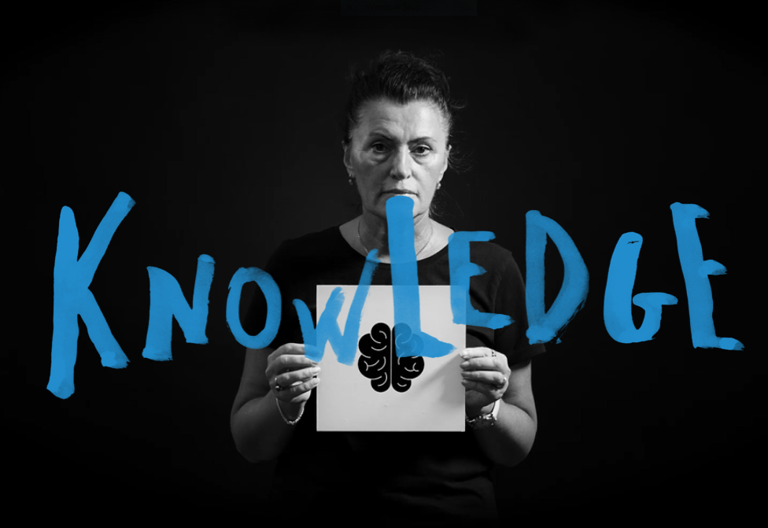


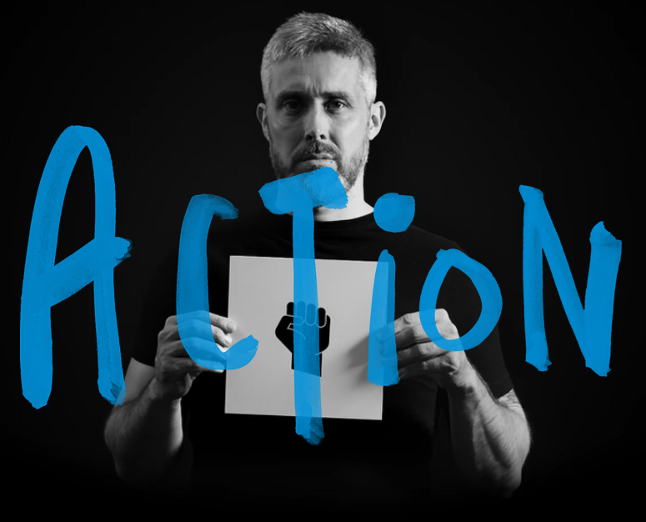




W I T H

Slide 2

Arm Yourself With Love, Action, Knowledge & Facts
Online platform
Available in English, Albanian, Romanian, Macedonian and BCMS
Awareness Raising Campaign for citizens in South East Europe about the dangers caused by the misuse of guns and their illegal possession
Based on the information and insights from
  Regional Perception Survey
  SEESAC’s Armed Violence Monitoring Platform
  SEESAC’s Gender and SALW Study
Created and maintained with the financial support of the European Union and the Government of Germany

Slide 3
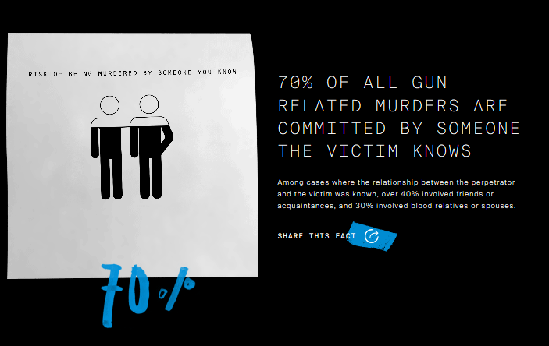
Arm Yourself With Love, Action, Knowledge & Facts
Platform is divided into 4 sections:
  Love
  Action
  Knowledge
  Facts
User friendly with simple features to share the website’s content

Slide 4
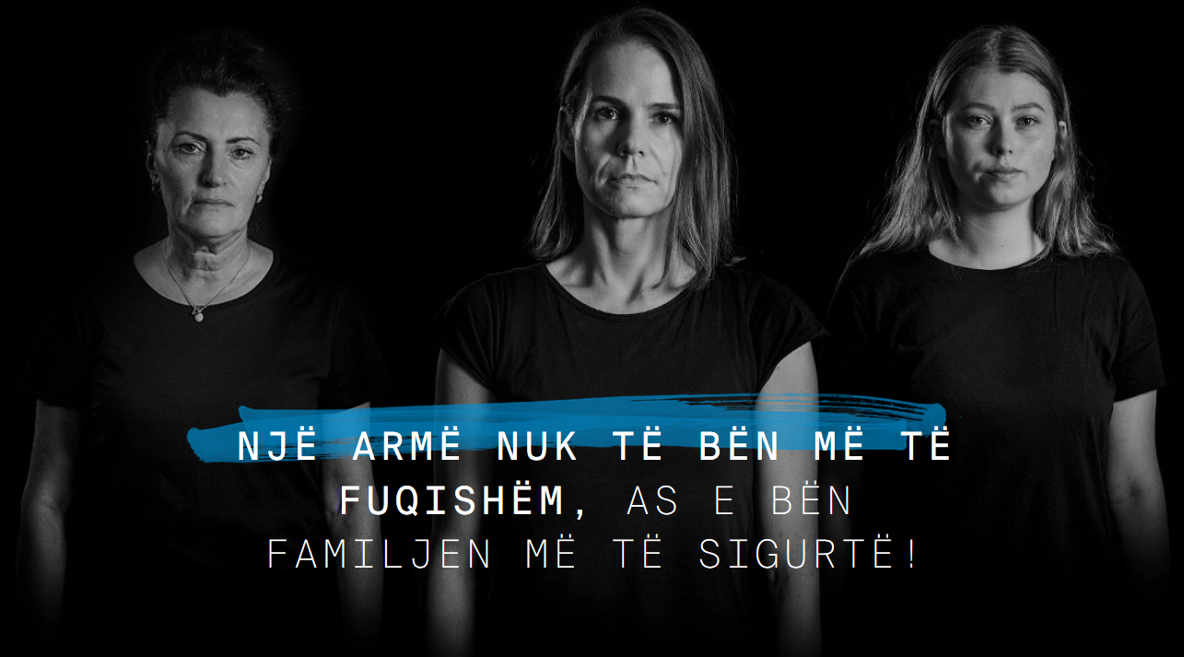
Arm Yourself With Love, Action, Knowledge & Facts
Includes subsection on domestic violence:

Slide 5
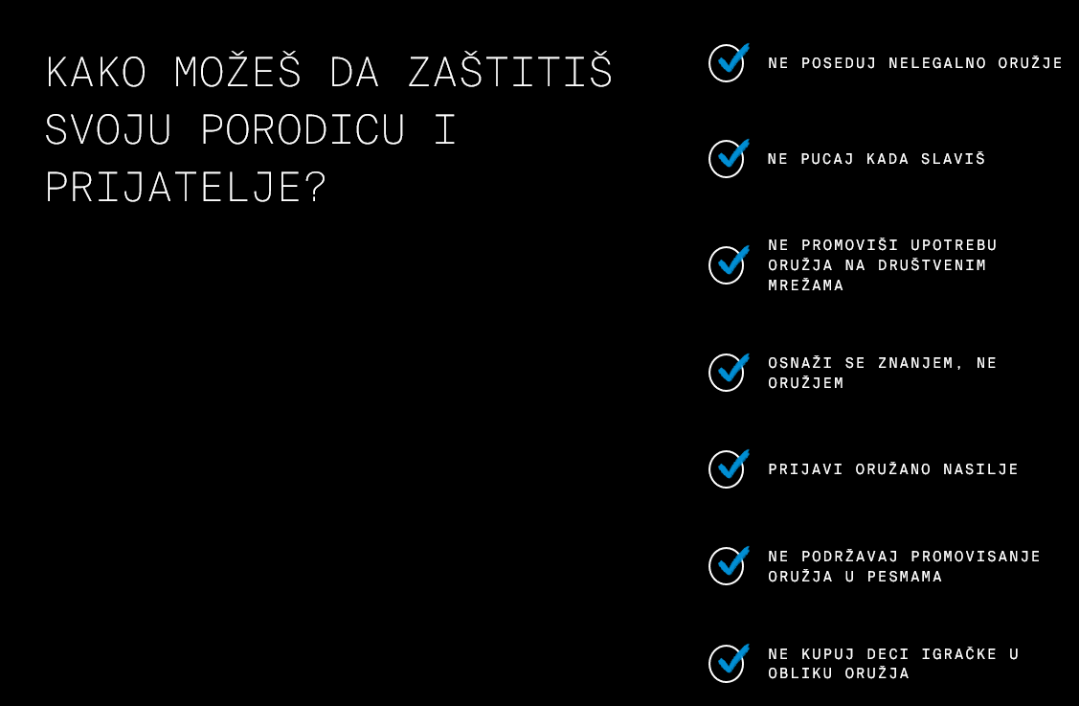
Arm Yourself With Love, Action, Knowledge & Facts
Offers simple call to actions to follow:

Slide 6
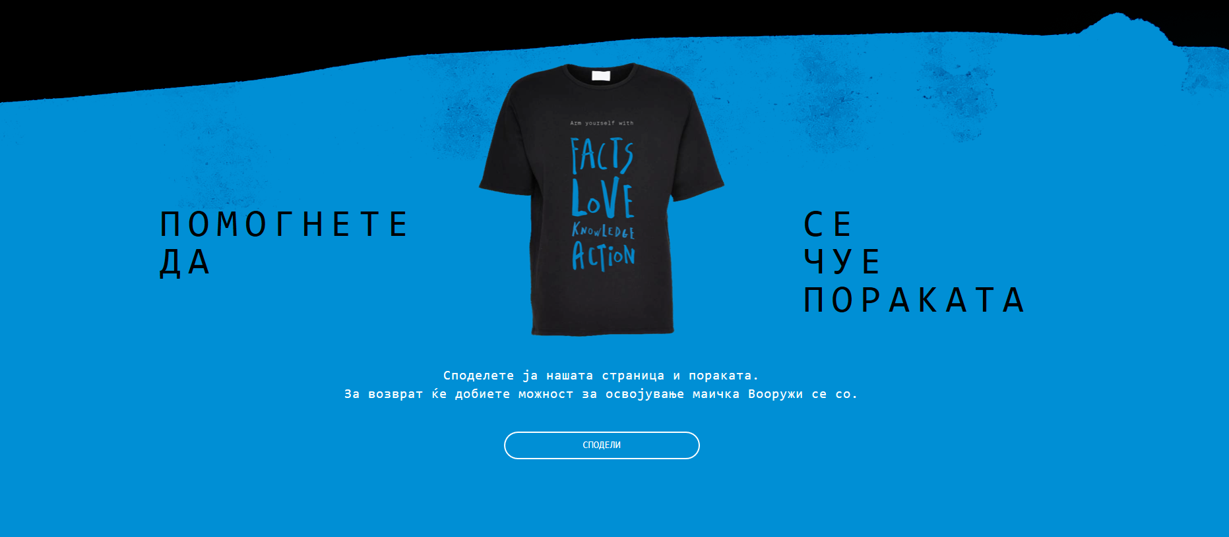
Arm Yourself With Love, Action, Knowledge & Facts
Incentivizes users to share content and raise awareness through giveaway:

Slide 7

WWW.ARMYOURSELFWITH.ORG

