Slide 1
10th REGIONAL MEETING OF SALW COMMISSIONS
NATIONAL AND INTERNATIONAL REPORTING ON ARMS EXPORT
Momir Brajic, MFA Bosnia and Herzegovina

Slide 2
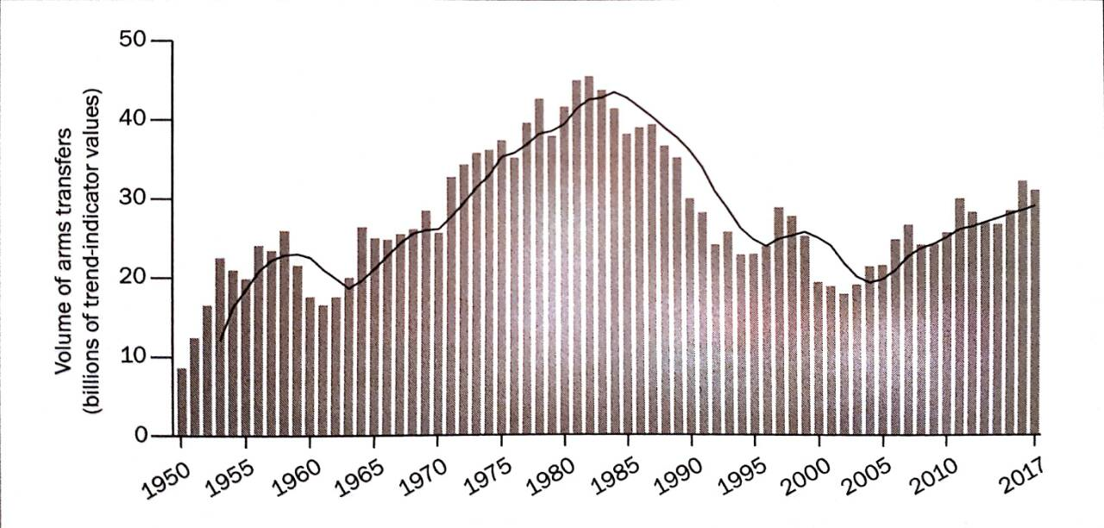
INTRODUCTION
The trend of international transfers of major weapons, 1950-2017

Slide 3



LEGAL FRAMEWORK
Transparency and accountability
UN register of conventional arms (UNROCA)
ATT
OSCE

Slide 4
TIME FRAMEWORK
ATT – 31 May
OSCE – 30 June
UN – 31 May

Slide 5
CHALLANGES
Lack of human resources
Insufficient coordination among the institutions
Timely delivery of relevant information
Translation into English

Slide 6
SCOPE OF FOREIGN TRADE IN MILITARY ITEMS
Year | Number of issued licenses for export from the ML | Value of issued licences for export from the ML
2016 | 201 | 305.025.719,00 euros
2017 | 223 | 296.107.156,00 euros
2018 | 175 | 207 770 749,00 euros
Year | Number of issued licenses for import from the ML | Value of issued licences for import from the ML
2016 | 117 | 38.113.123, 00 euros
2017 | 136 | 110.197.847,00 euros
2018 | 102 | 102.588.645,00 euros

Slide 7

CONCLUSION

