Slide 1

SALW control
KOSOVO
Progress and challenges in arms control

Slide 2

Legal Framework
Law on Weapon
Law on weapons, ammunition and relevant security equipment for authorized state security institutions
Law on civil use of explosives
Law on legalization and surrender of weapons, ammunition and explosive devices
Law on the trade of strategic goods
29 Subordinate legal acts– Administrative Instructions
SOP etc.

Slide 3
Legal Framework
Following the changes in the European legal regulation, we will also make the necessary changes to the primary and secondary legislation of RKS and its adaptation to the new changes
Workgroup is formed to amend the laws and further harmonize with the new
amendments in the EU regulatory framework.
Review of National Action Plan and adoption of Roadmap Action Plan
Goal I ROADMAP for a sustainable solution to the illegal possession, misuse and trafficking of Small Arms and Light Weapons in the Western Balkans

Slide 4


SALW E Strategy
LEGAL FRAMEWORK
Linkage to other relevant strategies
  Intelligence Led policing (ILP)
  Integrated Border Management Strategy (IBM)
  Organized Crime Strategy
  Counter Terrorism Strategy
  Community Safety Strategy
  Crime Prevention Strategy
In line with the
ROAD MAP

Slide 5


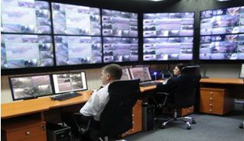
Cross border interagency cooperation
IBM Strategy
Law on State border protection
Law on IBM ensures full cooperation between border and customs
National Border Management - Coordination Center
NCBM
Joint risk analyses

Slide 6
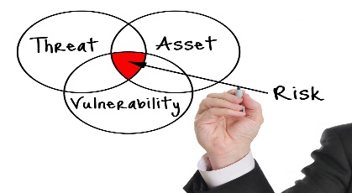
Evidence based policies
Intelligence Led Strategy
SOCTA report
Joint risk analyses
Gun crime report
SOCTA
NCBM
Firearm Focal Point
Goal II ROADMAP for a sustainable solution to the illegal possession, misuse and trafficking of Small Arms and Light Weapons in the Western Balkans

Slide 7




KOSOVO FIREARM FOCAL POINT
IBIS
SACONS
KPIS

Slide 8

PREVENTION AND COUNTERING
  Marking
Test firing
Goal III ROADMAP for a sustainable solution to the illegal possession, misuse and trafficking of Small Arms and Light Weapons in the Western Balkans

Slide 9
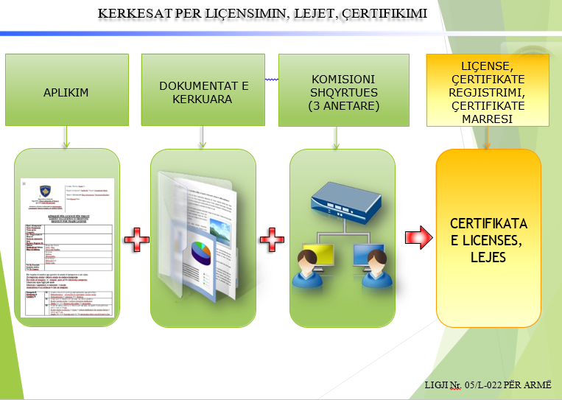
IMPORT CONTROL
Goal II ROADMAP for a sustainable solution to the illegal possession, misuse and trafficking of Small Arms and Light Weapons in the Western Balkans

Slide 10
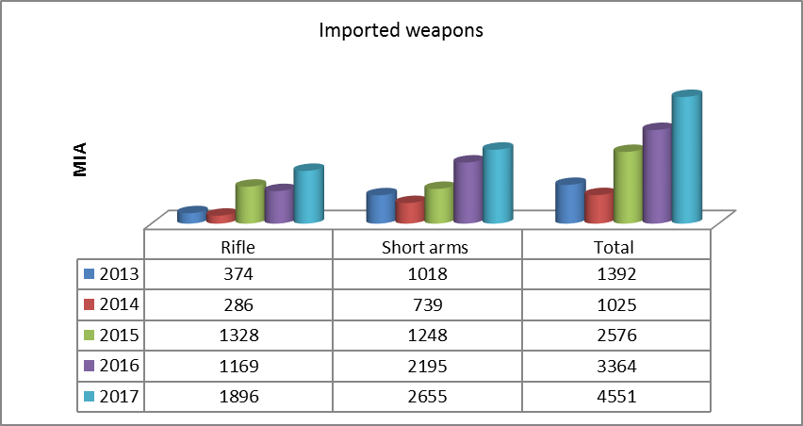
  Import control
  Marking
Test firing
Pëlqimet |  | Person Juridik |  | Person Fizik
 |  | Kërkesa | Aprovime | Kërkesa | Aprovime
1 | Pëlqim për blerje të armës | 74 | 74 | 3538 | 5414
2 | Pëlqim për blerje të municionit | 386 |  | 454 | 1157
3 | Legalizimet vazhdimi i WRC dhe WAC |  |  | 929 | 868
4 | Kërkesë për vazhdim të lejes |  |  | 130 | 131

Slide 11
Stockpile Management
International Ammunition Technical guidelines
Kosovo standards on stockpile management for civilians as well as for law enforcement agencies
Licensed by the inspectors of the Department of Public safety in accordance international standards

Slide 12

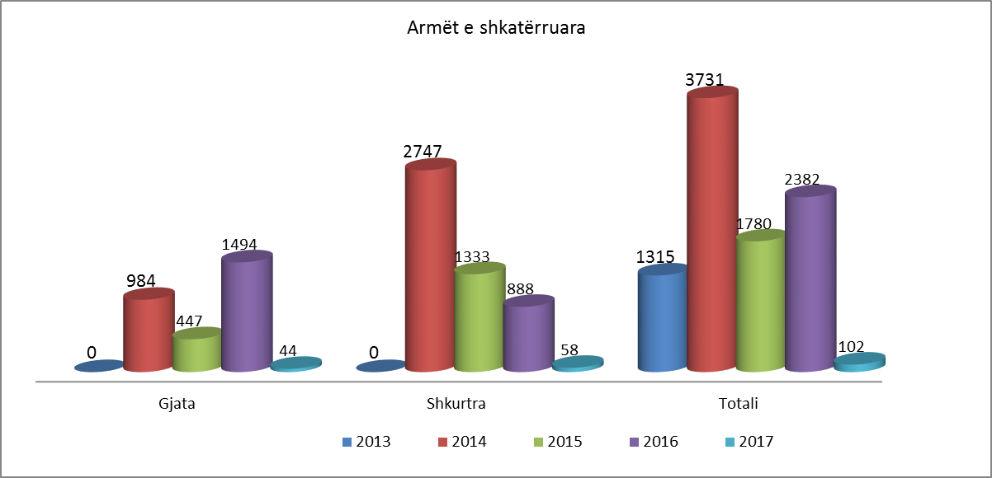
SALW Destruction
From 2013 , app. 9624 weapons were destroyed
133347 ammunitions

Slide 13
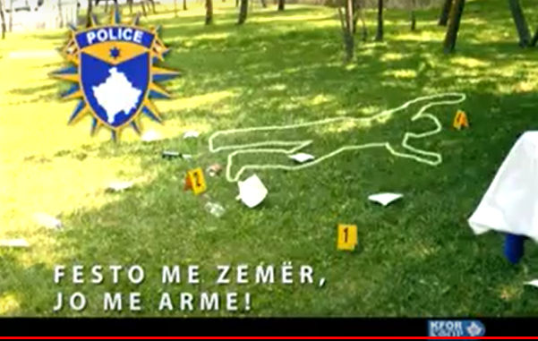
Awareness
Link between SALW Strategy and Community safety strategy
Implementation through partnership Police -local government , civil society, and community.
Public campaign - celebratory shooting
  Legalization campaign - Preparation
  Celebrate with heart not with the gun

Slide 14
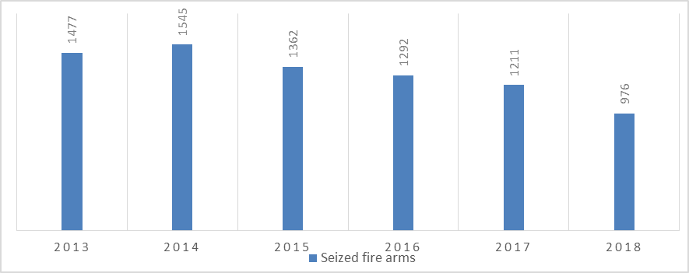
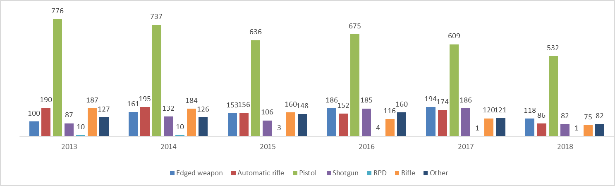
confiscations

Slide 15
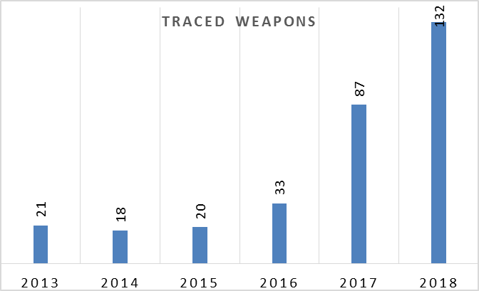
TRACING

Slide 16

THANK YOU

