Slide 1

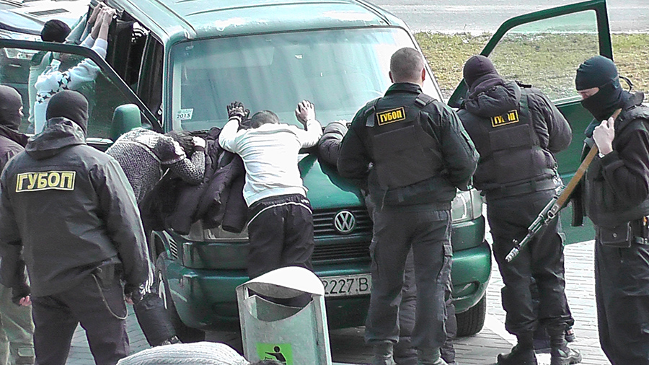
The Ministry of Internal Affairs of the Republic of Belarus
The results of the struggle illegal traffic firearms
in Belarus in 2018

Slide 2
Illegal trafficking in firearms in 2018
During the ten months of 2018,
Belarusian law enforcement agencies seized
from illegal trafficking 506 unregistered firearms, including 107 rifled weapons.
As well as 66 000 ammunition
of various calibers.

Slide 3
Illegal trafficking in firearms in 2018
During the ten months of 2018,
Belarusian citizens voluntarily surrendered
the police have 436 unregistered firearms, including 108 rifled weapons.
As well as 250 000 ammunition
of various calibers.

Slide 4
Operation «Arsenal»
In 2018, operation "Arsenal“ was held
from March 19 to March 23.
For five days of the event, citizens voluntarily surrendered to the police:
222 unregistered firearms;
193 000 ammunition of various caliber;
11 kg of explosives.
In addition, during this time the Belarusian police seized from illegal traffic:
127 unregistered firearms;
21 000 ammunition of various caliber;
19 kg of explosives.

Slide 5
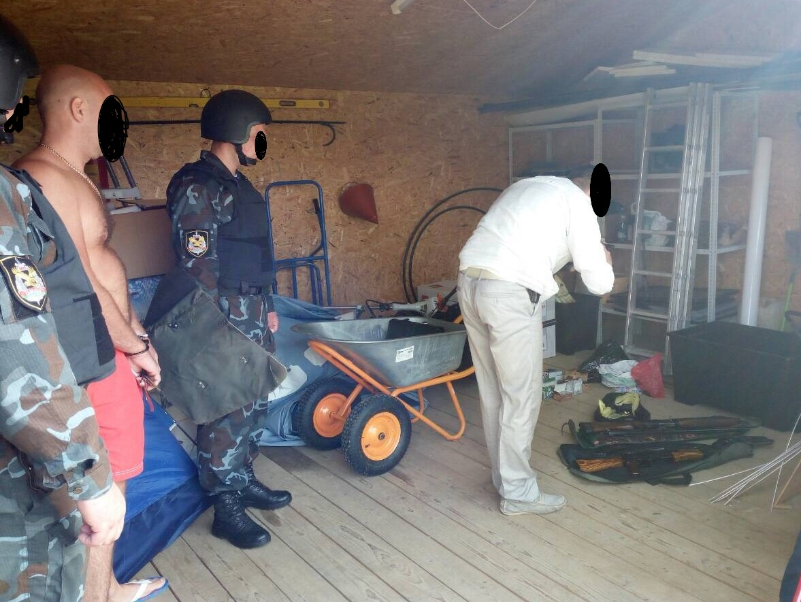
Examples of weapons seizure in 2018

Slide 6
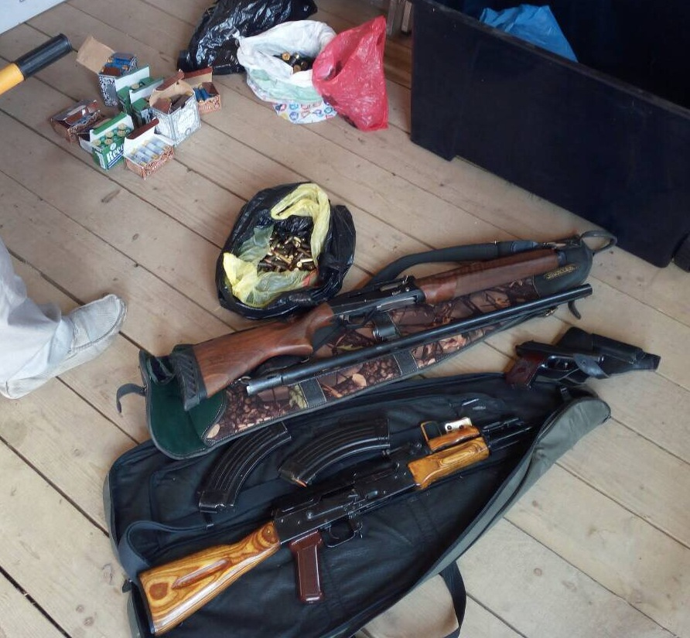
Examples of weapons seizure in 2018

Slide 7
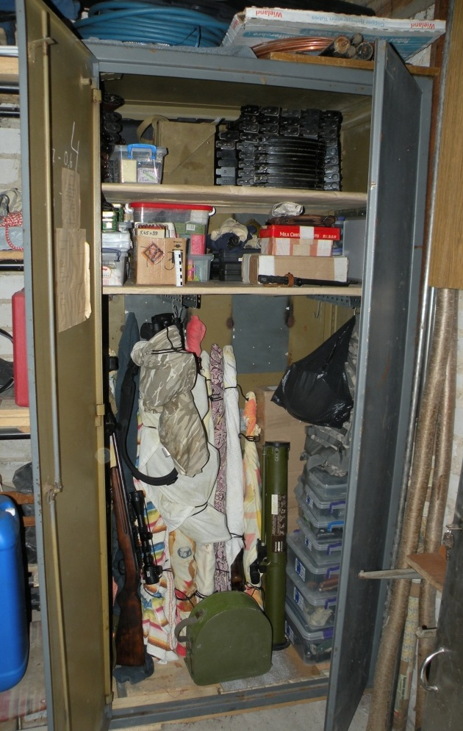
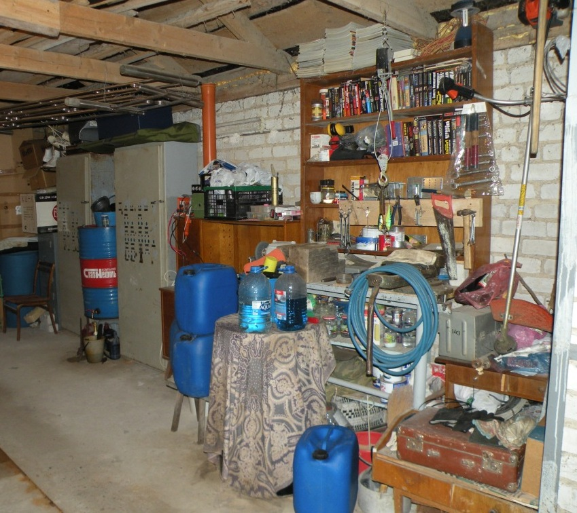
Examples of weapons seizure in 2018

Slide 8
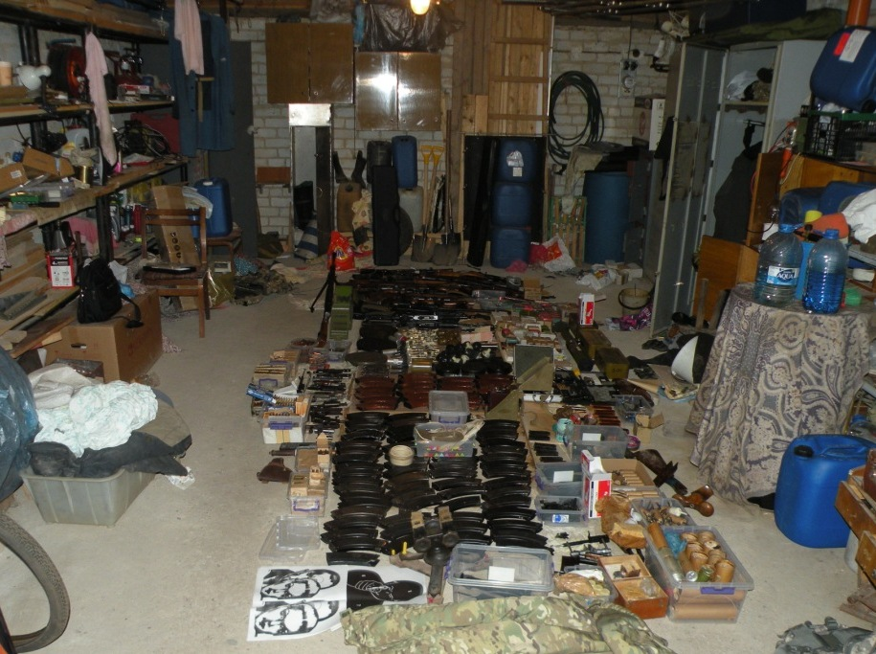
Examples of weapons seizure in 2018

Slide 9
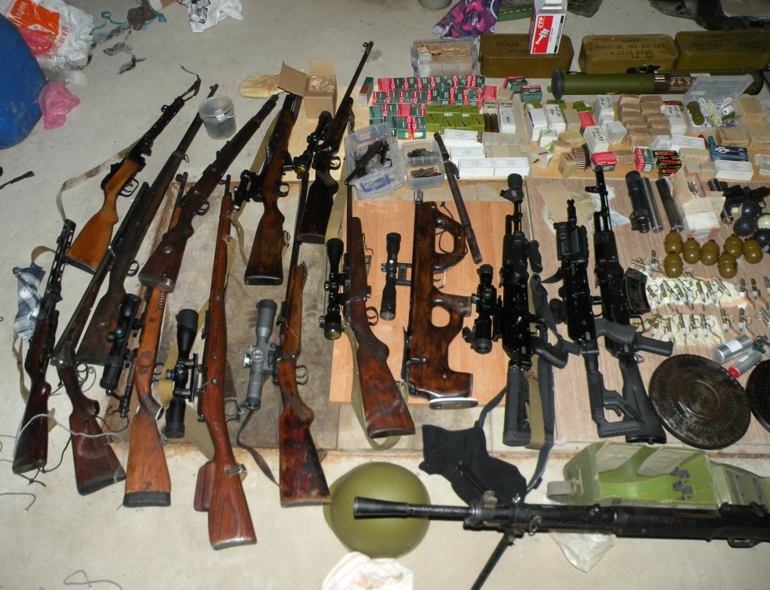
Examples of weapons seizure in 2018

Slide 10
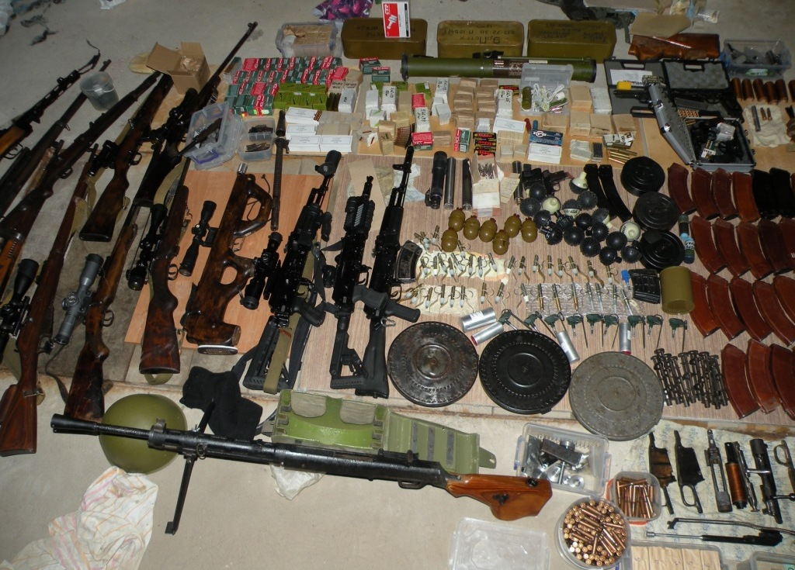
Examples of weapons seizure in 2018

Slide 11
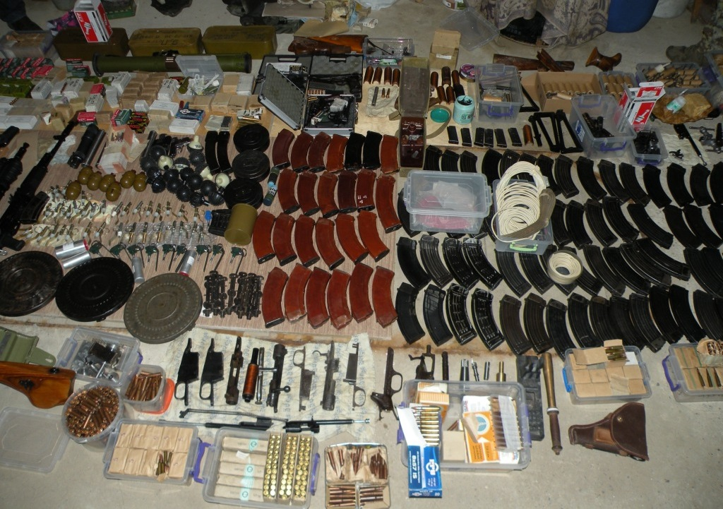
Examples of weapons seizure in 2018

Slide 12
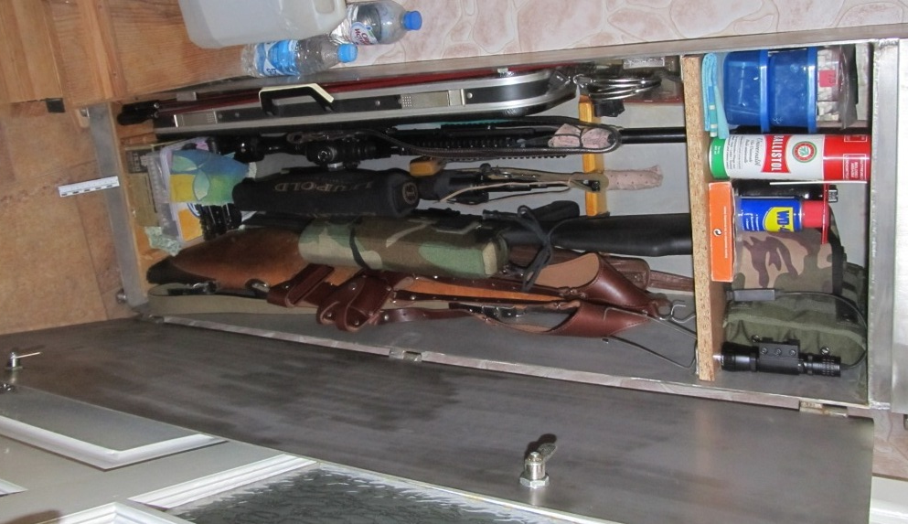
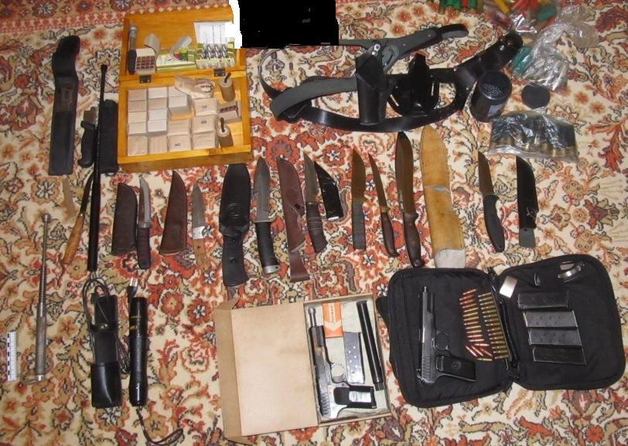
Examples of weapons seizure in 2018

Slide 13
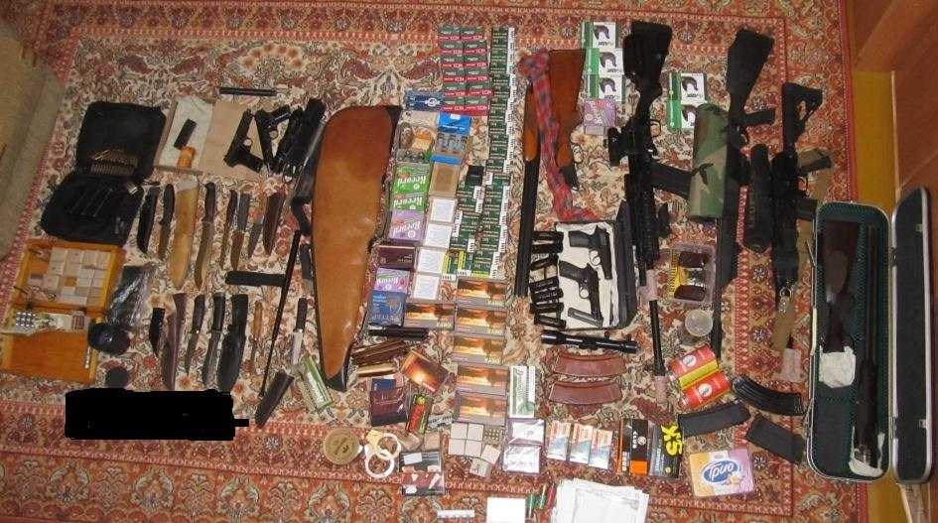
Examples of weapons seizure in 2018

Slide 14
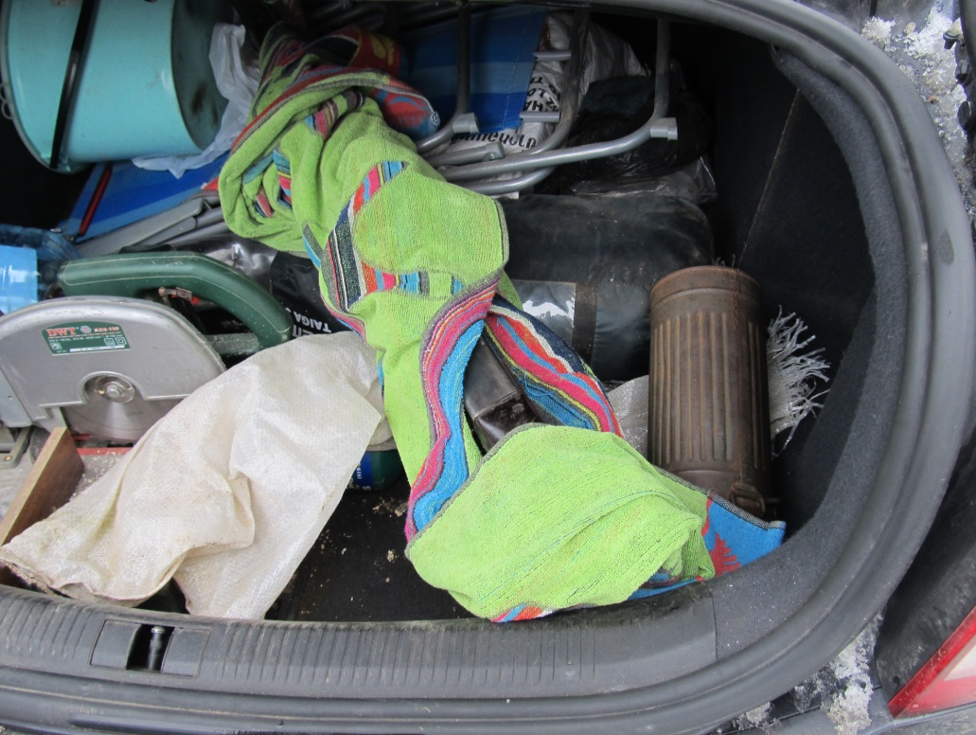
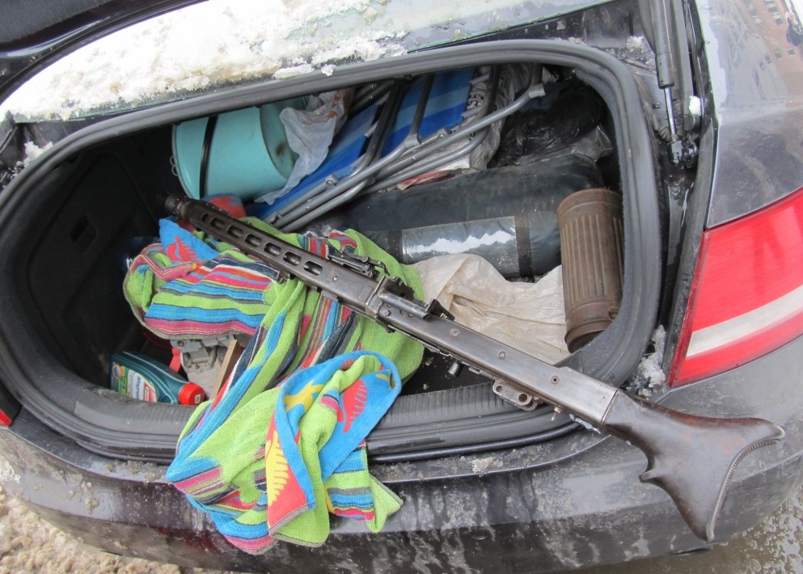
Examples of weapons seizure in 2018

Slide 15
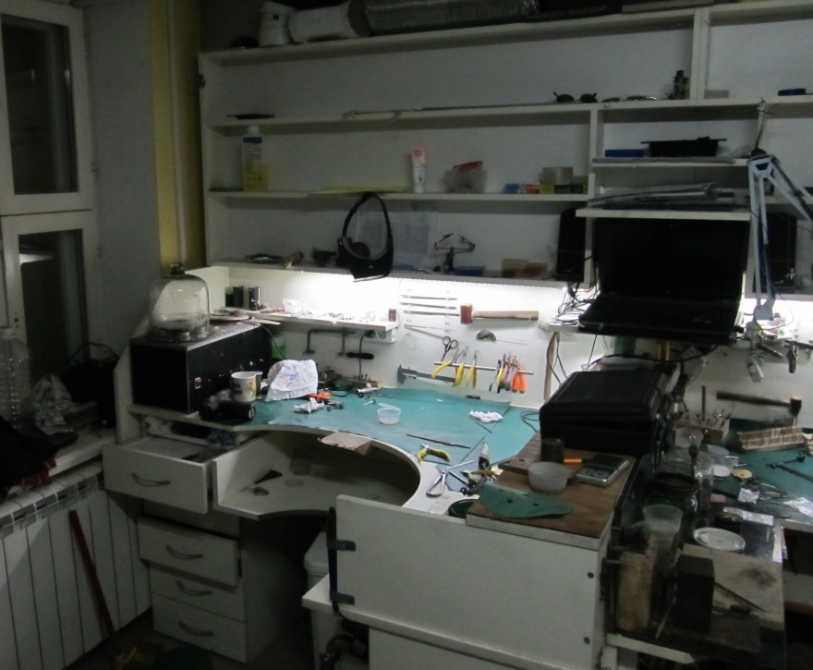
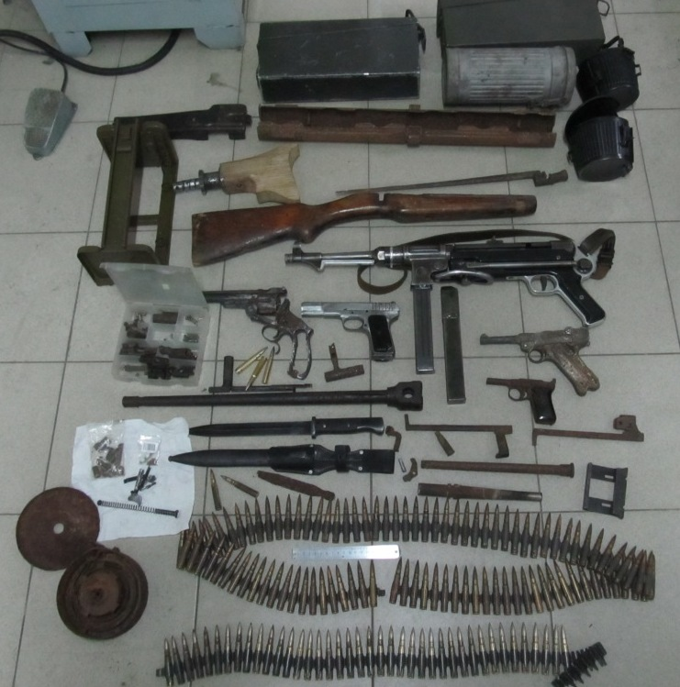
Examples of weapons seizure in 2018

