Slide 1

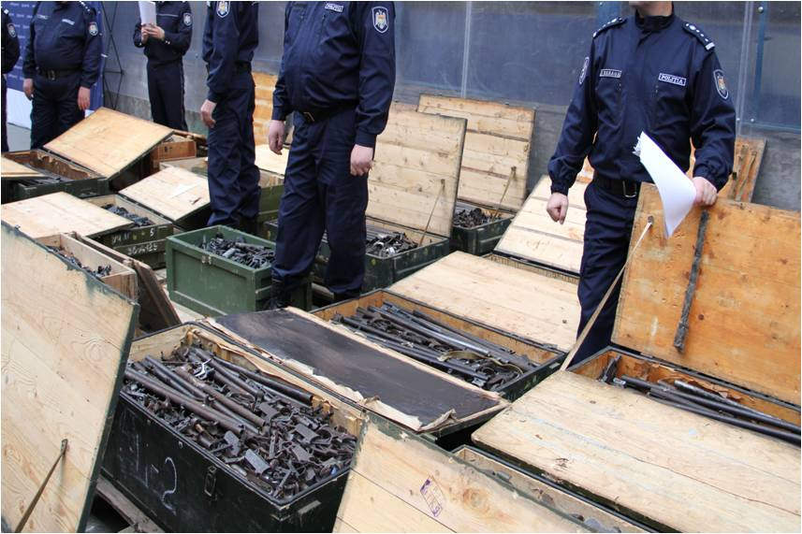
SALW Commission
1o^{th} Regional Meeting Of Salw Commissions

Slide 2
Arms control legal framework
Establishment of the expert group in the field of examination and harmonization of national legislation (Law 130 from 2012);
Harmonization with the EU regulatory and standards.

Slide 3
Arms control policies
Governmental Decision number 609 – The concept of the informational system “National register of arms”;
Decision of the SALW national commission from September 3, 2018 - group of experts for drafting the future SALW Strategy
Working on the needs assessment report (deadline 4th December) on the acquisition of the software and specialized platforms;
Focal Point establishing with SEESAC support.

Slide 4
Weapons captured or voluntarily surrendered from illegal possession during the period 2017 - 2018

Slide 5
Activities towards prevention
Organizing and Deploying the National Campaign to Raise Civil Society on the Dangers of Illegally Owned Weapons "Now is the time to hand over the weapons!“
Awareness programs with shooting clubs
Facilitation of the right culture in using arms and munitions

Slide 6
Upgrading the infrastructure of the arms depot of the Police
At the moment, the Police's Arms Depot stores weapons from police equipment, delinquent weapons and confiscated weapons. It is becoming more and more difficult to keep them because the warehouse is located in the city center and is in a deplorable condition.
With the support of SEESAC, the procedure of identifying a company for the modernization of storage facilities for temporary storage and storage of weapons from police custody

Slide 7
Thank you for your attention

