Slide 1
Republic of Serbia
NATIONAL AND INTERNATIONAL REPORTING ON ARMS EXPORTS
Jasmina Roskic, Head od Department,
Ministry of Trade, Tourism and Telecommunications
Budva, November 2018

Slide 2
REPORTS
1. National
2. Regional
3. ATT
4. UN Register
5. OSCE

Slide 3
NATIONAL REPORTS
Law on export and import of Arms and Military Equipment („Official Gazette of RS“, no 107/14)Article 28
Artical 28, paragraph 4 and 5
The first National report was adopted in 2006
Last one in 2018

Slide 4
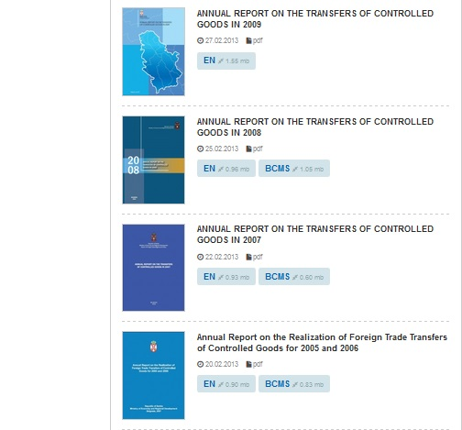

Slide 5
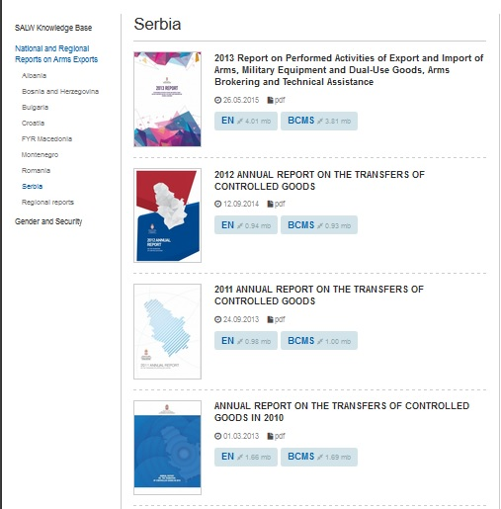

Slide 6
CONTENT
Chapters:
I-introduction
II- national legislation (Laws, bylaws, national control lists, international conventions and other regulations)
III-the basis of the import and export control system (registration, licensing, licensing criteria, relevant institutions in the licensing process, oversight and control)
IV- statistical overview
V-appendicies

Slide 7
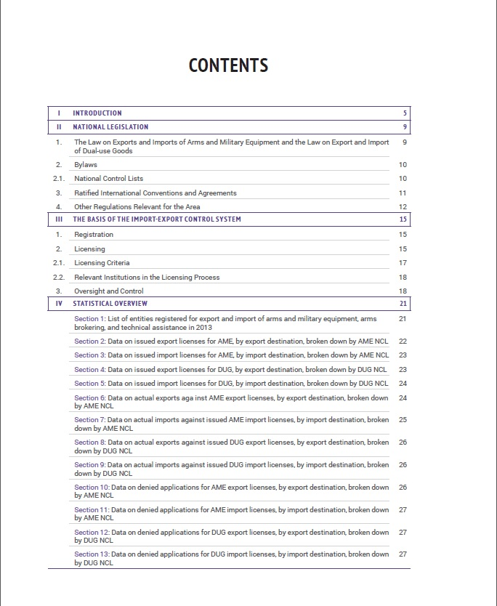

Slide 8
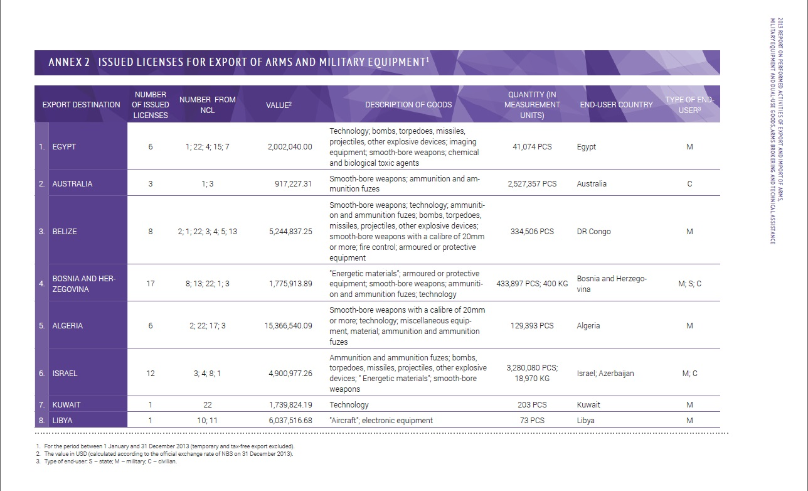
Example

Slide 9
REGIONAL REPORTS
Started in 2009, at the the regional conference in July where representatives from Albania, BiH, The FYR Macedonia, Montenegro and Serbia agreed on the format of the Regional report. The regional report will follow closely the format of the EU annual report on arms exports.

Slide 10


Slide 11
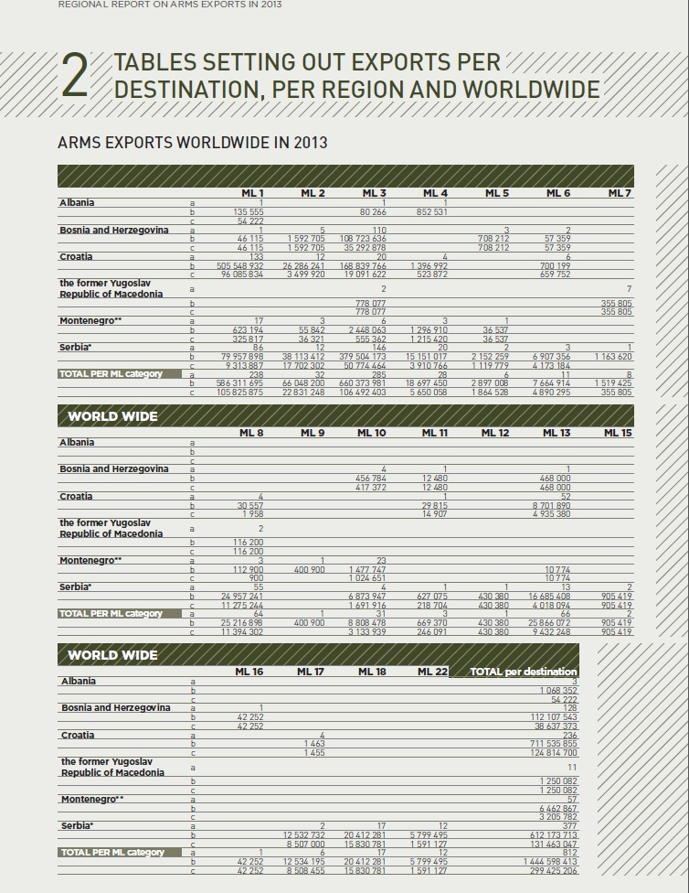

Slide 12
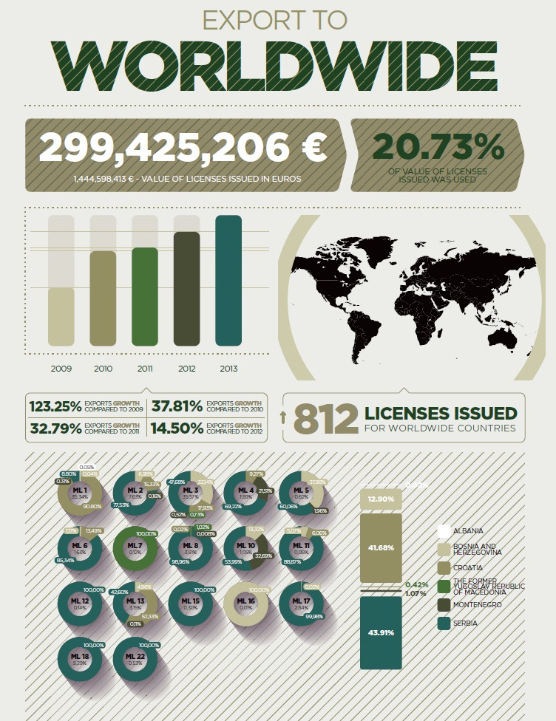

Slide 13
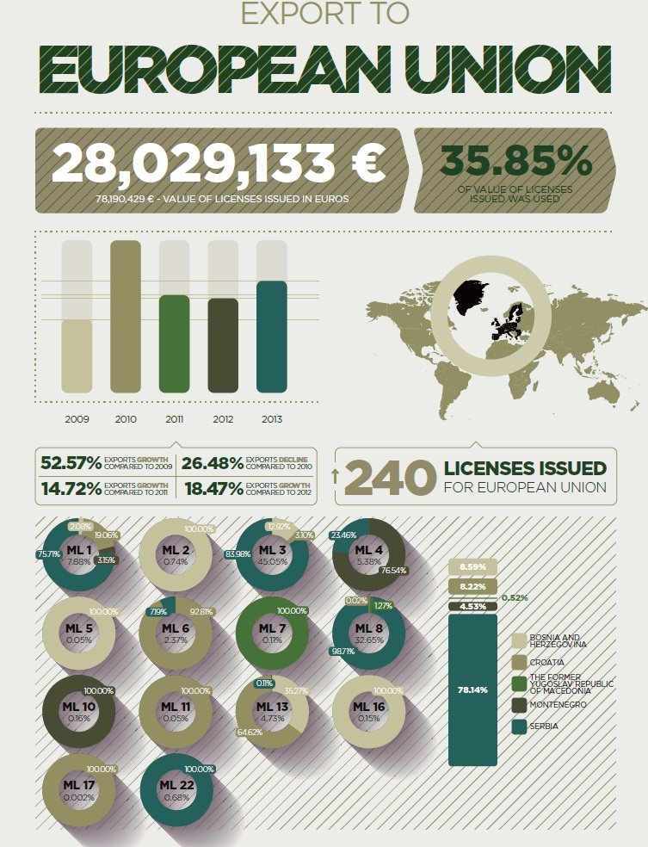

Slide 14
ARMS TRADE TREATY
ATT entered into force on December 24, 2014, in accordance with its Article 22 (ninety days following the date of the deposit of the fiftieth instrument of ratification).
The Republic of Serbia ratified ATT in October 2014, before its entering into force („Official Gazette of RoS - International Agreements“, no.14/14)

Slide 15
Obligations: record keeping
Maintain national records on export authorizations or actual exports of conventional arms for 10 years, pursuant to national laws and regulations
Optional provisions
Maintain records of imports of conventional arms for 10 years
Maintain records of authorizations for transit or trans-shipment of conventional arms covered in Article 2 (1) for 10 years
Records should contain the following information: quantity, value, model/type, exporting State, importing State, transit and trans-shipment State(s) and end-users as appropriate for authorized transfers and actual transfers

Slide 16
REPORTING
Obligations
Initial report to the Secretariat on measures undertaken to implement the ATT, including national laws, national control lists and other regulations and administrative measures, to be submitted within the first year after its entry into force.
Additionally: Report to the Secretariat on any new measures undertaken
Annual report to the Secretariat by 31 May - a report for the preceding calendar year concerning authorized or actual exports and imports of conventional arms
Optional provisions
Report to other States Parties, through the Secretariat, information on effective measures in addressing diversion of transferred conventional arms

Slide 17
RECORDS AND DATA TO BE KEPT
Recommended by Treaty:
quantity, value, model/type, exporting State, importing State, transit and trans-shipment State(s) and end-users
Others? E.g. parts in the transaction, brokers…
Use?
Reporting template-possibilities for different interpretation
Initial report-based on the ATT Baseline Assessment Product
Annual report: based on the UN Register of Conventional Arms (UNROCA)

Slide 18
Reporting (cont.)
Options for the State Parties to report on:
- authorized or actual export and import
- number of items or financial value
- voluntary national categories of conventional arms
- additional data (e.g. type of end users) and additional categories (ammunition and parts/components)
- exclusion of commercially sensitive or national security information
Reporting on ATT is obligatory

Slide 19
Reporting (cont.)
UN Register on Conventional Arms
UN Register on Small Arms and Light Weapons
OSCE reports on conventional arms
OSCE reports on small arms and light weapons
Voluntary based
The importance of database
SEESAC

Slide 20
DATABASE
Importance of database
Software improved by SEESAC support

Slide 21
FURTHER ACTIVITIES
EU Strategy Against Illicit Firearms, Small Arms &Light Weapons and their Ammunitions
Transparency, information sharing, cooperation
SMALL ARMS SURVEY

Slide 22
www.mtt.gov.rs
THANK YOU FOR YOUR ATTENTION
izvozna.kontrola@mtt.gov.rs
jasmina.roskic@mtt.gov.rs

