Slide 1

Arms Trade Treaty:
Reporting obligations and practices
Sarah PARKER, Policy Support Officer, ATT Secretariat
SEESAC SALW Commissions Regional Meeting, Budva, 27 November 2018
Notes:
Introduce self
Thank organisers
Outline objectives: Overview of:
Background
Purpose
Obligations
Status
Impact

Slide 2
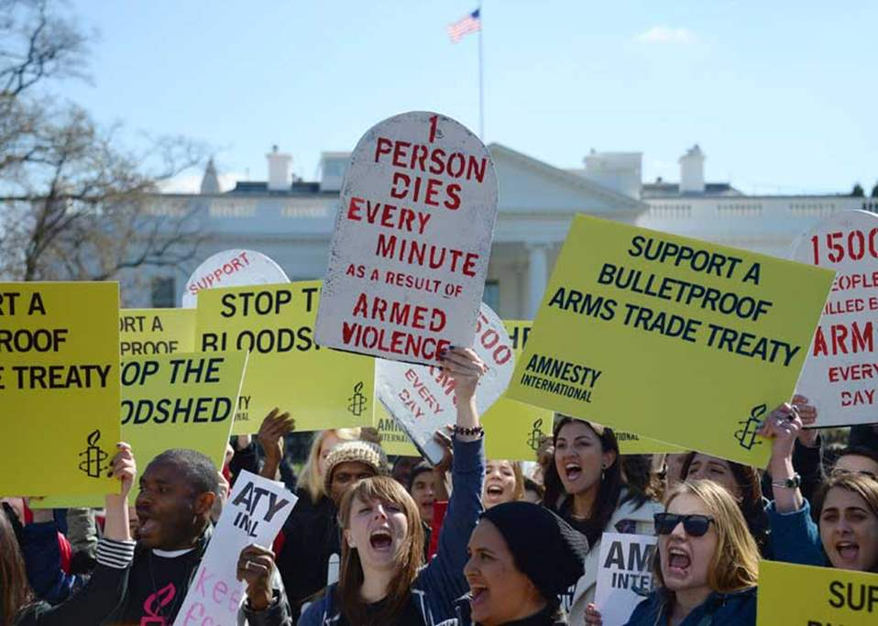
Background

Slide 3
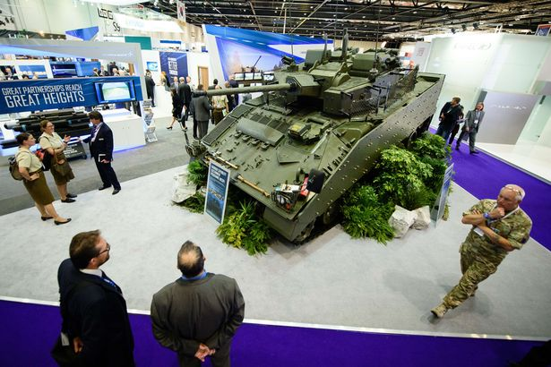
Purpose

Slide 4

Object and purpose (Art. 1)
The object of this Treaty is to:
Establish the highest possible common international standards for regulating or improving the regulation of the international trade in conventional arms;
Prevent and eradicate the illicit trade in conventional arms and prevent their diversion;
for the purpose of:
Contributing to international and regional peace, security and stability;
Reducing human suffering;
Promoting cooperation, transparency and responsible action by States Parties in the international trade in conventional arms, thereby building confidence among States Parties.

Slide 5
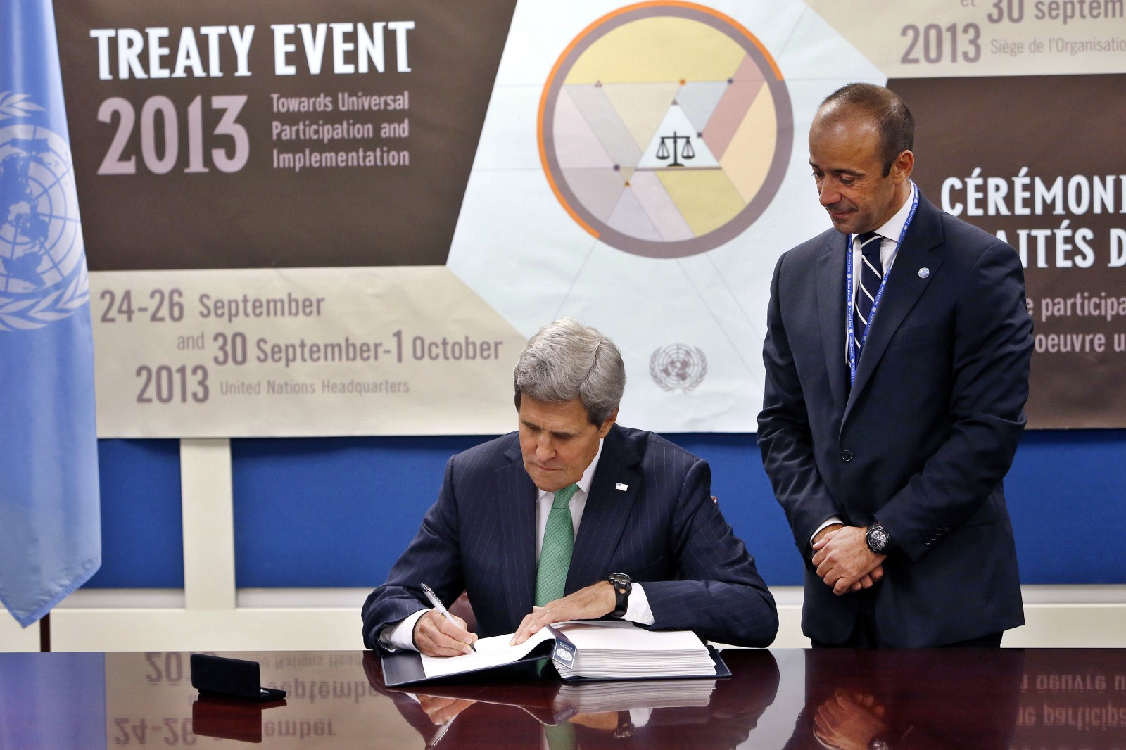
Status of participation

Slide 6
ATT Participation
Global overview
ATT Status | No.
States Parties | 99
Signatories that have not ratified, approved, or accepted the ATT | 36
States that have not joined | 59
Notes:
Currently of the 194 UN Member States and UN Observer State, there are:
96 States Parties
39 States that have signed the Treaty but not yet ratified, approved or accepted it
59 States that have not joined it – not states parties or signatories
Note: we are talking about UN member States and Observer States (194)

Slide 7
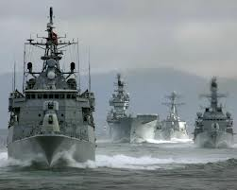
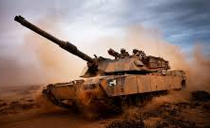
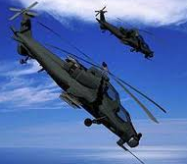
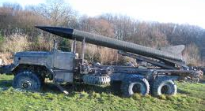
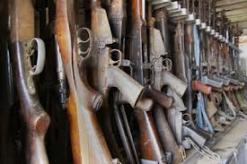
Scope (Art. 2)
Arms
Battle tanks
Armoured combat vehicles
Large-calibre artillery systems
Combat aircraft
Attack helicopters
Warships
Missiles/Missile launchers
Small arms and light weapons
Activities
Export, import, transit, trans-shipment and brokering
Notes:
Ammunition: Each State Party shall establish and maintain a national control system to regulate the export of ammunition/munitions fired, launched or delivered by the conventional arms covered under Article 2 (1), and shall apply the provisions of Article 6 and Article 7 prior to authorizing the export of such ammunition/munitions.
Parts and components: Each State Party shall establish and maintain a national control system to regulate the export of parts and components where the export is in a form that provides the capability to assemble the conventional arms covered under Article 2 (1) and shall apply the provisions of Article 6 and Article 7 prior to authorizing the export of such parts and components.

Slide 8
Reporting (Art. 13)
Implementation - must submit:
  Initial report on implementation (Art. 13(1))
  Ad hoc reports as new implementation measures taken (Art. 13(1))
Diversion - encouraged to report on:
  Measures taken to address diversion
Transfers – must submit annually:
  Authorized or actual exports & imports (Art. 13(3))

Slide 9
Initial reports
Global statistics
Regional statistics

Slide 10
Annual reports
Global statistics
Notes:
As Marc also mentioned, states Parties are required to report every year on their actual or authorized exports and imports of conventional arms.
##

Slide 11
Reporting by SEESAC
Initial Reports
Annual Reports (2015-2018)

Slide 12
Questions
What are the key elements to successful reporting?
What challenges do you face in reporting?
Could SEESAC States help build the reporting capacity of other States?
Will an online reporting tool help States report?

Slide 13
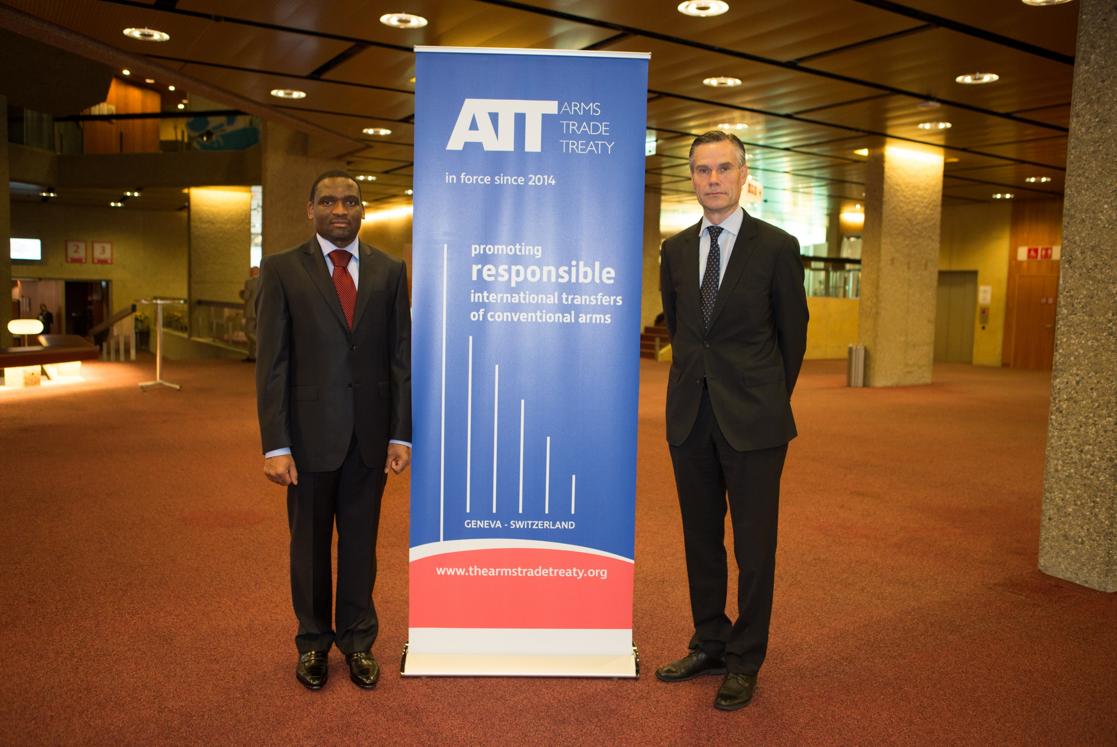
Thank you
Notes:
DAVID :
Before we get started, perhaps we can ask IF ANYONE HERE ATTENDED THE NEGOTIATIONS OF THE ATT as part of a national delegation or in some other capacity?.... Maybe we can have a show of hands….
And perhaps we can also ask how many of you have already started looking at what the ATT means for your country and how you might need to adapt your national systems if you plan to join the treaty?
[hopefully brief exchange with participants….but if they are not overly engaged, don’t wait too long]
ANECDOTE: for those of you that were present during the negotiations, you will recognise the person in this photo – Ambassador Moritan from Argentina – who presided over the lead up to the negotiations and the first negotiating conference in 2012
[you will also recognise Daniel Prins…]
SARAH :
[no need for me to speak here]

