Slide 1

Notes:
Introduction:
Starting a business, managing the power use, finding cheap rents, taking the safest road to work or avoiding high crime neighbourhoods, cities and their citizens worldwide are discovering the power of open data. By opening up data about transportation, education, health care, and more, municipal governments are helping app developers and others to find new ways to tackle old and new problems.
- Why should any body engage in open data?
Role of citizens?
Challenges
Outlook

Slide 2

Notes:
Why should governments do open data
traditionally, open data supported movements to hold governments to account and exercise civic oversight,
High potential in addressing governance/public service/development challenges
Provides new insights into existing issues, is the core of evidence-based decision making, helping governments improve targeting of services.
There are cases where regimes known to be authoritarian will open a high number of datasets, called ‘open washing’, But that by itself is not sufficient – data is only meaningful if it is used and re-used, if citizens are engaged and participate in the process.

Slide 3
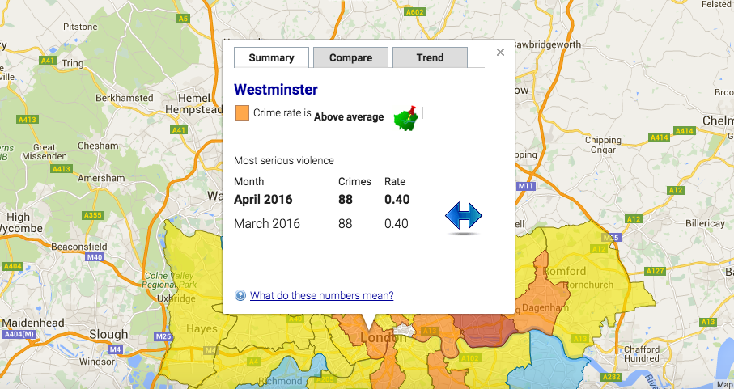
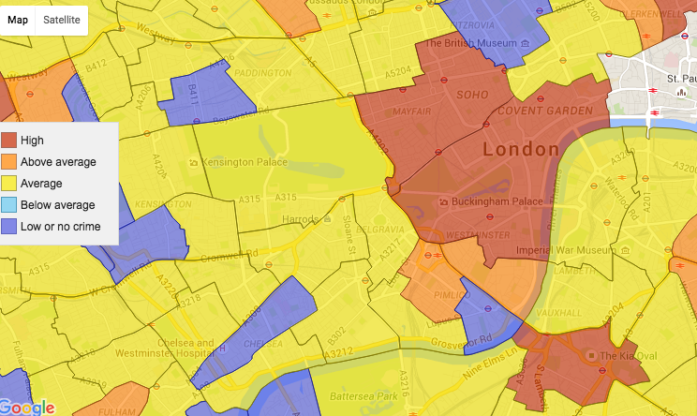
Notes:
Crime map from London:
Ability to see at neighbourhood and street level what are the crimes that are taking place, as well as the average for the neighbourhood and broader area, how does that compare to other areas, different times, and that

Slide 4
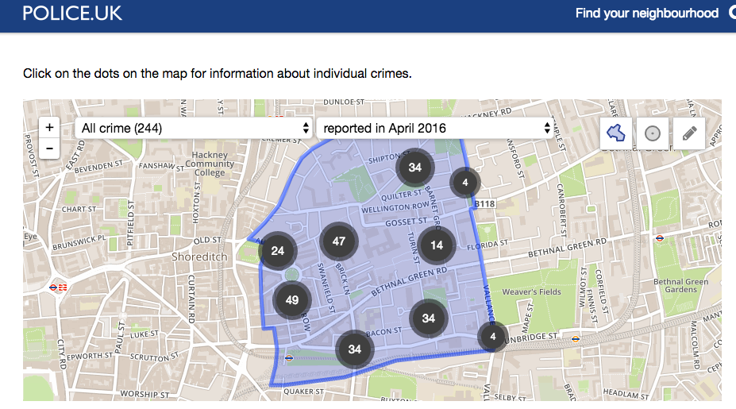


Slide 5

Notes:
Challenges:- Opening data is scary.
Recently conducted Open Data Impact Assessment – many challenges:
Quality
Reliability
Lack of digital skills
Low demand
Resources (IT and money)
Silos/ inter-intra agency
Human error/lack of standardization (Public procurement)
Ministry of Data: - standardization; + the energy (the potential; #of applications)

Slide 6

Notes:
The role of citizens:
Open data initiatives can be successful only through a substantive engagement and continuous communication with citizens. And that’s possible.
Governments gain from skills available among the citizens, tapping into collective knowledge and creativity.
Citizens are encouraged to be a part of the city, have a say in how it is designed, participate and contribute in a way that matters and that is sensed by them;
Montenegro be responsible
Generation of new data, to supplement existing ones;
Road safety Serbia
This spurs social innovation – many companies around the world have been created based on data that has been opened (think about weather).
But most importantly –this is a win-win situation for all:
Governments get skills which are very expensive
Open data can also be used to enhance data literacy skills of young people, improving their employability in the labour market
Kosovo example

Slide 7
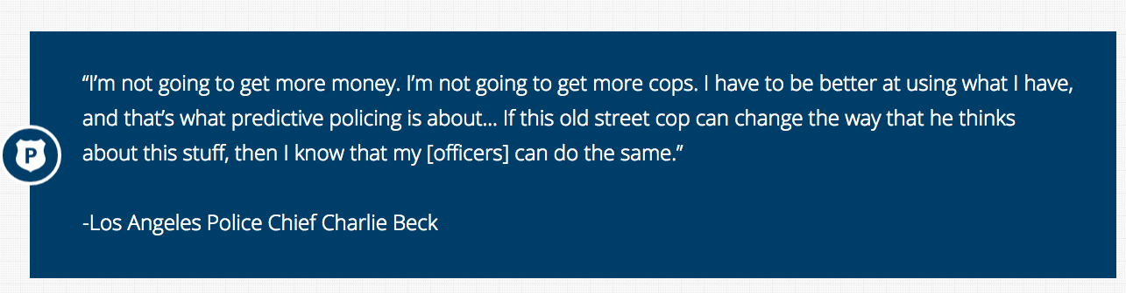
Notes:
Use of big data –combining demographics, school attendance, mobile data, lowering crime up to 30% in Santa Cruz, LA, London.
Follow up conversation –possibility to use historical data to predict where and when crimes take place/

Slide 8
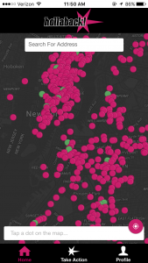
Notes:
Citizen driven innovation.

Slide 9

Notes:
That energy gives a general positive outlook,
but it’s important to do things one step at a time:
Engage citizens
Prioritize
Open
Engage
Improve
Continue
Employ international standards
Adopting the International Open Data Charter is a great resource and would give Tirana Municipality an opportunity to engage with the global open data community and be a pioneer at that in our region; and get access to best practices;
Connect, learn and share with each other (friends are very important)!
UNDP will be suporting open data work throughout the region, including through a recently funded facility, which looks at the practical implementation and use, as well as strengthening the entire eco-system, we will be developing data literacy programmes in Albanian as well as supporting implementation of the charter, regional open data challenges.
The future of the smart city is not centered around technology, but around it’s citizens.

Slide 10

lejla.sadiku@undp.org
@lejlasadiku

