Slide 1



Current Status EU Legislation
SALW Commissions – TIRANA – 22 /23 May 2016
Alain E. Lapon

Slide 2
Civilian possession of weapons
EU Directive 91/477 or Firearms Directive as amended by 2008/51
Main Legislation applicable
EU Regulation 258/2012 implementing Article 10 of the UN Firearms Protocol

Slide 3
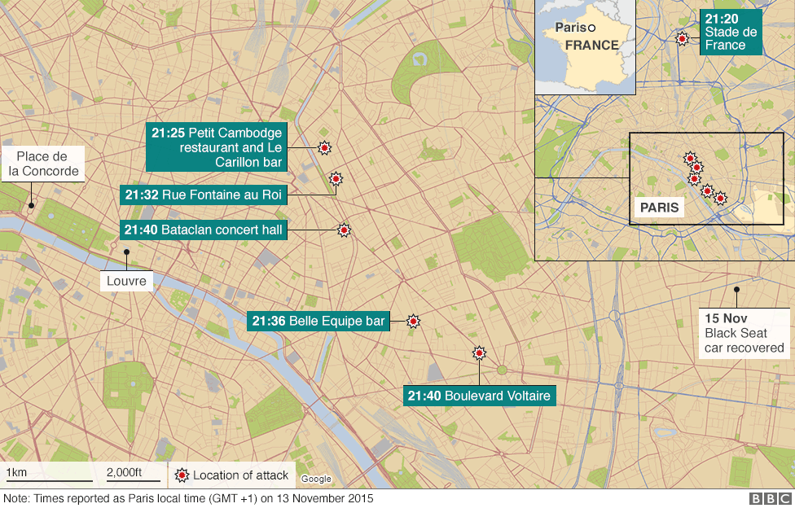
PARIS ATTACKS

Slide 4
18 November 2015
1
The Commission proposal to amend the EU Firearms Directive:
The main elements of the proposed revision are:
Stricter rules to ban certain semi-automatic firearms, which will not, under any circumstance, be allowed to be held by private persons, even if they have been permanently deactivated;
Tighter rules on the online acquisition of firearms, to avoid the acquisition of firearms, key parts or ammunition through the Internet;
EU common rules on marking of firearms to improve the traceability of weapons;
Better exchange of information between Member States, for example on any refusal of authorisation to own a firearm decided by another national authority, and obligation to interconnect national registers of weapons;
Common criteria concerning alarm weapons (e.g. distress flares and starter pistols)in order to prevent their transformation into fully functioning firearms;
Stricter conditions for the circulation of deactivated firearms;
Stricter conditions for collectors to limit the risk of sale to criminals.
Proposal

Slide 5
18 November 2015
2
An Implementing Regulation on common minimum standards for deactivation of firearms
Proposal

Slide 6
18 November 2015
3
An action plan against the illegal trafficking of weapons and explosives
In addition to the adoption of these stricter rules and standards, the Commission also announced today that it is developing an action plan against the illegal trafficking of weapons and explosives. Issues to be tackled in this future action plan will include:
The illegal purchase of weapons on the black market;
The control of illegal weapons and explosives in the internal market (especially from the Balkan countries or ex-war zones);
The fight against organised crime.
Proposal

Slide 7


Slide 8
18 November 2015
1
Send to the Parliament and still in Process
- Last meeting was held on 14 June 2016 where 900 amendments were discussed.
- Proposed to be voted on 14 July 2016
- Rapporteur: Vicky Ford
Commission Proposal to amend strategy

Slide 9
18 November 2015
2
An Implementing Regulation on common minimum standards for deactivation of firearms
  Commission Implementing Regulation (EU) 2015/2403.
Deactivation

Slide 10
18 November 2015
3
An action plan against the illegal trafficking of weapons and explosives
Ongoing and Plan for SEE
Action Plan

Slide 11


